Slide 1
Math Jeopardy!

Slide 2
Do you Know
How to
Count?
Factorials
Of
Life
Perms
&
Combs
Pathways
100
100
100
100
200
200
200
200
300
300
300
300
FINAL ROUND

Slide 3
100

Slide 4
A teacher tells her students that on a multiple-choice test with 12 questions, 2 answers are A, 3 are B, 3 are C, and 4 are D. How many different answer keys are possible?
200

Slide 5
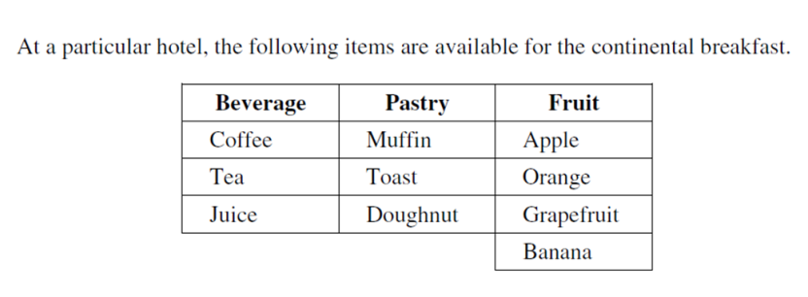
300

Slide 6
Express as a quotient of factorials:
$$\frac{10×9×8×7}{3×2×1}$$
100

Slide 7
Evaluate
$$\frac{\left(n+5\right)!}{\left(n+3\right)!}=12$$
200

Slide 8
Solve for n algebraically
$$\frac{\left(n+1\right)! }{\left(n−2\right)!}\text{=}\text{20(}n−1\text{)}$$
300

Slide 9
100

Slide 10
In a group of 9 people, there are 4 females and 5 males. Determine the number of 4-member committees consisting of at least 1 female that can be formed.
200

Slide 11
In a basketball league there are 6 teams. In league play, each team must play every other team four times. Determine the number of games that must be scheduled.
300

Slide 12
In a particular town, all the streets run N-S or E-W. A student must travel 5 blocks east and 3 blocks north to arrive at school. The number of different routes, 8 blocks in length, that the student can take to get to school is ____________________
100

Slide 13
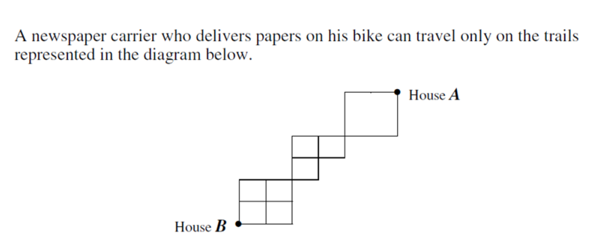
200

Slide 14
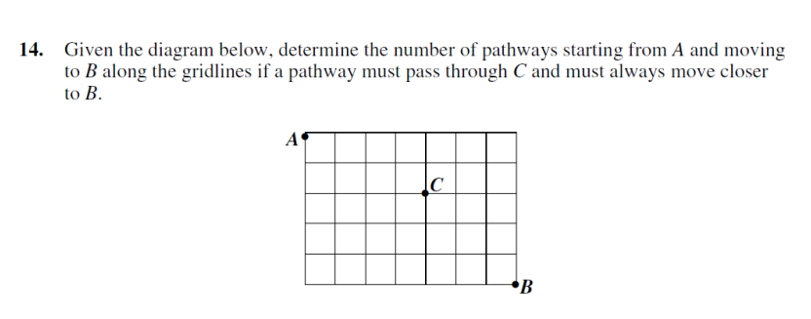
300

Slide 15
FINAL JEOPARDY
MAKE
YOUR
WAGER!

Slide 16
The question....
Poker is a game played using a standard deck of 52 cards and each player is dealt 5 cards.
How many ways can you be dealt 4 aces?
.

Slide 17
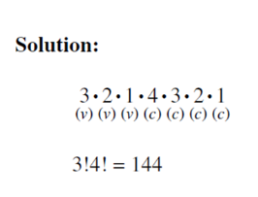
100
the answer:

Slide 18
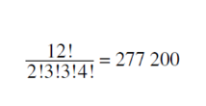
200
the answer:

Slide 19
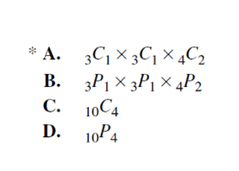
300
the answer:

Slide 20
100
the answer:
$$\frac{10!}{6!3!}$$

Slide 21
200
the answer:
$$\frac{\left(n+5\right)!}{\left(n+3\right)!}=12$$
$$n=−1$$

Slide 22
300
the answer:
$$\frac{\left(n+1\right)\left(n\right)\left(n−1\right)\left(n−2\right)! }{\left(n−2\right)!}\text{=}\text{20(}n−1\text{)}$$
$$n\left(n+1\right)=20$$
$$n^{2}+n −20=0$$
Or solve by inspection
$$\left(n+5\right)\left(n−4\right)=0$$
$$n=4$$

Slide 23
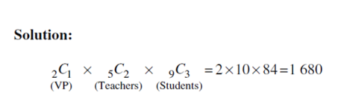
100
the answer:

Slide 24
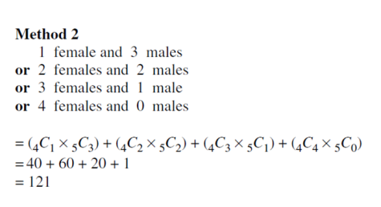
200
the answer:

Slide 25
300
the answer:
,.
4
60 games

Slide 26
100
the answer:
$\frac{8!}{5!3!}$ = 56

Slide 27
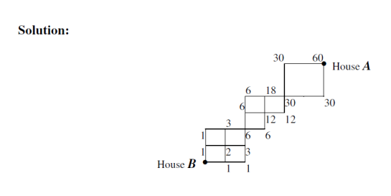
200
the answer:

Slide 28
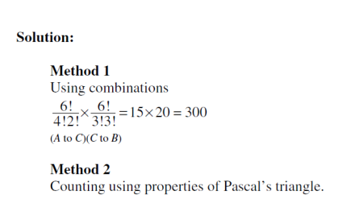
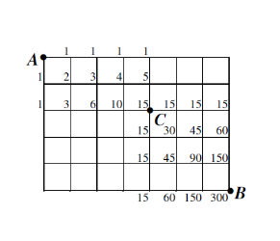
300
the answer:

Slide 29
the final jeopardy answer:
Are
you
ready?

Slide 30
Four aces and 1 other card
(₄C₄ )(₄₈C₁)
= 48 ways

Slide 31
And the winner is....

