Slide 1
Patterning and Algebraic Thinking
Cheryl Schaub
cschaub@crcpd.ab.ca

Slide 2
Key Ideas in Patterns and Algebra
Patterns represent identified regularities based on rules describing the patterns’ elements.
Any pattern can be represented in a variety of ways. Representing aspects of a situation with numbers make it easier to see patterns in the situation.
To describe a number pattern means to provide a precise rule that produces the pattern.
There are strategies that help us become better at recognizing common types of patterns. Data can be arranged to highlight patterns and relationships.
Patterns underlie mathematical concepts and can also be found in the real world. Our numeration system has a lot of specially built-in patterns that make working with numbers easier.
Some numbers have interesting or useful properties. Investigating the patterns in these special numbers can help us to understand them better.

Slide 3
Key idea
1
Patterns represent identified regularities based on rules describing the patterns’ elements

Slide 4
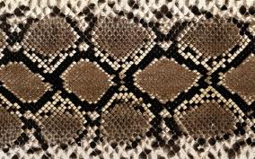
Students can look in books or on the internet for patterns in nature.
Ask: What makes this snake skin design a pattern?
The answer is….
Ask students to make up as many addition sentences that has a specified answer such as 24. After a period of time, ask specific students to share their work. Find those students who have put their sums in order……
1 + 23 = 24
2 + 22 = 24
3 + 21 = 24
Ask what do you notice?
I worked out the problem
237 + 492 = 729
Can you find other pairs that must add to 729 without doing the calculations?
Try this problem
48.34 + 72.63 =
Show students part of a repeating
Core pattern using blocks
Ask students to predict what they will
see as you uncover the rest of the pattern
.
In order to focus on Key Idea 1 ask, “Why
did I need to tell you that it was a pattern for
you to predict the next bead?
1

Slide 5
Provide students with 30 linking cubes all the same colour.
Use the cubes to show enough of a growing pattern so that
another student could figure out the pattern.
Rearrange to make the pattern more obvious
To bring out Key Idea 1, ask:
What will your partner say repeats (or stays the same
in your growing pattern?
1

Slide 6
What do you notice about this pattern?
What do you notice about this pattern?
These are complex multi –attribute pattern
To bring our Key Idea 1 ask,
“What is it that makes the above patterns?
1

Slide 7
Patterns can be repeating or increasing/decreasing
Learning Tasks
5
10
15
1
2
3
a) What would the 20th shape be?
b) What would the 30th shape be?
c) What would the 32nd shape be?
Predicting Patterns
Making the link between repeating and increasing patterns
1

Slide 8
Key idea
2
Any pattern can be represented in a variety of ways. Representing aspects of a situation with numbers make it easier to see patterns in the situation.

Slide 9
I am thinking about an ABCA pattern
Use pattern blocks to show what your pattern might look like.
To bring out Key Idea 2 ask, “How are all of our patterns alike? How are they different?
2

Slide 10
Using linking cubes represent the pattern 1, 4, 9, ….
2

Slide 11
Using linking cubes represent the pattern 1, 4, 9, ….
1 x 1 2 x 2 3 x 3
1 1 + 3 1 + 3 + 5
To bring out Key Idea 2 point out that the same pattern is represented in different ways.
One represents the squared nature of the numbers, while the other emphasizes that it is the sum of increasing odd numbers.
Ask, “Can you find another representation for the same number pattern?
2

Slide 12
You need to help a tricycle manufacturer work out how
many parts are needed for different sized orders.
Begin with wheels. How many wheels will be needed for
an order of one tricycle, two tricycles, three tricycles?
How many wheels will be needed for nine tricycles?
Produce a table showing the number of parts for
different numbers of tricycles…..
‘wheels’, ‘seats’, hand-grips’, ‘tires’
Draw out that the same number pattern may apply to
different parts.
2

Slide 13
Learning Task – Handshake Problem
Six students arrive at a special gathering for students taking part in a Mathematics Fair. As the students are all from different schools, the teacher wants each to get to know the others. The teacher asks each student to shake hands with each of the other students and introduce themselves. How many handshakes took place?
38
Notes:
Complete the Handshake Problem learning task in groups of 10. Ask participants to act out the problem first. Then work on creating a model that explains the mathematical relationships in the problem.

Slide 14
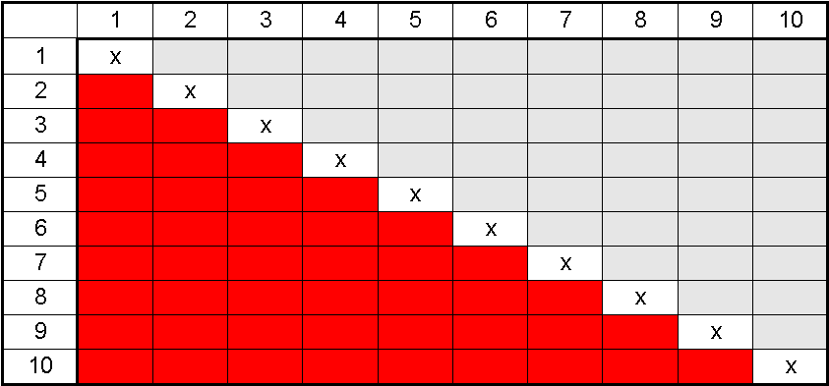
Learning Task – Handshake Problem
Models become tools for thinking
1
2
6
5
3
4
40
Notes:
Organized lists, diagonals in shapes, grids.

Slide 15
How are these problems the same and how are they different from the handshake task?
How many steps are there?
How many angles do you see?
5+4+3+2+1 = 15
2
Ideas from Marion Small (PRIME – Nelson)
Notes:
Answer- 15; but what more can we get out of it- how can we dig deeper?

Slide 16
The Twelve Days of Christmas
How many gifts, in all, were given?
See if you can find a system and pattern to help.
Record your work and be able to explain how your arrived at your answer.
Extension : How much would these gifts cost?
Would they all fit in your bedroom?
2

Slide 17
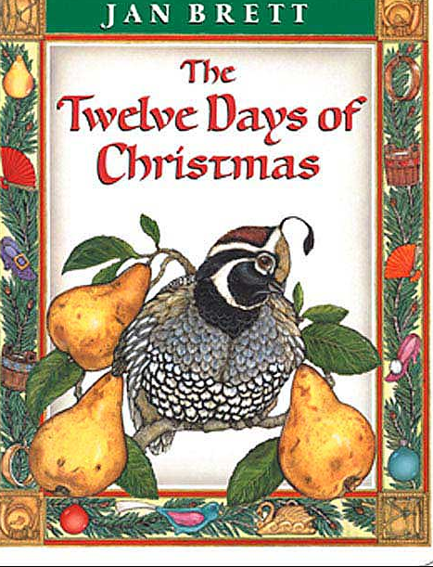
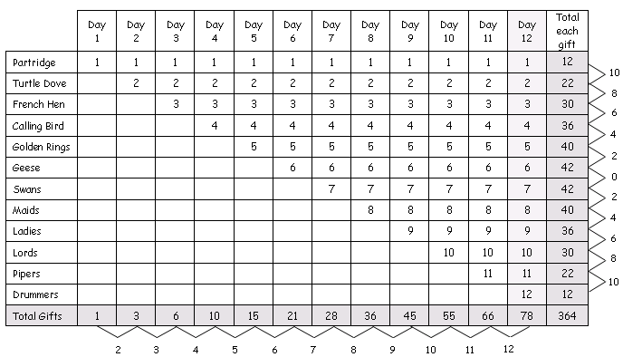
Twelve Days of Christmas
Analyzing Recursive Patterns
2
Note: From Analyzing Students’ Thinking on Mathematical Tasks: Professional Development for Elementary Teachers (p. 34), by K. Willson, L. Gibeau and R. Mckay, 2006, Edmonton, AB: Ioncmaste, University of Alberta. Copyright 2006 by the authors. Reprinted with permission.
28
Notes:
Looking across the bottom row, the total number of gifts given on any day can be found by starting at 1 and adding 2, 3, 4, 5…consecutively for each increasing day. This is a recursive relationship—finding the next number depends on knowing the previous one. Participants can also find the total number of gifts given on any day by adding all numbers in descending order up to that day; e.g., on the 6th day, add 6 + 5 + 4 + 3 + 2+ 1. (Although none of the students in the sample classes were asked to do so, the total number of gifts on any given day can also be found by (x² + x)/2 where x is the day number; however, this goes beyond Grade 3 expectations.) The total number of each type of present is an interesting pattern. The difference between each type of gift first follows a decreasing pattern (10, 8, 6, 4, 2, 0) and then an increasing one (2, 4, 6, 8, 10). The six geese a-laying and seven swans a-swimming were both given as presents the most—a total of 42 times (7 x 6 and 6 x 7).

Slide 18
Triangular numbers
1+ 2 1 + 2 + 3 1 + 2 + 3 + 4
1 + 3 + 6 + 10
2

Slide 19
Key idea
3
To describe a number pattern means to provide a precise rule that produces the pattern

Slide 20
Find a rule to describe the toothpick pattern….
Shape 1
Shape 2
Shape 3
Shape 4
3 5 7 9
Write a rule to say how the toothpicks change with each new shape.
Exchange rules with a partner and use the rule to find the number of toothpicks in the next few shapes.
Ask, “Did the rule work? Would your partner be able to predict the number of toothpicks for any shape position? Why or why not?
3

Slide 21
Can both of these students be right?
Shape 1
Shape 2
Shape 3
Shape 4
3 5 7 9
It’s three, add the number of shape less one, times two
Times the number of the shape by two, then add one
3 + (s-1) x 2
3+ 2(s-1)
3 + 2s – 2
2s + 1
2s + 1
3

Slide 22
Build five stages of the following pattern using two different coloured tiles or blocks What do you see as growing and what do you see as staying the same?
Decide on a pattern rule for
stage 10 of this growing pattern.
3

Slide 23
1
2
3
4
5
Sample A
Stage | What I see | Total
1 | 2 + 1 | 3
2 | 2 + 2 | 4
3 | 2 + 3 | 5
4 | 2 + 4 | 6
5 | 2 + 5 | 7
I see the bottom two red staying the same
For stage 10, I see
2 + stage number
2 + 10 = 12
3

Slide 24
1
2
3
4
5
Sample B
Stage | What I see | Total
1 | 1 + 2 | 3
2 | 1 + 3 | 4
3 | 1 + 4 | 5
4 | 1 + 5 | 6
5 | 1 + 6 | 7
I see the bottom one red staying the same.
For stage 10, I see one red tile plus a tower of one more than the stage number.
3

Slide 25
1
2
3
4
5
Sample C
Stage | What I see | Total
1 | (2 x 2) -1 | 3
2 | (2 x 3) - 2 | 4
3 | (2 x 4) - 3 | 5
4 | (2 x 5) - 4 | 6
5 | (2 x 6) - 5 | 7
2 is the base. I made a rectangle that was one more than the stage number. Then subtract the stage number.
For stage 10,
2 x (10+1) - 10
3

Slide 26
Consolidating ideas.
Sample A
For stage 10, I see
2 + stage number
2 + 10 = 12
Sample B
For stage 10, I see one red tile plus a tower of one more than the stage number.
Sample C
For stage 10,
2 x (10+1) - 10
T = 1 + (s+ 1)
T = 1 + s + 1
T = 2 + s
T = 2 (s+1) – s
T = 2s + 2 – s
T = 2 + s
T = 2 + s
What is the same and what is different about the formulas?
What if the total number of tiles was “64” what is the stage number?
3

Slide 27
Key idea
4
There are strategies that help us become better at recognizing common types of patterns. Data can be arranged to highlight patterns and relationships.

Slide 28
Have students use the constant function on a calculator to generate patterns such as:
‘add 2’ (3 + 2 = = = =)
‘subtract 3 (24-3====)
Let them choose their own starting number and generate a sequence using the calculator.
Try starting with 24 and using x 0.5
Invite students to investigate ‘halving’ sequences by giving them a strip of paper between 30 - 40 cm long. Have them fold it in half and measure it. Repeat . Have students compare their sequences.
What is happening to the numbers of each?
How could you generate this sequence with a calculator?
How is this different from a subtraction sequence?
You may graph all these results
4

Slide 29
Recursive rule increase by ‘1’
Worm
Birthday 1
Birthday 2
Birthday 3
Birthday
Number of body parts
1
2
3
4
3
4
5
6
4

Slide 30
Explicit rule T = 1s + 2 What is staying the same?
Birthday 1
Birthday 2
Birthday 3
Birthday
Number of body parts
0
1
2
3
4
2
3
4
5
6
4
You may graph this on your graph paper

Slide 31
Growing Trees
Birthday
# blocks
What is the recursive rule?
(how much each shape is
increasing by)
What is the explicit rule?
(the formula).
Birthday 1
1
2
3
3
5
7
0 1
Increase by ‘2’
Birthday 2
T = 2r + 1’
Birthday 3
4
You may graph this on your graph paper

Slide 32
Your turn – Growing Creatures
What is the recursive rule?
(how much each shape is
increasing by)
What is the explicit rule?
(the formula).
Stage # # of blocks
0
1
2
3
2
5
8
11
Increase by ‘3’
T = 3r +2
4
You may graph this on your graph paper

Slide 33
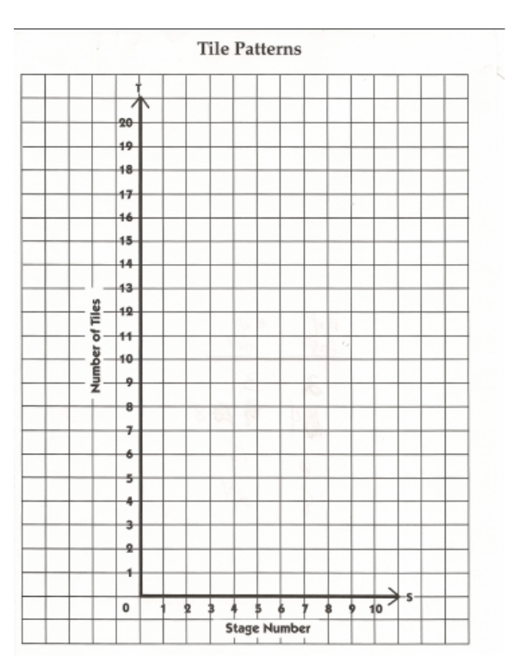
Growing Creatures
Trees
Worm

Slide 34
Key idea
5
Patterns underlie mathematical concepts and can also be found in the real world. Our numeration system has a lot of specially built-in patterns that make working with numbers easier.

Slide 35
Create a number where you would say each of these words as you read the number:
Forty, five, million, thousand, two, hundred, six
Write it symbolically.
possible solutions:
45 600 002 or 46 502 000 or 5 206 042
How did you know your number would have at least 7 digits?
How did you know the digit 4 would be the middle
digit in a period?
5

Slide 36
In groups of 4, create a place-mat. In the centre, write the word “one million.”
For two minutes, write about one million in your section of the place-mat.
Which of the things you wrote show that you understand the place value system?
Which of them show that you have compared one million to other benchmark numbers? Which did both?
How is this useful as an assessment for learning tool?
Why is it better to write “one million” than 1 000 000?
One million
5

Slide 37
Follow-up questions
Ask students to think about:
• How many loonies make $1 000 000? How many $100 bills?
• How long would a line of 1 000 000 pennies be?
• How long would it take to roll 1 million pennies?
• Then ask: What place value ideas did you use to help you answer these questions?
5

Slide 38
When a book of unexplainable occurrences brings Petra Andalee and Calder Pillay together, strange things start to happen: seemingly unrelated events connect, an eccentric old woman seeks their company, and an invaluable Vermeer painting disappears. Before they know it, the two find themselves at the center of an international art scandal, where no one — neighbors, parents, teachers — is spared from suspicion. As Petra and Calder are drawn clue by clue into a mysterious labyrinth, they must draw on their powers of intuition, their problem-solving skills, and their knowledge of Vermeer. Can they decipher a crime that has left even the FBI baffled?
Chasing Vermeer
By Blue Balliet
5

Slide 39
Pentominoes
Work with a partner to discover all the ways you can link 5 cubes at a time.
Record your work on grid paper.
When you think you have found all the arrangements, figure out the area and perimeter of each shape.
http://www.scholastic.com/blueballiett/games/pentominoes_game.htm
5

Slide 40
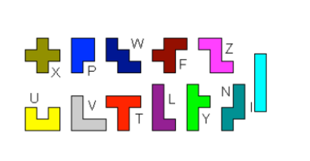
Shape | Area | Perimeter
X | 5 | 12
P | 5 | 10
W | 5 | 12
F | 5 | 12
Z | 5 | 12
U | 5 | 12
V | 5 | 12
T | 5 | 12
L | 5 | 12
Y | 5 | 12
N | 5 | 12
I | 5 | 12
5

Slide 41
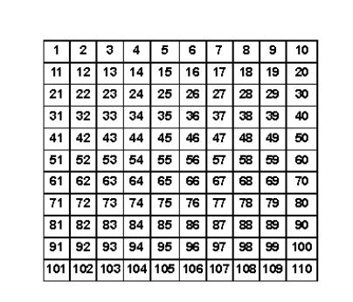
Hide the numbers
Provide various pentominoes – each made of five squares as those of a 100 chart. Have students work in pairs and use a pentominoe to cover parts of the 100 grid. Say what numbers are hidden.
Ask: How did you decide which numbers were hidden? What patterns did you use? How did the way our numbers are written help?
5

Slide 42
Key idea
6
Some numbers have interesting or useful properties. Investigating the patterns in these special numbers can help us to understand them better.

Slide 43
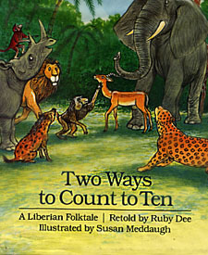
Ways to Count to Ten A Liberian Folktale by Ruby Dee
Leopard, who is king of all the other animals, holds a contest to find a successor. The challenge: throw a spear into the air and count to ten before it hits the ground. No matter how strong the animal is he can't throw the spear high enough or count quickly enough.
6

Slide 44
Have the children predict who they think will be the king of the jungle.
Read the story and as a group, discuss the ways the animals counted to ten. Record on the board and share how this is recorded.
For example 10 = 1, 2, 5, 10
These are factors of 10.
How might we write it another way?
Working cooperatively, in groups of 2, have the children discover all the ways to get to 1, 2, 3, …..30.
Encourage them to record so that the information is meaningful to them.
** This activity may uncover the following mathematical ideas, depending on what patterns the children discover.**
prime numbers, composite numbers, square and triangular number sequences, factors, rules of divisibility and more…
6

Slide 45
Number | Factors | Ways
1
2
3
4
5
6
7
8
9
10 | 1,2,5,10 | 4
11

Slide 46
Number | Factors | Ways
1 | 1 | 1
2 | 1,2 | 2
3 | 1,3 | 2
4 | 1,2,4 | 3
5 | 1,5 | 2
6 | 1,2,3,6 | 4
7 | 1,7 | 2
8 | 1,2,4,8 | 4
9 | 1,3,9 | 3
10 | 1,2,5,10 | 4
11 | 1,11 | 2

Slide 47
Observations:
Perfect squares have three factors. Is this always so? What do you notice about the next perfect squares? Can you generalize a statement about perfect square numbers?
What do you notice about those numbers that only have two factors?
If I gave you square tiles and grid-paper what kinds of rectangles could you make with those numbers? What do you notice?
6

Slide 48
Questions
Cheryl Schaub
cschaub@crcpd.ab.ca

Slide 49
Resources
Alberta Education – Patterns and Algebra K-3 and 4-6 workshops
Small, M. Big Ideas from Dr. Small: Creating a Comfort Zone for Teaching Mathematics Grade K-3 Book, Nelson Education
Small, M. Big Ideas from Dr. Small: Creating a Comfort Zone for Teaching Mathematics Grade 4-8 Book, Nelson Education
Wickett, M. & Kharas, K & Burns, M. Lessons for Algebraic Thinking Grades 3 -5, Math Solutions Publications, Sausalito, CA

