Slide 1
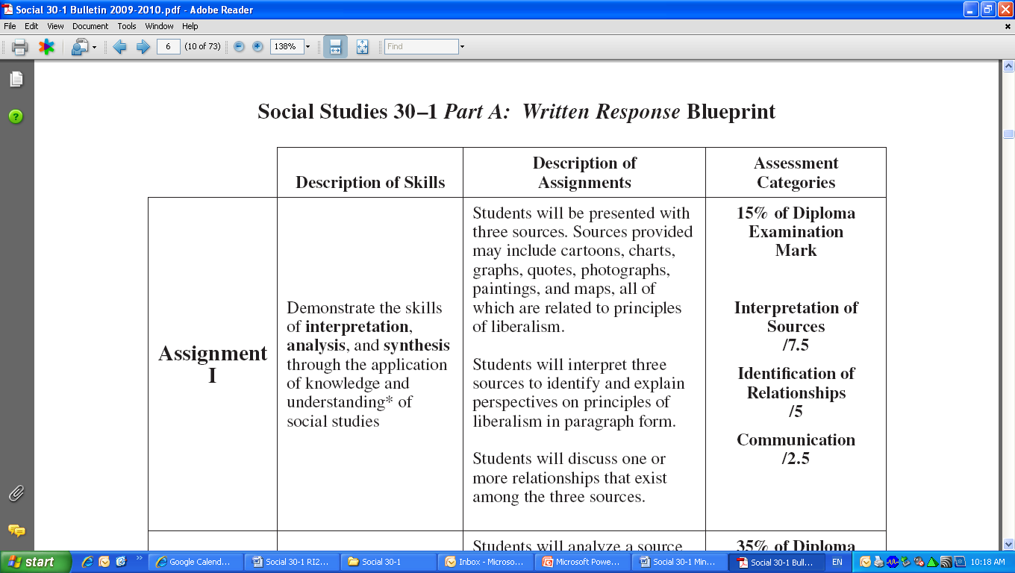
S CIAL STUDIES
Perspective Essay Writing

Slide 2
S CIAL STUDIES
Perspective Essay Writing
Examine each source. Write a response in which you:
interpret each source, explain the ideological perspective(s) presented in each source, and discuss the links between the principles of liberalism and each source
Identify and explain one or more of the relationships that exist among the sources.
Suggestions for Writing:
Organize your response to effectively address the tasks in the assignment.
Proofread and edit your response.

Slide 3
S CIAL STUDIES
Perspective Essay Writing
The principles of liberalism:
The principles of collectivism:

Slide 4
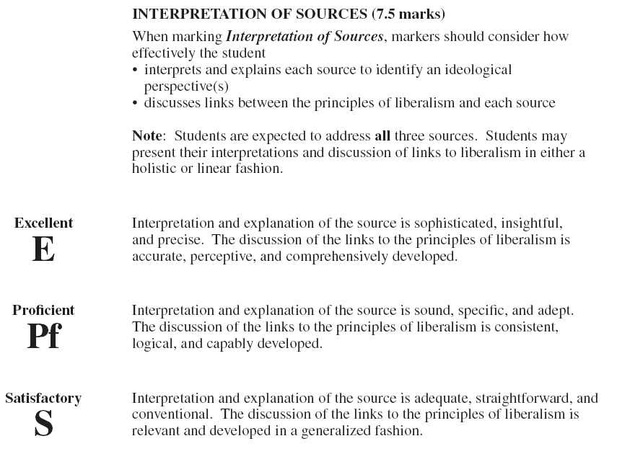
S CIAL STUDIES
Perspective Essay Writing

Slide 5
S CIAL STUDIES
Perspective Essay Writing

Slide 6
S CIAL STUDIES
Perspective Essay Writing

Slide 7
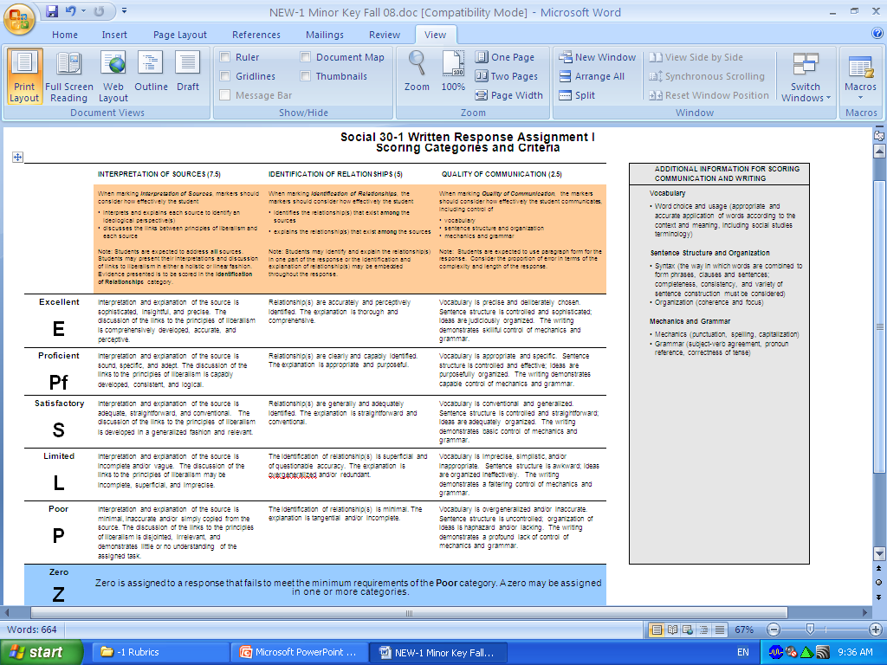

Slide 8
Sources
Analyzing
When analyzing ANY source, one should:
Identify & Explain the context of the source
CONTEXT: the set of circumstances or facts that surround a particular event, situation, etc.
Background info!
Identify & Explain the perspective of the source (purpose/message)
Source’s Creator: Artist, speaker, singer, photographer
Use evidence from the source that supports this perspective
If possible, try to identify who may share this perspective!

Slide 9
When analyzing IDEOLOGICAL PERSPECTIVE, consider:
WHO’S PERSPECTIVE?
Attitude towards the topic?
Sympathizer/Supporter/Critic OR No opinion (neutral)
Individualist or collectivist
Capitalist, socialist, communist, fascist etc.
Context?
Time?
Location?
Position? (Gov’t official etc, slave etc)
Bias?
May be one of the above, or any combination of all of them!

Slide 10
Format?
There is no real official format for this type of essay yet. Below are some suggestions:
Intro?
Introduce the topic given in the question
In this case, historical globalization
Perspective 1
Perspective 2
Perspective 3
Unifying Relationship

Slide 11
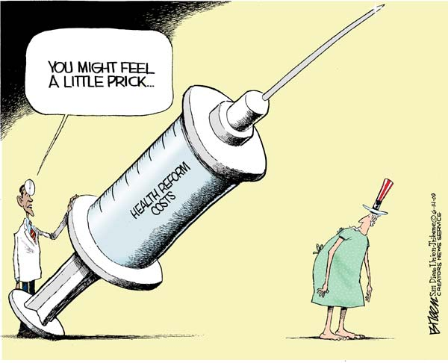
Source I
Artist uses sarcasm to show that he feels Obama’s view of this cost is either unrealistic or biased…
HUGE needle represents size of the cost of health reforms.
Uncle Sam is a symbol of America. In this case it is suggesting the cost of these reforms will be felt by all Americans.

Slide 12
Source II
"John Edwards says 'I'm just going to take all these people and I'm going to cover them in Medicaid.' Well, OK, fine, that's socialized medicine. If you want a system like England has, if you want a system like Canada has, if you want a system like Cuba has, that's where we're headed."
- Former New York mayor and Republican Party Leadership candidate Rudy Giuliani July 31, 2007, at a media event in Rochester, New Hampshire
Topic is healthcare reform
Speaker is discussing healthcare reform…specifically universal healthcare
Speaker is Republican, an ideology that traditionally supports a privatized system of healthcare.
His Republican perspective does not support “socialized” medicine, as is demonstrated in his distaste for other nations socialized healthcare.

Slide 13
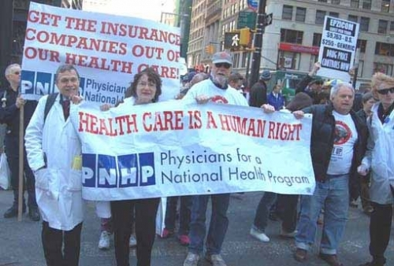
Source III
TEXT IS VERY SIGNIFICANT!!
Reveals specific perspective.
Reveals message – Healthcare is a human right…there is no place for privatized medicine.
Healthcare
Supporters of universal health program, as revealed in the phrase “National Health Program”.
Critical of privatized health insurance companies, as evident in “Get the insurance companies out of our healthcare.
Represent a group of doctors, but not ALL doctors…demonstrates even SOME in the profession support healthcare reform
This is significant because they are in the field, and see the everyday problems with the current system…their voice is credible.

Slide 14
Analyzing Relationship
Relationship: a connection, association or involvement.
When analyzing a source for a common relationship, consider:
Do all the sources SHARE a perspective? Or common theme?
Do all the sources reveal the conflicting forces shaping the issue
Do all the sources reveal possible solutions to an issue
Be sure to:
Identify the relationship that exists among all the sources.
Explain the relationship that exists among all the sources.
Straight from the rubric!!

