Slide 1
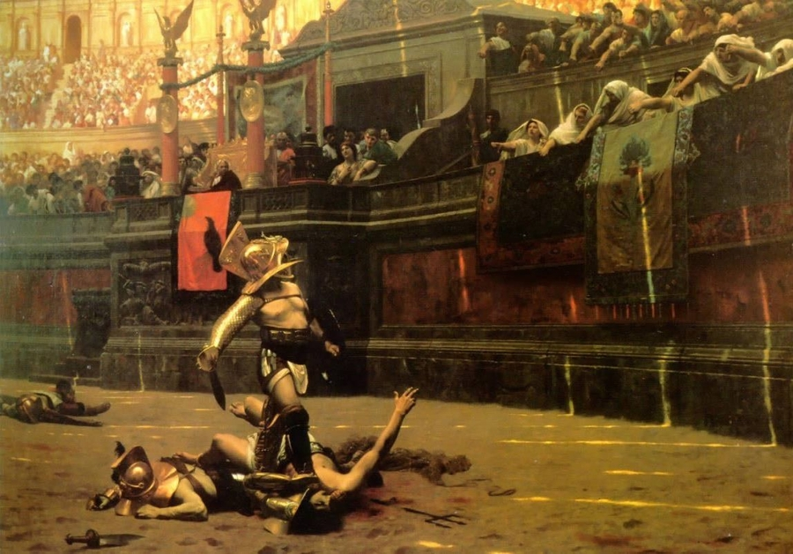
Léon Gérôme, Pollice Verso (1873)

Slide 2
These men once were horn-blowers and attendants
At every municipal arena, known as trumpeters in every village. Now they present their own spectacles, and, to win applause, Kill whomever the mob gives the “thumbs up”.
—Decimus Junius Juvenalis; a.k.a. Juvenal (c. 55-140 A.D.), “Third Satire”

Slide 3
Juvenal refers to the Roman custom of spectators’ voting on the fate of wounded gladiators with their thumbs. You may think a gladiator would appreciate the crowd’s “thumbs up” (verso pollice), but exactly the opposite is true. Where we give thumbs up as a sign of approval, it meant death to its Roman recipient; much to the crowd’s delight.
Thumbs down, signified “swords down,” which meant the loser was worth more to them alive than dead, and he was spared apparently so he could make up for his disgrace the next time he appeared in the arena. Keep this in mind the next time you give someone the “thumbs up” sign.
Our reverse interpretation of this custom apparently was the result of the work of the French artist Léon Gérôme who apparently understood the Latin verso (“turned”) to mean “turned down”, and therefore in his painting Pollice Verso (1873) he presents the death sentence with the thumbs-down gesture. The painting became so popular that Gérôme’s mistake became the accepted interpretation and it is unlikely that it will ever be changed back to the meaning that it had with the Romans.
Scholars before Gérôme gave support to the view that “thumbs down” among the Romans, meant the hapless gladiator was to be spared, not slain. The gesture meant “Throw your sword down”. A 1601 translation of Pliny equates the gesture with “assent” or “favor”, and John Dryden’s 1693 version of Juvenal’s Satires gives the thumb being bent back, not down, as the death signal. http://www.wordquest.info/thumbs-up.html

