Slide 1
Luddites

Slide 2
Chartists
Chartism was a working-class movement in Britain that focused on
political and social reform. Flourishing from 1838 to 1848, Chartism got its name from the People’s Charter of 1838, which outlined the six essential goals of the movement:
• universal suffrage for all men over 21
• equal-sized electoral districts
• voting by secret ballot
• an end to the need for property qualifications for Parliament
• pay for Members of Parliament
• annual elections
The significance of the Chartists lies in their demonstration of the discontent that gripped Britain at the time. The government saw them as an unruly mob reminiscent of the French Revolution, but most of their demands were eventually implemented in the Reform Acts of 1867 and 1884.

Slide 3
Idealistic rather than pragmatic, Utopian
socialists did not intend to overturn the basic political, economic, and social systems. Individuals such as Robert Owen in Great Britain, Charles Fourier and Claude Saint-Simon in France, and Horace Greeley in the United States believed that education and improved working conditions could peacefully eradicate the worst aspects of capitalism and lead to an ideal socialist society where everyone would live happily.
Robert Owen (1771–1858) believed that the harshness of life under laissez-faire capitalism corrupted human nature. Owen exemplified the classical liberal belief that individuals could realize their potential if they were free to pursue their own inclinations. New Lanark became a model community to demonstrate his utopian principles.

Slide 4
The term Marxism was never used by Karl Marx (1818–1883). A
group of French socialists, among them Jules Guesde and Benoît
Malon, coined the term in the 1880s. Karl Marx himself, on hearing
about some of the things these so-called followers were doing,
proclaimed that he was not a Marxist. Marx spent three years in France
and wrote about the ideas of Jean-Jacques Rousseau and other early
socialists, but rejected these ideas for not being scientific enough.
Marxism is a radical form of socialism, often called scientific
socialism or communism to distinguish it from other socialist
ideologies. Marx developed a theory that history is the story of evolving
class warfare. According to Marx, the only way to overthrow capitalism
was by means of a class struggle between the proletariat (workers) and
the bourgeoisie (owners). He argued that this workers’ revolution was
necessary before any significant changes could be made in society.
Marx collaborated with Friedrich Engels to write The Communist
Manifesto in 1848

Slide 6
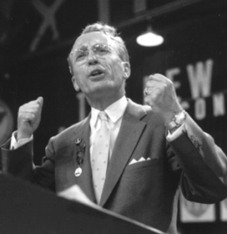
In Canada, the Co-operative Commonwealth and democratic socialist party founded in Canada in 1933, in the depths of the Great Depression, at a time when laissez-faire capitalism seemed to be failing. In reaction to classical liberalism, the CCF stated its ideology in the Regina Manifesto. This manifesto was adopted at the CCF’s first national convention, which was held in Regina, Saskatchewan, in July 1933. The CCF merged with labour groups to form the New Democratic Party in 1961.
Tommy Douglas got a first-hand look at the devastating impact of the Great Depression. His vision of socialism seemed to coalesce in the years that followed, and in 1935 he made a leap of faith by moving from the ministry to politics. He served nine years as the federal MP for Weyburn before leading the provincial Co-operative Commonwealth Federation (CCF) to victory in the 1944 election.

Slide 7
Edmund Burke reacted to the political issues of the day. Horrified by the extremes of the French Revolution, Burke used these as an example of the flaws of following the values of equality, individualism, and freedom. Burke believed that established institutions, run by the educated people of society, were necessary to control the irrational passions of the uneducated masses. According to Burke, the only reason to make changes to these institutions was to preserve them from the radical or revolutionary change demanded by the masses. Burke’s was one voice among many. Burke and other classical
conservatives shared a set of beliefs:
• Society is an organic whole that should be structured in a hierarchical fashion with those best suited to leadership at the top, because people do not have equal abilities.
• Government should be chosen by a limited electorate with special rights, responsibilities, and privileges.
• The stability of society is the paramount concern, to be achieved through law and order and the maintenance of the customs and traditions that bind society together.

Slide 8
In America, the term welfare capitalism referred to these kinds of initiatives by industrialists. In the rest of the industrialized world, however, welfare capitalism referred to a classical liberal economic system combined with a government that used legislation to give workers protections such as limited working hours and a minimum wage, and a safety net with features like pensions and medical insurance. The legislative journey to workers’ rights was a long one. Britain, for example, passed a series of Factory Acts, beginning in 1810. Each act gradually improved the working conditions in factories, decreased working hours, regulated the age at which children could be employed, and regulated the number of hours women and children could be required to work.

Slide 9
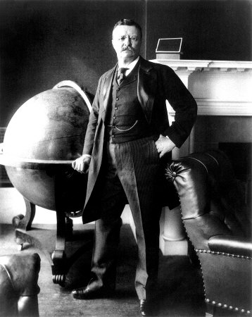
Theodore Roosevelt went on to found a new political party in 1912—the National Progressive Party—whose platform contained a new kind of liberalism, sometimes referred to as progressivism. Theodore Roosevelt founded the new party because the Democrats and Republicans were so resistant to change.
• The Progressive party, believing that no people can justly claim to be a
true democracy which denies political rights on account of sex, pledges
itself to the task of securing equal suffrage to men and women alike.
• The supreme duty of the Nation is the conservation of human resources through an enlightened measure of social and industrial justice.

Slide 10
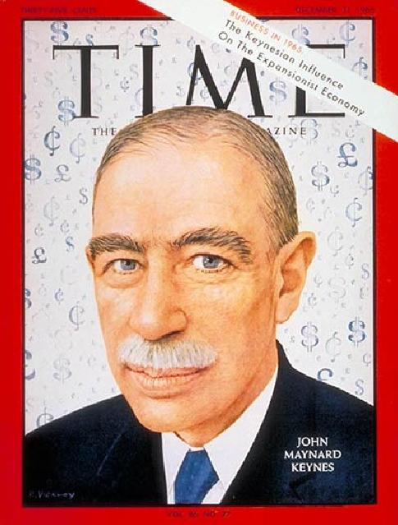
Depression became a catalyst for change, and what began to emerge was modern liberalism as we know it today. As the 1930s progressed, the recession deepened and no one seemed to be able to do anything about it. John Maynard Keynes (1883–1946), a British economist, studied the Depression and developed a new economic theory. He believed that classical liberal economic theory, the basis for the market economy, was based on a fundamental error. Classical liberals believed that there would be full employment if supply and demand were in balance. Keynes used the Great Depression as proof that this was not true.

Slide 11
Keynes believed the application of monetary and fiscal policy would lessen the effects of both inflation and recession and would still leave the free-market system largely intact. (“Monetary policy” refers to actions taken by the central bank of a country to control the supply of money. The most common tools used in monetary policy are raising or lowering interest rates, and printing or destroying money. “Fiscal policy” refers to the direct taxing and spending functions of governments. Governments can raise or lower taxes, and raise or lower their spending on projects and programs. Governments are usually the biggest single spender in a modern economy, these decisions have a direct effect on the economy of the country.)

Slide 12
Franklin D. Roosevelt, president of the United States from 1933 to 1945 (and distant cousin of Theodore Roosevelt), was the first convert to Keynes’s theories. He implemented massive public works programs to put people to work. Called the “New Deal”, an echo of Theodore
Roosevelt’s “square deal,” it consisted of a series of programs from 1933 to 1938. As well as providing employment through massive projects such as the Tennessee Valley Authority, which built dams to generate electricity.
New Deal programs provided emergency relief, reformed the banking system, and tried to invigorate agriculture and the economy. Other programs attempted to redistribute power and resources. The New Deal left a legacy of government involvement in the economy that is still debated today.

Slide 13
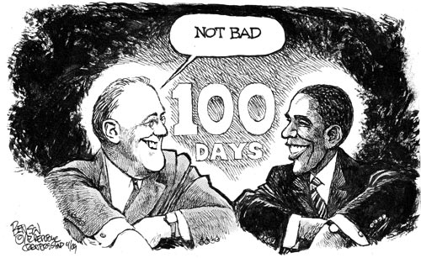

Slide 14
Initially, the values and beliefs of classical liberalism had brought greater liberty to entrepreneurs—factory owners, mine owners, investors, and other leaders of industry. This freedom for the producers of wealth also resulted in improved products and in better conditions for most members of society as evidenced by the passing of labour laws to establish labour standards. The legislative reforms that benefited the working class were welcomed by workers. However, these reforms were the result of collaboration between government and capitalists, without the participation of workers themselves. Workers wanted more than this. They wanted an equal voice that spoke directly for their interests and reflected their own perspective.

Slide 15
Labour Unions
During the 19th century, labourers who wanted to improve their standard of living began to attempt to form unions. What this involved was a recognition of a new right—the right to organize and bargain collectively. If all the workers in one particular trade were united, they could bargain collectively for better hours and wages and threaten to go on strike if their demands were not met.
The International Labour Organization was formed in 1919, as part of the League of Nations. In 1948, the United Nations incorporated two articles on labour in the Universal Declaration of Human Rights.

Slide 16
Classical liberalism proclaimed the equality of men, meaning the male gender, but in reality only certain men were equal. This becomes obvious when one examines the right to vote. In the 18th century, in countries where voting took place at all, the right to vote was reserved for propertied men with some wealth. From 1867 to 1919, the classical liberal idea that voting was a privilege for the few gradually gave way to the modern liberal concept that the franchise was a right, and the various qualifications were eliminated, at first for men only.

Slide 17
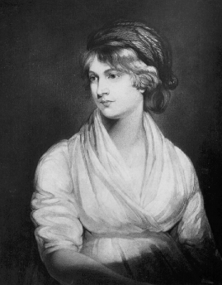
Feminism, at its simplest, is the belief that men and women are to be treated equally in all respects. Modern feminism had its roots in the Enlightenment thinkers who demanded “the rights of man.” Initially, of course, most people took this literally; that is, they considered man to mean men. But classical liberalism did provide a way of thinking about civil liberties that allowed feminism to emerge. Paradoxically, very few of the classical liberal thinkers were willing to concede any rights to women. Some women fought against the classical liberal view of women. Mary Wollstonecraft, an early novelist, was a feminist. In A Vindication of the Rights of Women (1792) she argued that not only would education make women better wives and mothers, it would also make them the equals of men.

