Slide 1
“To what extent is resistance to liberalism justified?”
Related Issue 2

Slide 2
Looking ahead
“To what extent is resistance to liberalism justified?”
Chapter 3: Uncovering 19th Century Liberalism
Chapter 4: Responding to Classical Liberalism
Chapter 5: Twentieth-Century Reactions to Liberalism
Chapter 6: The Evolution of Modern Liberalism
Chapter 7: Challenges to Liberalism Related to Foreign Policy
Chapter 8: Contemporary Challenges to Liberalism

Slide 3
19th Century Liberalism
What is Classical Liberalism?
Embraces the principles of individualism
Rule of law
Individual rights and freedoms
Private property
Economic freedom
Self-interest
Competition

Slide 5
Liberalism evolves
In the European context liberalism emerged from the confluence of major historic events including the Enlightenment (Age of Reason), the Industrial Revolution, the American Revolution and the French Revolution. Prior to liberal ideas taking hold, politically and economically, the vast majority of power and wealth resided in the hands of powerful elites, the pinnacle of which was the Absolute Monarch.

Slide 6
Liberalism evolves
What do you remember about these historical events: Enlightenment (Age of Reason), the Industrial Revolution, the American Revolution and the French Revolution?
Briefly review what you remember with a partner.

Slide 7
Liberalism evolves
Therefore, classical liberalism (emerging from the events listed above) represented an individualist ideology and allowed tradition economic and political power structures to be dismantled. However, the new political and economic elites did not do a good job of sharing the new wealth being generated and liberalism slid to the left adopting more collectivist ideals in trying to bring more equity to society.
Modern liberalism is now associated with government involvement in the economy to ensure a certain level of economic equality.

Slide 8
Liberalism evolves
The term liberalism can be confusing because it has come to represent different sets of ideas at different times in history – it is all about historical context. The birth of liberal ideas emerged from the event described above and represented the growing power of the individual – politically and economically.
As time rolls on the new economic freedoms afforded to the rising middle class were being used to benefit the few and exploit the many which resulted in the state (government) slowly starting to get involved in the economy and political life to ensure a certain level of equality within society.

Slide 9
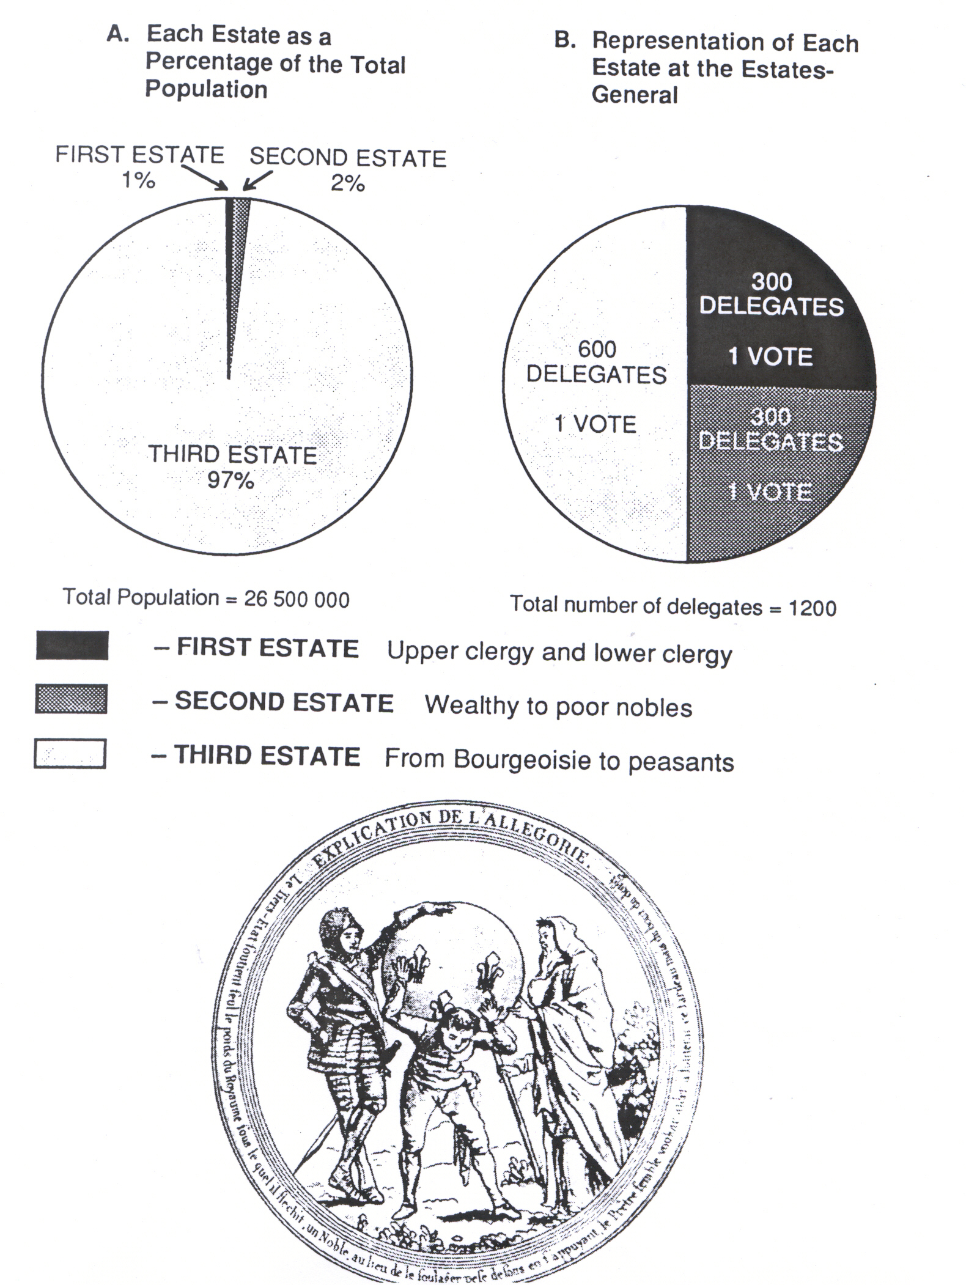

Slide 10
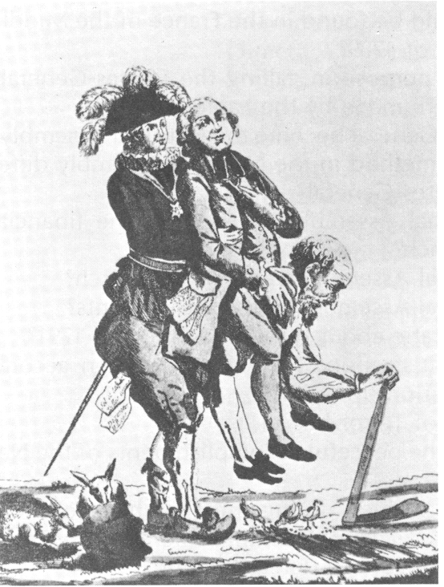
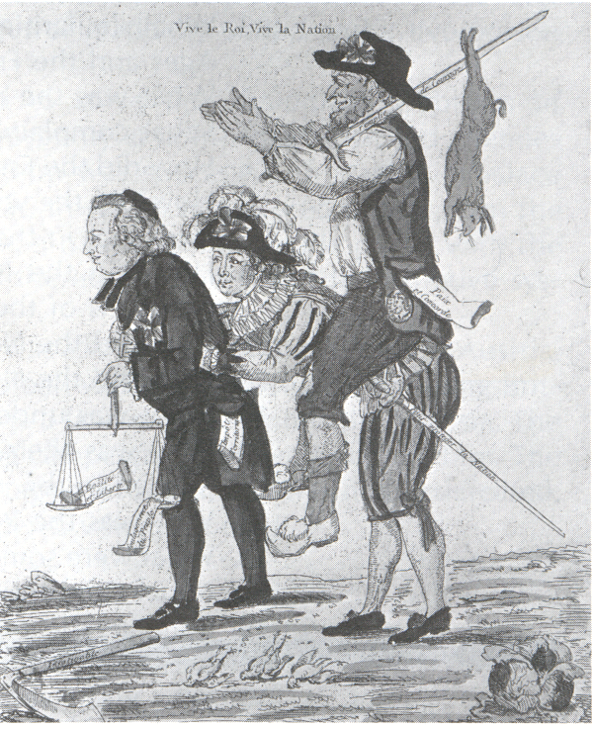
The Old Regime
The "New" Republic
What do these cartoons say about the changes brought about by the French Revolution?

Slide 11
Looking at History
1400 ( 14th-16th Centuries)
Awareness of individualism
Growth of secularism
humanism
18th Century - Enlightenment
The Age of Reason (acceptance of the power of human reason)
Worth of the individual
Natural rights
Democratic values
Authority rests with the people
1500
Protestant Reformation
1776
American Revolution
1789
French Revolution

Slide 12
Looking at History
18th and 19th Centuries- Industrial Revolution
Power of the market
Individual reward for individual initiative (reaction to mercantilism)
Freedom to pursue personal wealth
Individual responsibility
Progress, inventiveness, innovation, efficiency
1900
Liberalism: a movement born out of the Enlightenment (political parent) and the Industrial Revolution (economic parent)

Slide 13
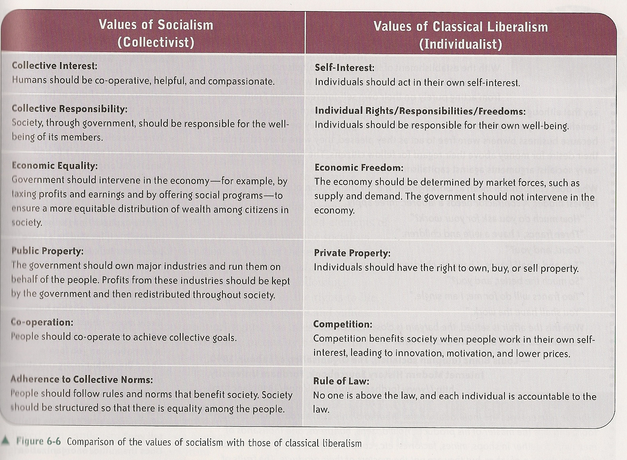

Slide 14
