Slide 1
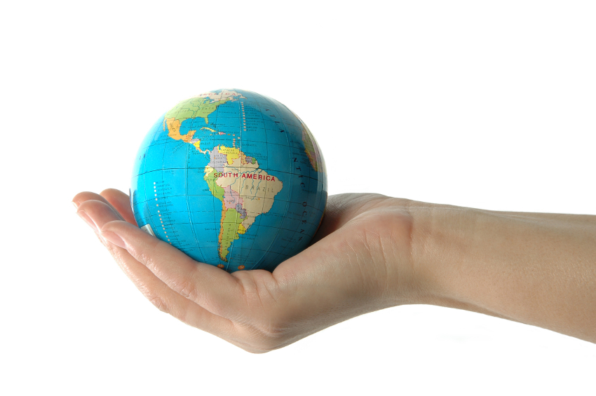
The principles of
LIBERALISM
AND THE
eNVIRONMENT
Are they
compatible?

Slide 2
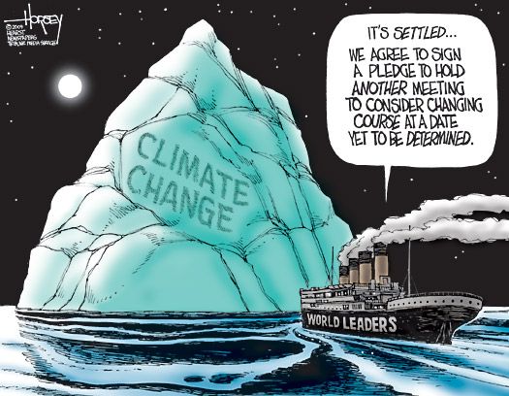

Slide 4
The country “is the dirty old man of the climate world,” according to a recent Guardian article. Another prominent article published ahead of the Copenhagen climate-change summit called it a “corrupt petro-state.” Various diplomats and scientists have rallied for its expulsion from international organizations.
China? Venezuela or an oil-stained African state?
Try Canada.
Almost 200 countries will attend the Copenhagen conference, which starts Monday, but few of them will roll in with a more blackened image. Among the international carbon-reduction negotiators, Canada is seen as part of the problem, not part of the solution, partly because its greenhouse emissions under the soon-to-expire Kyoto Protocol soared when they were supposed to go in the opposite direction, and because the proposed new cuts are relatively small.

Slide 6
PERSPECTIVES ON KYOTO
Watch the following clips:
http://www.youtube.com/watch?v=FcAsdw7Lblc&feature=related
http://www.youtube.com/watch?v=U-zxxQQQlVA&feature=related
http://www.youtube.com/watch?v=IaJf3YX5tcw&feature=related
http://www.youtube.com/watch?v=i9WFDcZxT0s&feature=related

Slide 7
KYOTO PROTOCOL
The UNFCCC's landmark achievement, the first international treaty to set down legally-binding targets for cutting greenhouse-gas emissions.
It was signed as a "framework" accord in 1997; its complex rulebook was completed in 2001; it took effect on February 16 2005. It has been ratified by 183 countries plus the European Community (EC).
Kyoto set down commitments for industrialised economies that would reduce overall emissions of six categories of greenhouse gases by "at least" five percent by a 2008-2012 timeframe compared to 1990.
Rich countries can trade in emissions or invest in cleaner-energy projects in former Soviet economies or developing economies in order to gain "carbon credits" that they can then offset against their quota.
Poorer countries do not having binding emissions targets. They make a general pledge to avoid pollution.
Kyoto has been badly wounded by the absence of the United States, which signed but refused to ratify the pact, and by massive overshoots in carbon emissions by Canada and Australia.

Slide 8
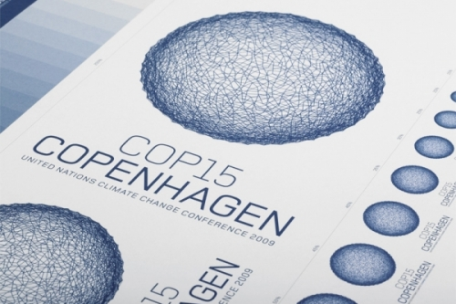

Slide 9
These are the core goals of the Copenhagen Talks (2009):
- Forging a "shared vision" for long-term cooperative action, "including a long-term global goal for emissions reductions."
- Emissions curbs will be determined by "measurable, reportable and verifiable" actions to cut carbon output. For all developed countries, these will include "quantified emissions limitation and reduction objectives." For developing countries, no mention is made of emissions reductions. Instead, the talks will cover "nationally appropriate mitigation actions."
- Financial help to enable poor countries cope with the impact of climate change.
- Encouraging the transfer of cleaner technology through "effective mechanisms and enhanced means," including financial incentives but also the removal of obstacles, a shorthand term for trade barriers.
- Curbing emissions from deforestation, through "policy approaches and positive incentives" in developing countries as well as sustainable forest management and conservation

Slide 12
POINTS TO PONDER…
Should the government be subsidizing the development of carbon capture technology, essentially with taxpayers money?
Or, should the fossil fuel industry be investing their own money in the technology to ensure they can continue to operate?
Should the government be interfering in the fossil fuel marketplace?
Should we be investing $2 billion dollars in a technology that allows us to continue relying on fossil fuels? Or, should the money be spent on developing alternative and clean energy technologies that will be required in the future?

Slide 13
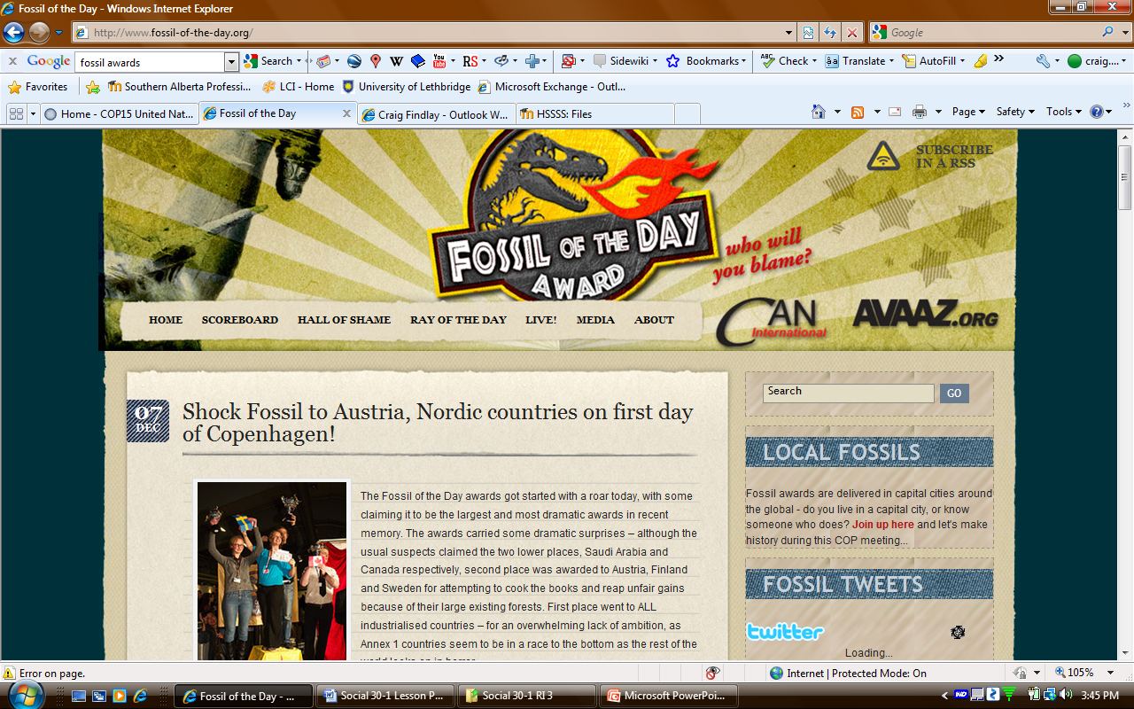

Slide 14
Can capitalism
Solve environmental
Problems?
Cap and trade?
http://www.youtube.com/watch?v=pA6FSy6EKrM&feature=channel

Slide 15
The principles of
LIBERALISM
AND THE
eNVIRONMENT
Are they
compatible?

