Slide 1

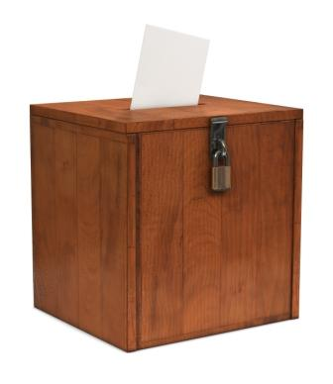
The principles of
LIBERALISM
AND
P LITICAL SySTEMS
To what extent do our
political systems
reflect the will
of the people?

Slide 2
What are the criteria
For a country to be
Considered
Democratic?

Slide 3
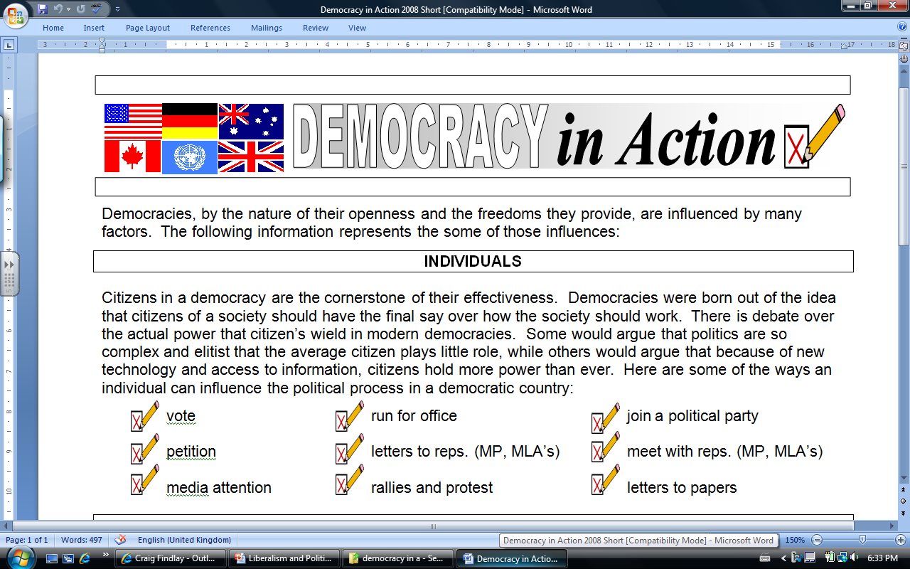
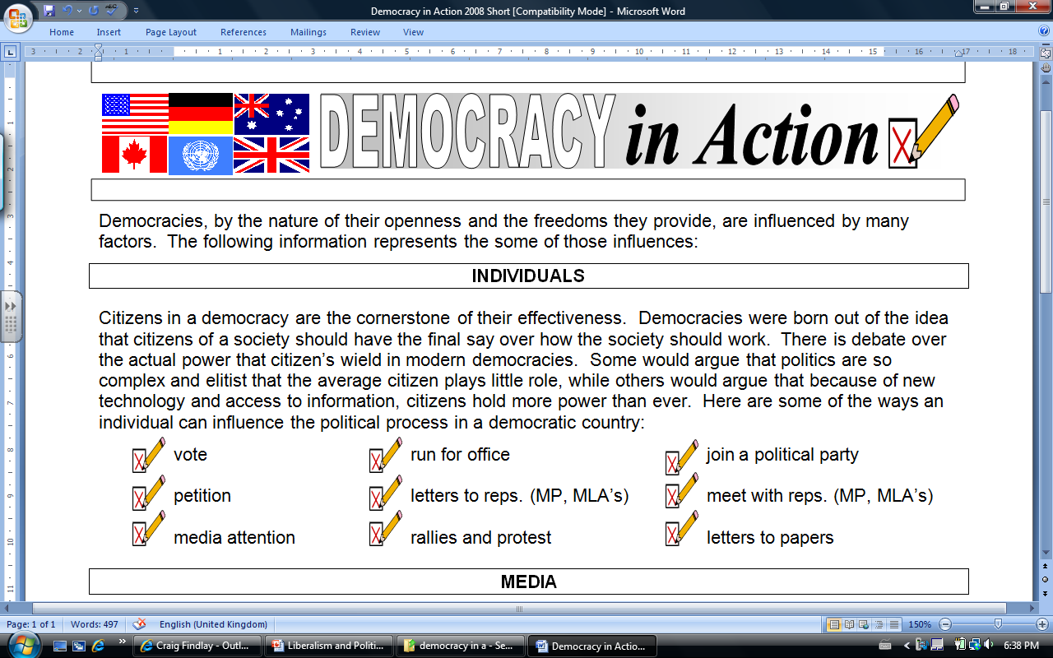

Slide 4
Decision making
Critique the following
decision-making models:
REPRESENTATIVE DEMOCRACY
(majority rule)
DIRECT DEMOCRACY
(majority rule)
CONSENSUS
AUTHORITARIAN or
TOTALITARIAN

Slide 5
What are the similarities
And differences between
CANADIAN
and
AMERICAN
Political systems?

Slide 6
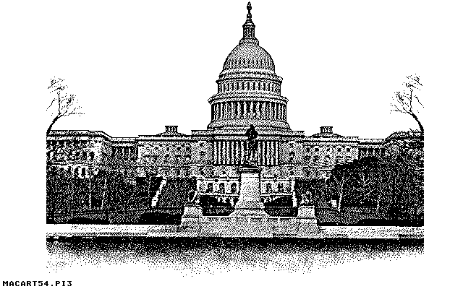
What are the similarities
And differences between
CANADIAN
and
AMERICAN
Political systems?

Slide 7
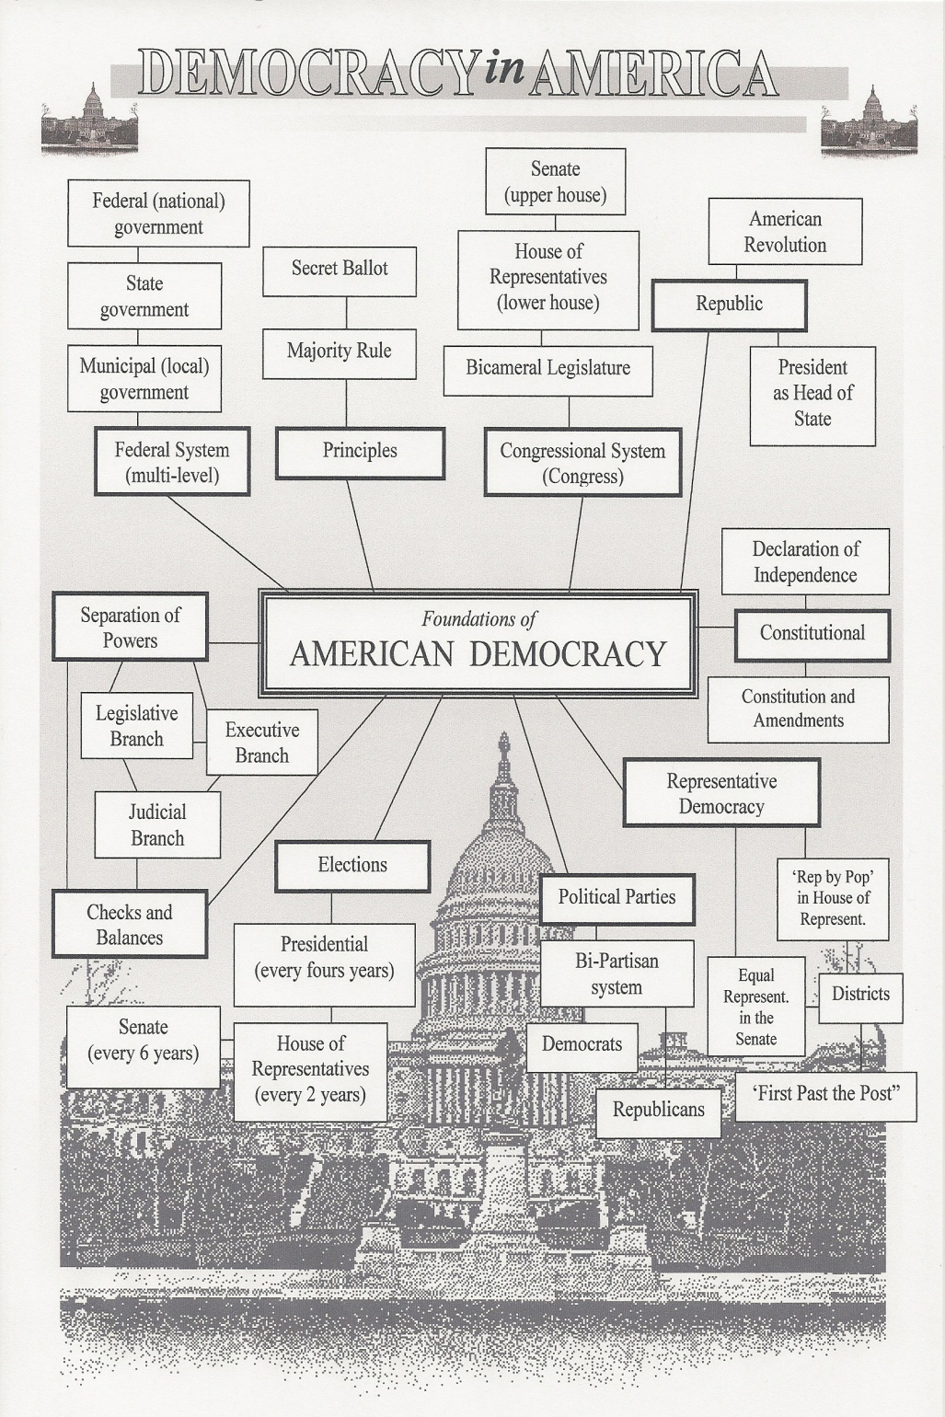
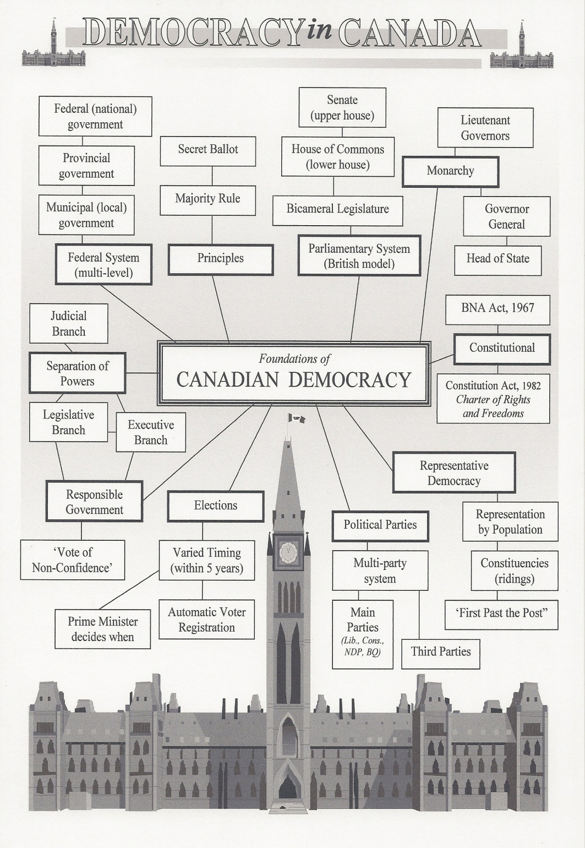

Slide 8
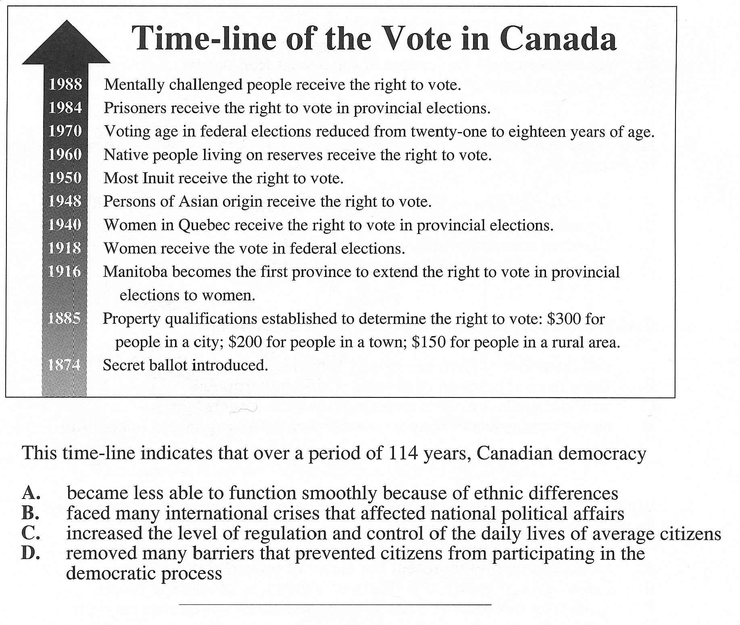

Slide 9
CONSIDER…
Voter turnout in the 2008 Alberta provincial election was only 41 per cent of the province's 2,252,104 eligible voters, a record low.
Voter turnout at the 2008 federal general election (59.1%) was the lowest in the history of Confederation

Slide 10
SOLUTIONS?
Should we have Mandatory Voting in Canada?
  In Australia, you receive a $50 fine if you don’t vote.
  They have enjoyed a 90%+ voter turnout since passing the mandatory voting law in 1924.
  Citizens are required to vote in 30+ countries, including Greece & Belguim
What do you think?

Slide 11
SOLUTIONS?
Should we lower the Voting Age in Canada?
Vote16 was started in December 2004 as an initiative involving members of each of Canada's four political parties with two principal aims:
  Lowering the federal voting age to 16
  Encouraging young people to become more engaged in politics
What about a system like this?:
    Age 16 – vote equals ¼ of an adult vote
    Age 17 – vote equals ½ of an adult vote
    Age 18 – full voting rights
What do you think?

Slide 12
Did you know?
In the United States the elected
President is the ‘Head of State’.
Who is Canada’s ‘Head of State’? Did you know that Canadian citizens have no choice (or part in selecting) our ‘Head of State’?
Revolutions in France and American created republics by eliminating the monarchy. Why do other democracies, such as Canada and Great Britain, maintain a monarchy?
What do you think?

Slide 13

Consider…
To what extent does the idea of a monarchy contradict the principles of liberalism?
Again…think about the revolutions
we have explored this semester:
American Revolution
French Revolution
Russian Revolution
What do you think?

Slide 14


Consider…
Watch the following clips about the Canadian Political System.
What do you think?

Slide 15
Did you know?
In Canada we elect people in a system called ‘single member plurality’ or ‘first-past-the post’.
Here is how it works…its pretty simple. The Candidate with the greatest number of votes wins the election.
In Canada there are 308 election races, one in each constituency (seat), carried out during a federal election. The political party winning the greatest number of these elections (seats) is invited to become the government of Canada. If a party has more than half of the seats they are considered a majority government. If the winning party has less than half of the seats they are considered a minority government.
What do you think?

Slide 16
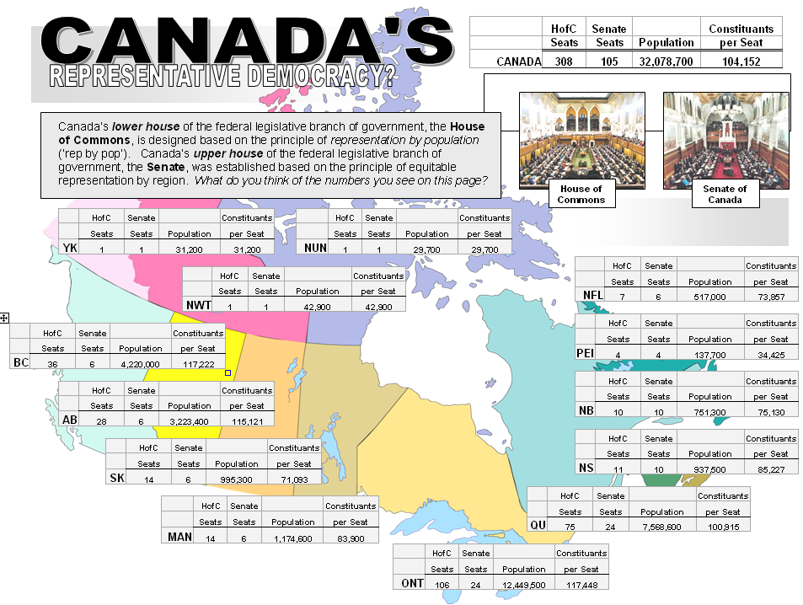

Slide 17
Consider…
What do you think of the layout
of the canadian house of commons and the american house of representatives ?
Which layout do think is most conducive to the facilitation of the democratic process?

Slide 18
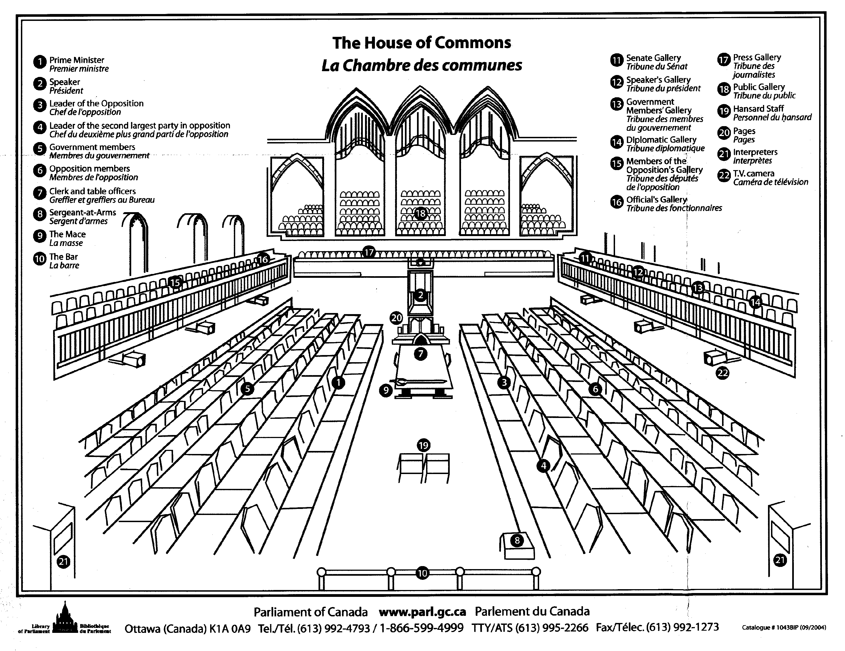

Slide 19
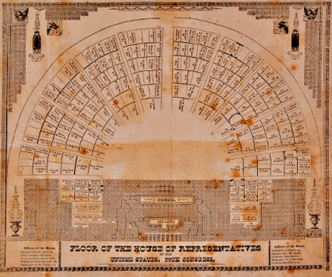
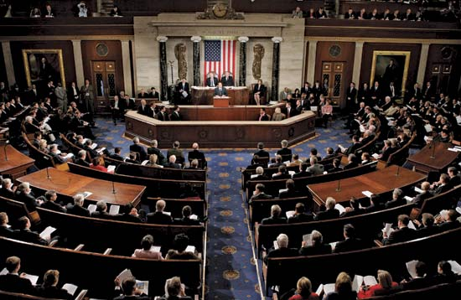

Slide 20
Consider…
ELECTION RESULTS for WOOD BUFFALO RIDING
VOTES PARTY
Candidate 1 10 001 Liberals
Candidate 2 10 000 Conservatives
Candidate 3 10 000 New Democratic
Candidate 4 9 999 Green
Candidate 5 9 998 Action
Which candidate wins the election?
Do you see any issues…

Slide 21
Consider…
Consider the following Canadian Federal election results from 2000:
PARTY SEATS % of VOTE % of SEATS
Liberal 172 41 57
Alliance 66 25 22
PC 12 12 4
BQ 38 11 13
NDP 13 9 4
What do you think?

Slide 22
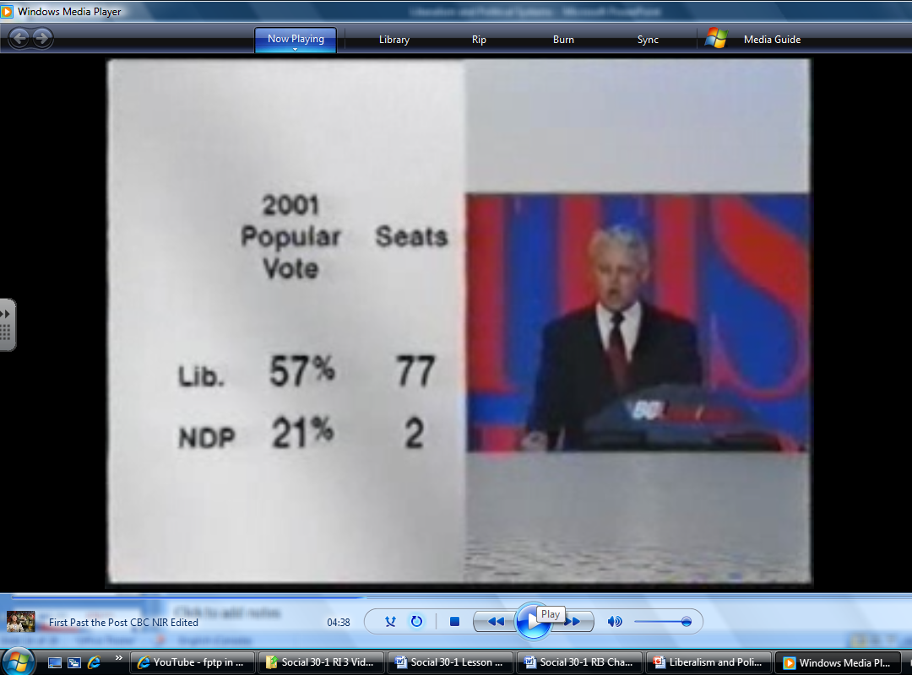
Consider…
Watch the clip from CBC News in Review on Canada’s FPTP electoral system:
What do you think?

Slide 23
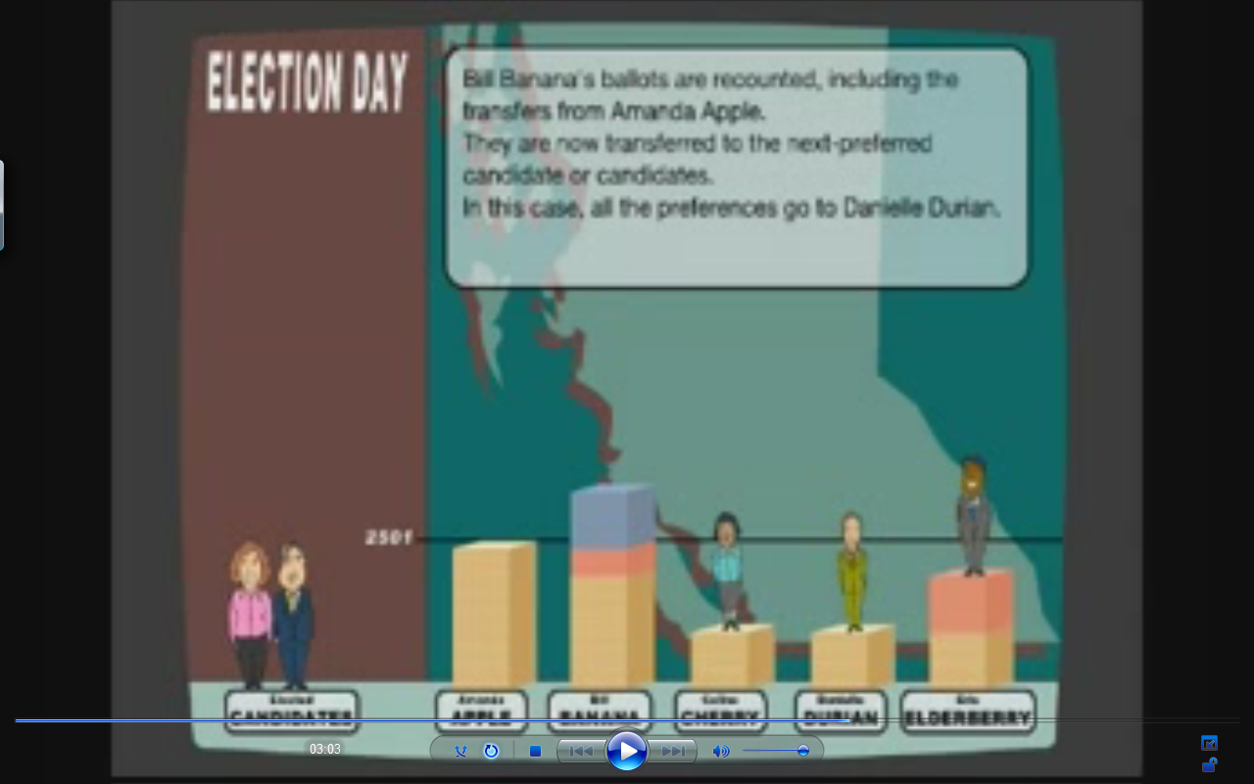
Consider…
What about Proportional Representation(PR)?
Check out the system the province of
British Columbia is proposing.
What do you think?

Slide 24
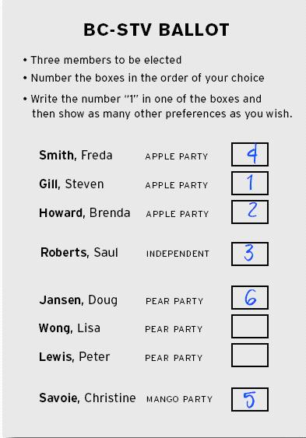
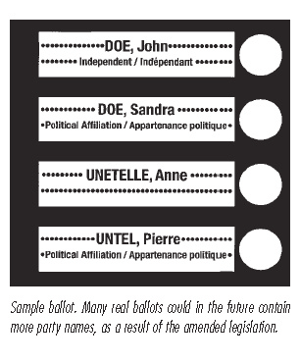
Consider…
SAMPLE PR ballot
TYPICAL FPTP ballot

Slide 25
Did you know?
Canada has a bicameral legislature at the federal level. We have two tiers to our legislative branch: the House of Commons and the Senate.
The United States also has a bicameral legislature know collectively as Congress. Congress is made up of the House of Representatives and the Senate.
Canada’s Senate is not an elected body. The Governor General appoints Senators – the reality is the Prime Minister picks the Senator when a Senate seat become open. Look at the Senate of Canada information sheet.
What do you think?

Slide 26
Did you know?
In our system it is important to keep the confidence of the legislature or house, because if the government tries to pass a major bill (piece of legislation), like a money bill (for example the budget), and they are defeated, the government must resign and a new election is called. This is called a vote of non-confidence.
As a result of this serious consequence of defeat, it is important that a government’s members (known as the party caucus) votes with the party – ‘tows the party line’. This is called party solidarity. There are severe penalties for those that vote against their party, including expulsion from the party.
What do you think?

Slide 27
Did you know?
This raises an interesting question about our system. If we elect someone as our constituency’s representative, then who should they represent in parliament? Should they vote with the party, maintaining party solidarity, even if it means going against the wishes of their constituents? Or, should they vote in accordance to the wishes of their constituents, the people that elected them, even if it means going against the party?
What do you think?

Slide 28
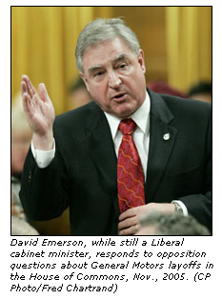
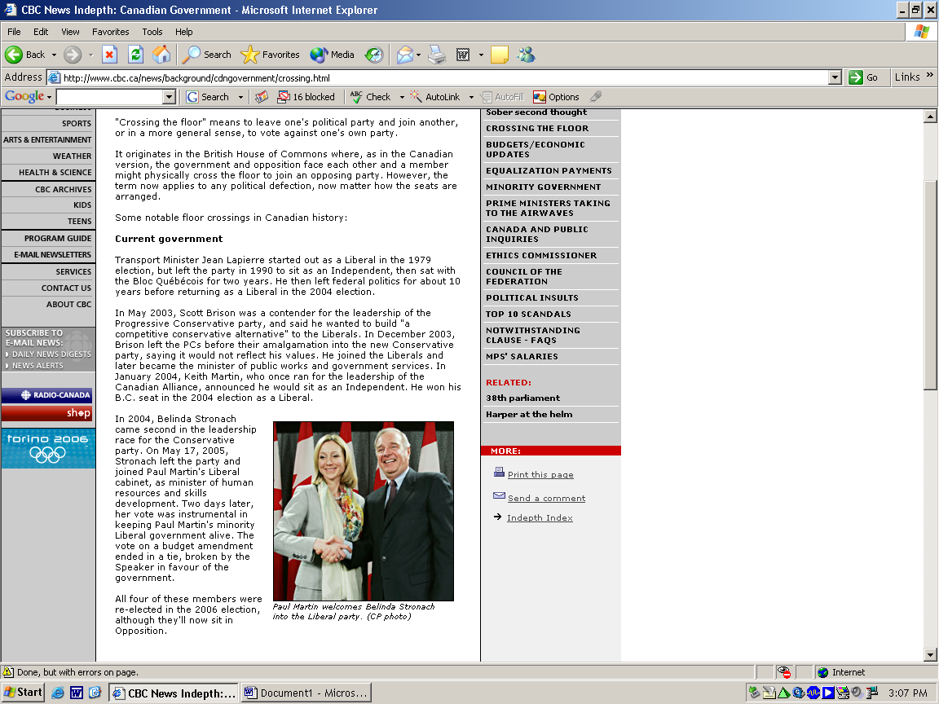
Did you know?
There is no rule stopping someone from switching political parties after being elected. Review the ‘crossing the floor’ document.
What do you think?

Slide 29
Consider…
George W. Bush won the 2000 election with fewer votes than Democratic Candidate Al Gore.
Watch the CBC News in Review clip on
the 2000 election.
Can you explain how this is possible?

Slide 30
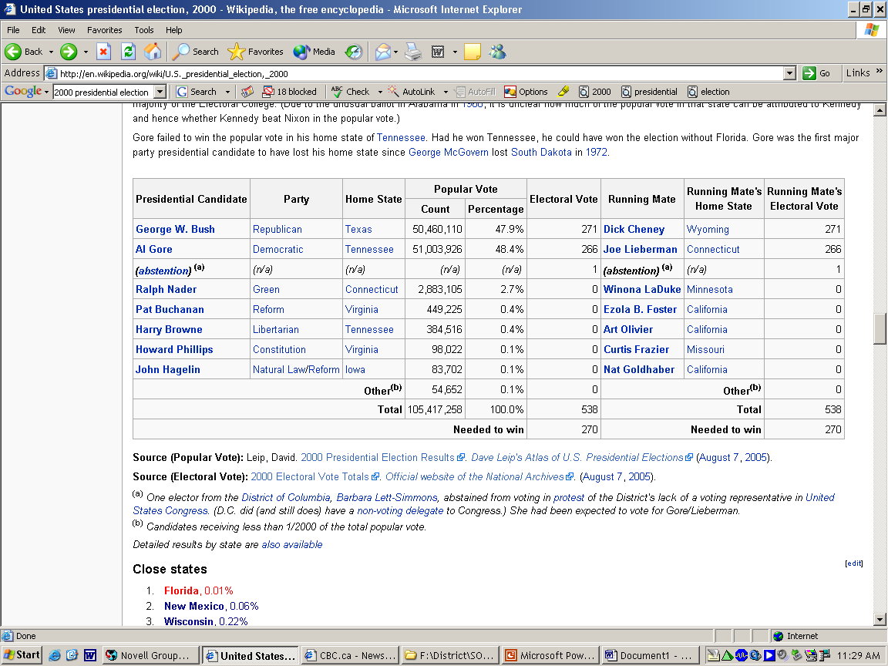
Consider…

Slide 31
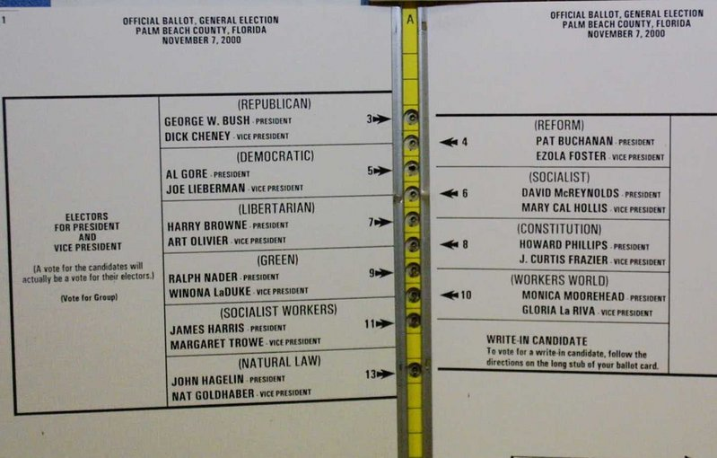
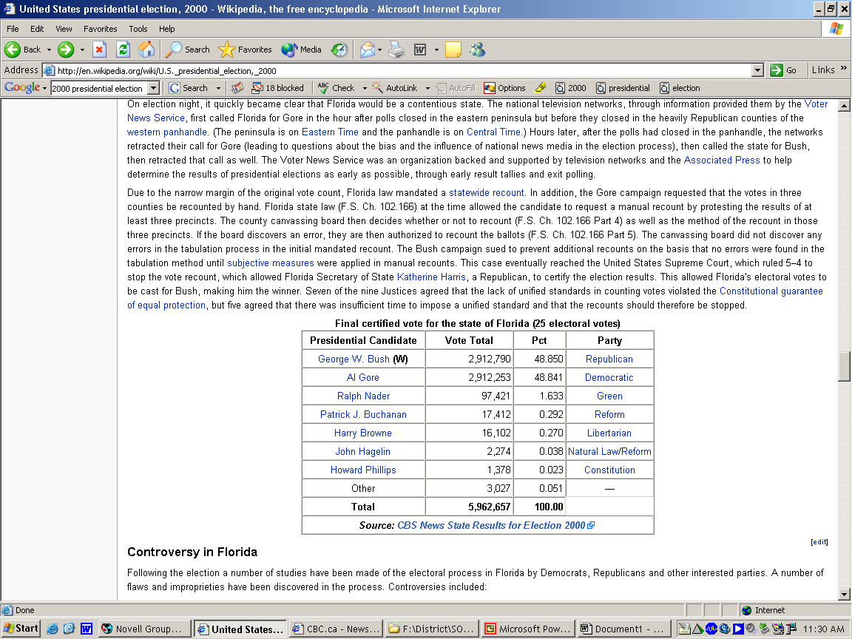
Consider…

Slide 32
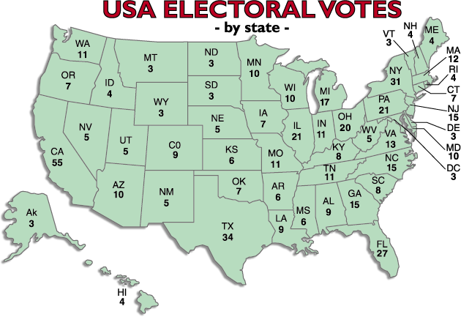

Slide 33
DID you know?
The U.S. President is said to be in-directly elected because of the ‘electoral college’. Rewind to the 2000 election when the importance of the College of Electors became known to everyone. Al Gore received more votes than George W. Bush. But Bush, after recounts and court challenges, wound up with more electoral college votes. In the end, that's what counts.
After presidential candidates are selected at the national conventions, there are three presidential debates. In 2004, these will be on September 30, October 8 and October 13.
Voting day is the first Tuesday after the first Monday in November, every four years. In 2004 this means the election will be Tuesday, Nov. 2. Congressional elections also take place on this day, with all of the House of Representative seats up for grabs, and 1/3 of the Senate seats.

Slide 34
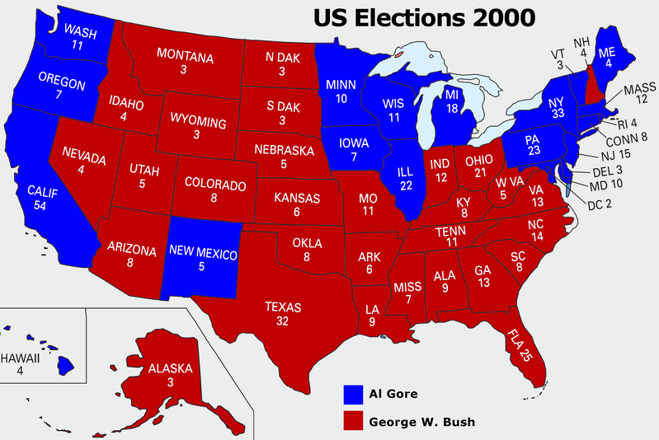
The 2000 election came down to the 25 electoral college votes from Florida.
Before the Florida votes the candidates sat with the following totals: Gore 266
Bush 246
They needed 270 to win the presidency.

Slide 35
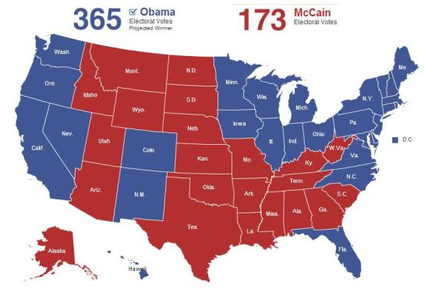

Slide 36
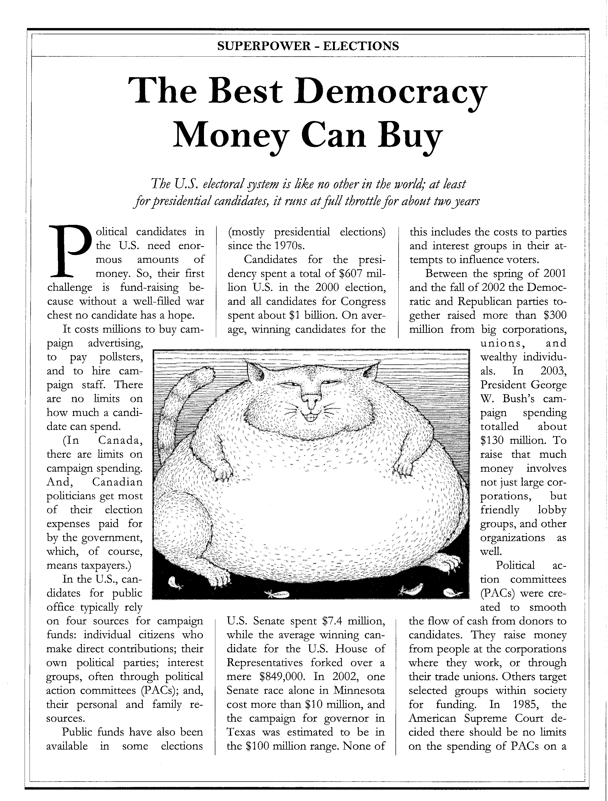
Consider…
?
Candidates for President spent more than $607 million in the 2000 election campaign
On average winning candidates for the House of Representatives spent $849 000
On average winning candidates for the Senate spent $7.4 million
In 2002, campaign spending for Governor (Gubernatorial race) in Texas was in the $100 million range
In 2003, the George W. Bush campaign spent $130 million
In 2002, the Republican and Democratic parties raised more than $300 million from big corporations, unions and wealthy individuals
Only a person born in the United States of American can become the President – sorry Arnold!
What do you think?

Slide 37
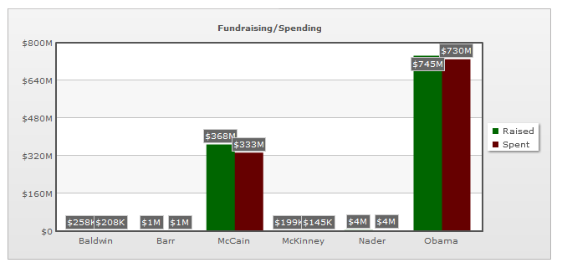
Consider…
In Canada there are strict laws limiting the amount of donations candidates and parties can receive and limits on what they can spend. Should there be limits on what candidates can spend?
What do you think?

