Slide 1
Guess The Profession
Use the clues to try and guess which profession is on each slide.
Can you guess all 5?

Slide 2
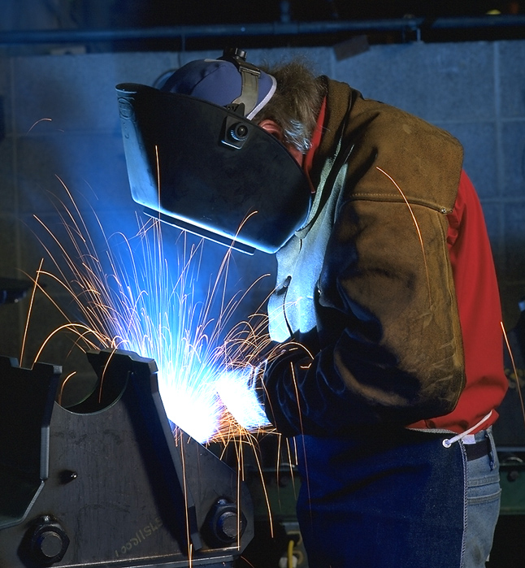
People in this profession must be able to work with little supervision.
People in this profession have a risk of injury from torches and hot metals.
This profession often requires you to work outside and in harsh conditions.
People with the ability to concentrate on detailed work do well in this profession.
People in this profession are able use their manual dexterity to build and bring things together.
Welder

Slide 3
Welder
Can work evenings & weekends and long hours
Join or sever metals in beams, girders, vessels and other metal components.
Wide variety of work environments, both inside and outside.
Certification requires 1500 hours on the job training and 8 weeks of schooling over the course of a 3 year apprenticeship.
Registered Apprenticeship Program(RAP) can be used to count toward hours.
Welders earn $25 to $40 per hour plus bonuses.
Welders can continue on to become welding inspectors, welding foremen or supervisor, or plant supervisors.

Slide 4
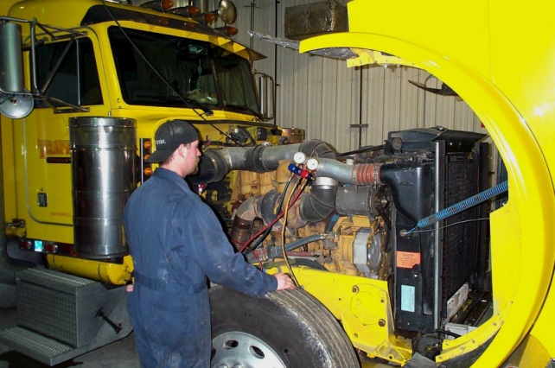
People in this profession have achieve expertise with precise work and working with their hands.
Strength and stamina is required for this job as well as mechanical ability.
This trade requires an apprenticeship prior to earning a certificate.
People must have knowledge of all types of machines and engines as well as electronics and precision equipment.
People in this profession have been known to work be “super people” as they would be required to lift “Heavy” parts.
Heavy Duty
Technician

Slide 5
Heavy Duty Technician
Hours vary as well as working conditions
Some risk of injury from heavy equipment and power tools.
Maintain, repair and overhaul heavy vehicles.
Certification requires 1500 hours on the job training plus 8 weeks schooling over a 4 year apprenticeship.
Registered Apprenticeship Program(RAP) can be used to count toward hours.
Certified Journeyman earn $25 to $40 per hour plus benefits.
Technicians can go on to become shop supervisors or service managers.

Slide 6
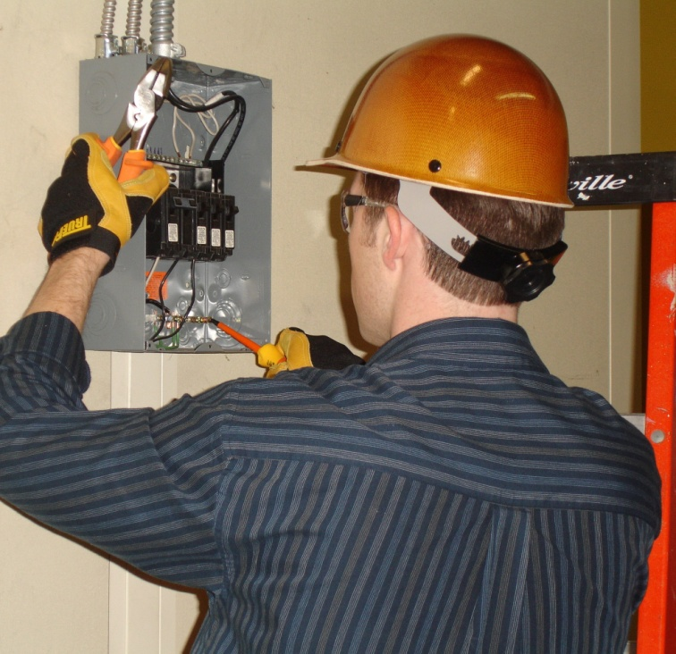
People in this trade must be able to work out arithmetic problems quickly and accurately.
People in this trade can specialize in residential, commercial, institutional, or industrial.
People in this trade can work outdoors on high scaffolding and indoors in cramped conditions.
People in this trade must be life-long learners.
The tradesperson in this field has to pay attention to the possibility of accidental electric shock.
Electrician

Slide 7
Electrician
Depending on the type of work may work indoors or outside. Outdoor work is often seasonal if working in the construction area.
Electricians install, alter, repair and maintain all electrical systems.
Certification requires 1500 hours of on the job training along with 8 weeks of schooling over 3 years as well as 1350 hours and 12 weeks in the fourth year.
Registered Apprenticeship Program can be used to count toward hours.
Certified Journeyman earn $25 to $40 per hour plus benefits.
Electricians can go on to become foreman, superintendent, electrical inspectors, business owners or estimators.

Slide 8
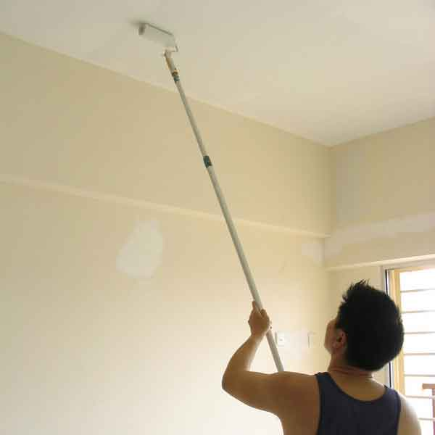
People in this profession do it because of the variety, creativity and for recognition of their special talents.
This trade requires a person to stand for long periods of time with their hands over their heads.
People in the profession face the risk of falling off ladders and working with thinners and removers.
People in this trade must have good color sense and be able to work with heights.
Do any of these clues paint a picture as to what this trade is?.
Painter or
Decorator

Slide 9
Painter or Decorator
Often work 40 hours during weekdays and some weekends
Try to organize the outside work in the spring and summer and inside work in the fall and winter.
Painters often work independently to apply paint and wall coverings to exterior and interior of structures.
Certification requires 1300 hours on the job training plus 8 weeks schooling over a 3 year apprenticeship.
Registered Apprenticeship Program can be used to count toward hours.
Certified Journeyman earn $16.00 to $30.00 per hour plus benefits.
Painters can go on to become business owners, contractors or vocational school instructors.

Slide 10
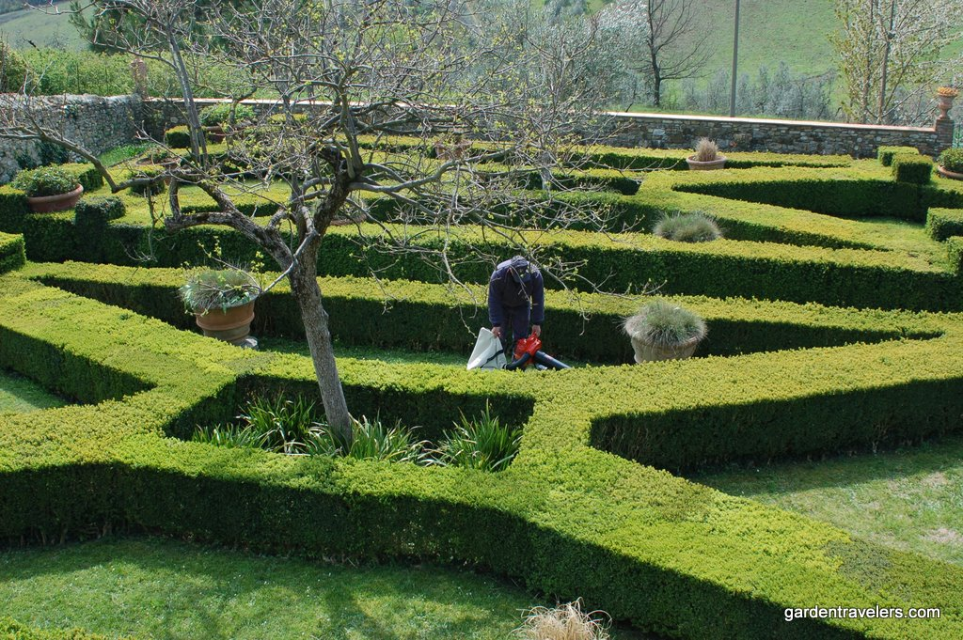
People in this profession must be able to work with simple hand tools all the way to large machinery.
People in this profession always work outdoors in all kinds of weather.
People in this profession have good customer service skills.
People in this profession like to work with their hands and get dirty.
The profession ahs the ability to grow on a person as they become planted in this occupation
Landscape Gardener

Slide 11
Landscape Gardener
Often the work seasonal and if for long hours to complete jobs before it gets cold. There may be work in green houses and maintenance that can be for the winter months.
Landscaping is a strenuous job with considerable lifting, bending and carrying. There is also the part of the job to be creative in designs and consultations.
Certification requires 1200 hours on the job training plus 8 weeks schooling over a 4 year apprenticeship.
Most certified landscapers earn $18.00 to $30.00 per hour plus benefits.
Chefs can go on to become supervisors, managers, head landscapers, owners or vocational school instructors.

Slide 12
How did you do?
Name 2 trades or professions that interest you
(you may pick other ones than those listed in the power point).
2. Write down 3 questions you would like to get answered about the two trades you described.
3. Share your questions with a partner and save them for later.

