Slide 1
Additive Thinking
Presenter Info
Notes:
All handouts can be downloaded from: https://drive.google.com/folderview?id=0B-I5D9zVEge0bXlLLUV2OUs0S2M&usp=sharing

Slide 2
Introduction

Slide 3
What is Additive Thinking?
Notes:
Give participants post it notes. Generate a list of keywords that you believe are directly related to additive thinking. In small groups, they collate their responses, combining matching sticky notes, making sure to actually stick matching ones together. Don’t just keep one of each.
They place on board, collating again if applicable. Speaker finds the largest piles and reads them to the group.
Alternative: Participants are asked to reflect individually for a minute. Then their share their thoughts with a partner. Then with the group.

Slide 4
What is Additive Thinking?
Students are able to manipulate numbers by joining, separating, and comparing while engaging in flexible mathematical reasoning. It is
a capacity to work flexibly with the concepts, strategies and representations of addition and subtraction as they occur in a wide range of contexts. (mathematical reasoning)
going beyond memorization of basic arithmetic skills
the means to communicate additive understanding effectively in a variety of ways (for example, words, diagrams, symbolic expressions, and written algorithms).
EMPLO, 2015
Notes:
What words would you highlight as the key ideas in the definition? Where do the ideas from our stickies/discussion fit in within this definition?

Slide 5
Why is it important?
Research says
Both mathematical reasoning and arithmetic skills are predictors of mathematical achievement, however, students ability to reason mathematically was the stronger predictor of success.
Nunes, Bryant, Barros, & Sylva, 2011

Slide 6
Why is it important?
Research says
Early literacy success is directly linked to later literacy success.
Early numeracy success is directly linked to later numeracy AND literacy success.
Early numeracy is a better predictor of school success than early literacy.
Study: School Readiness and Later Achievement
Notes:
Explain why this topic is important.

Slide 7
What are the Big Ideas?
Once students trust “the count”, they can flexibly manipulative numbers in order to make solving problems easier by
Using Parts and Wholes
Decomposing / Recomposing
Partitioning
Compensating
Using Constant Difference

Slide 8
What are the Big Ideas?
Students use mathematical reasoning to build connections between inverse problems.
Addition is not just adding. It’s subtraction as well.

Slide 9
What are the Big Ideas?
Additive Thinking deals with questions where the start, change or result is unknown. It is joining, separating and comparing.

Slide 10
Activity: Relating to POS
MATHEMATICS
KINDERGARTEN TO
GRADE 9
What Strategies Do Students Need?
Notes:
Think – Pair: Participants brainstorm a list of Additive Thinking strategies they believe their students need at their grade level. Don’t worry about the “proper” name for the strategy.
Optional for longer workshops: Participants could be provided with their grade specific Program of Studies to look through

Slide 11
Activity: Suggested Strategies
Standard / Traditional Algorithm
Doubles /
Near Doubles
Facts of 10
Making Ten
Reordering
Partitioning by place value
Compensating
Think Addition for Subtraction
Keeping a Constant Difference
Notes:
AB Education does NOT dictate which strategies you are required to teach in your classroom. However, when looking at the POS, these are the strategies that stand out for me. Please note that counting forwards and backwards is NOT an additive thinking strategy. It is just a counting strategy.
“Making Ten” also applies when talking about elapsed time. You are essentially “Making 60”

Slide 12
Alberta Education says…
“
Students investigate a variety of strategies, including standard/traditional algorithms, to become proficient in at least one appropriate and efficient strategy that they understand.
Over time, students refine their strategies to increase their accuracy and efficiency.
“
https://education.alberta.ca/media/464621/k_to_9_math_pos.pdf, pg. 9, 2016
Notes:
How many strategies do students need to master?

Slide 13
How Many Strategies?
“
Students investigate a variety of strategies for number operations, one of which must be the standard/traditional algorithm. Students are to use a strategy that they understand. A student’s strategy may evolve over time as the student continues to develop mathematical understanding.
“
Alberta Education. (2016) Clarification of Expectations Regarding Strategies and Maintenance
Notes:
How many strategies do you think students need to master for a particular outcome? (Discuss and share)
<click>
The teacher’s responsibility is to provide opportunities for students to explore a variety of strategies in order promote flexible mathematical thinking. Students are not required to use a specific strategy in order to demonstrate their understanding.
What is a standard algorithm? What is a traditional algorithm?

Slide 14
Just a Reminder
Notes:
Strategies must be
Efficient: You must be able to get to the answer in a reasonable amount of time.
Effective: It must get you the right answer every time.
Explainable: You have to be able to explain what you are doing and why it works.

Slide 15
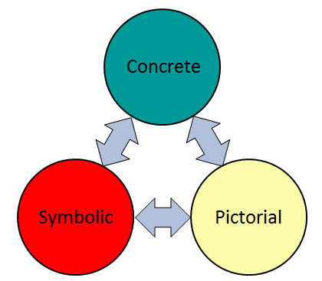
Using Manipulatives
Notes:
When using manipulatives as an instruction strategy, my students should be able to make connections between concrete, pictorial and symbolic representations.
The Concrete Stage focuses on…

Slide 16
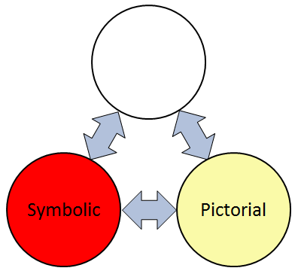
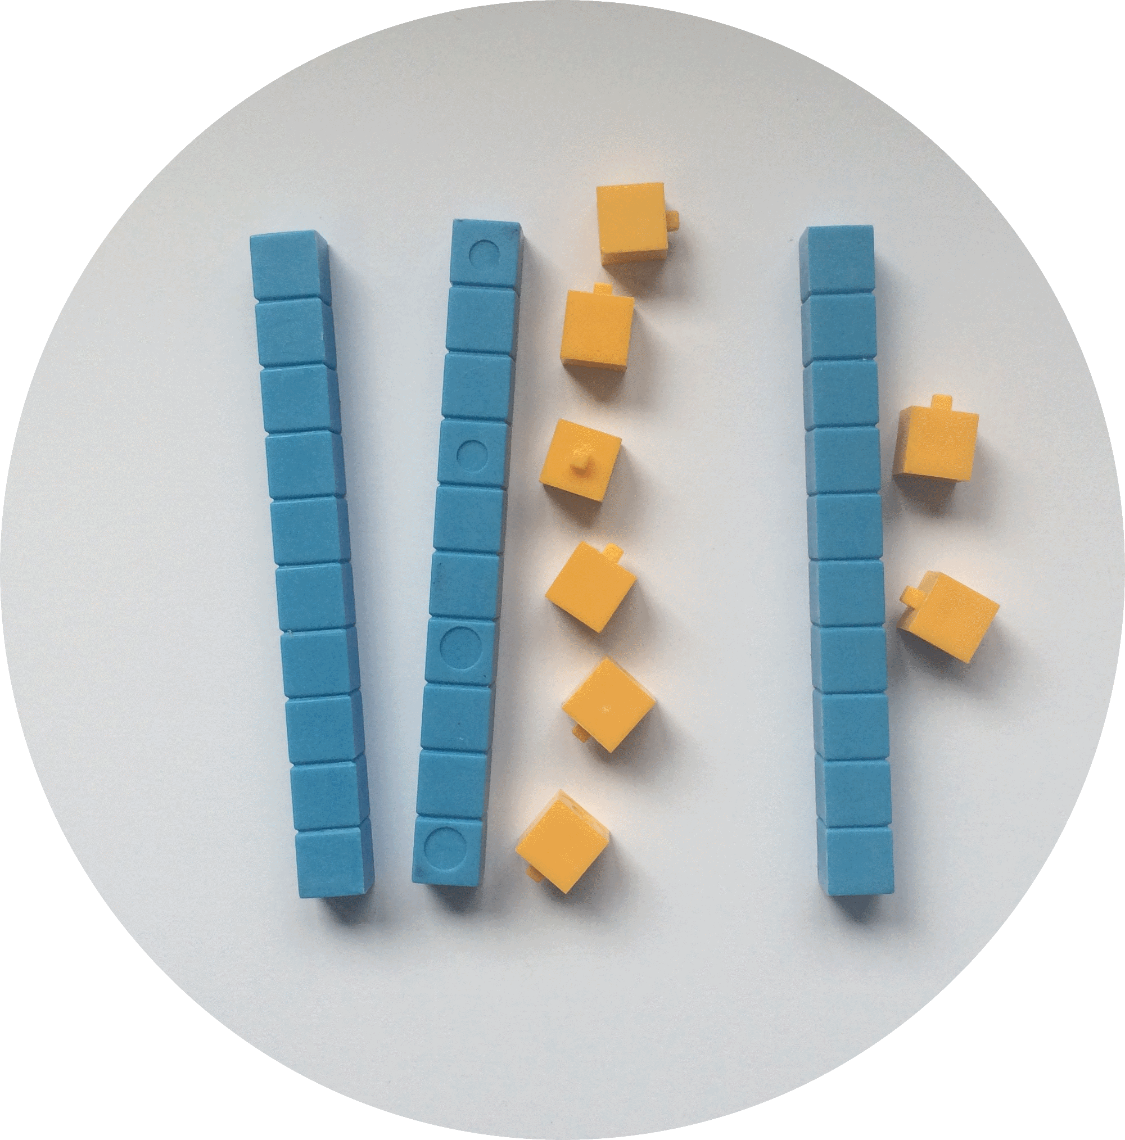
Using Manipulatives
Notes:
The use of physical models to represent the mathematical thinking. Models are tools that can be manipulated and adapted in order to find possible solutions to problems. This stage allows students to develop their visualization skills, enabling students to use concrete means to grapple with abstract concepts. Don’t rush through the use of manipulatives. Students need time to develop understanding.

Slide 17
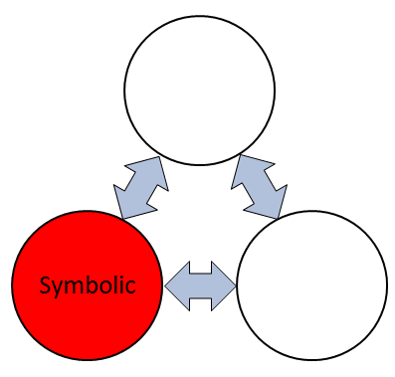
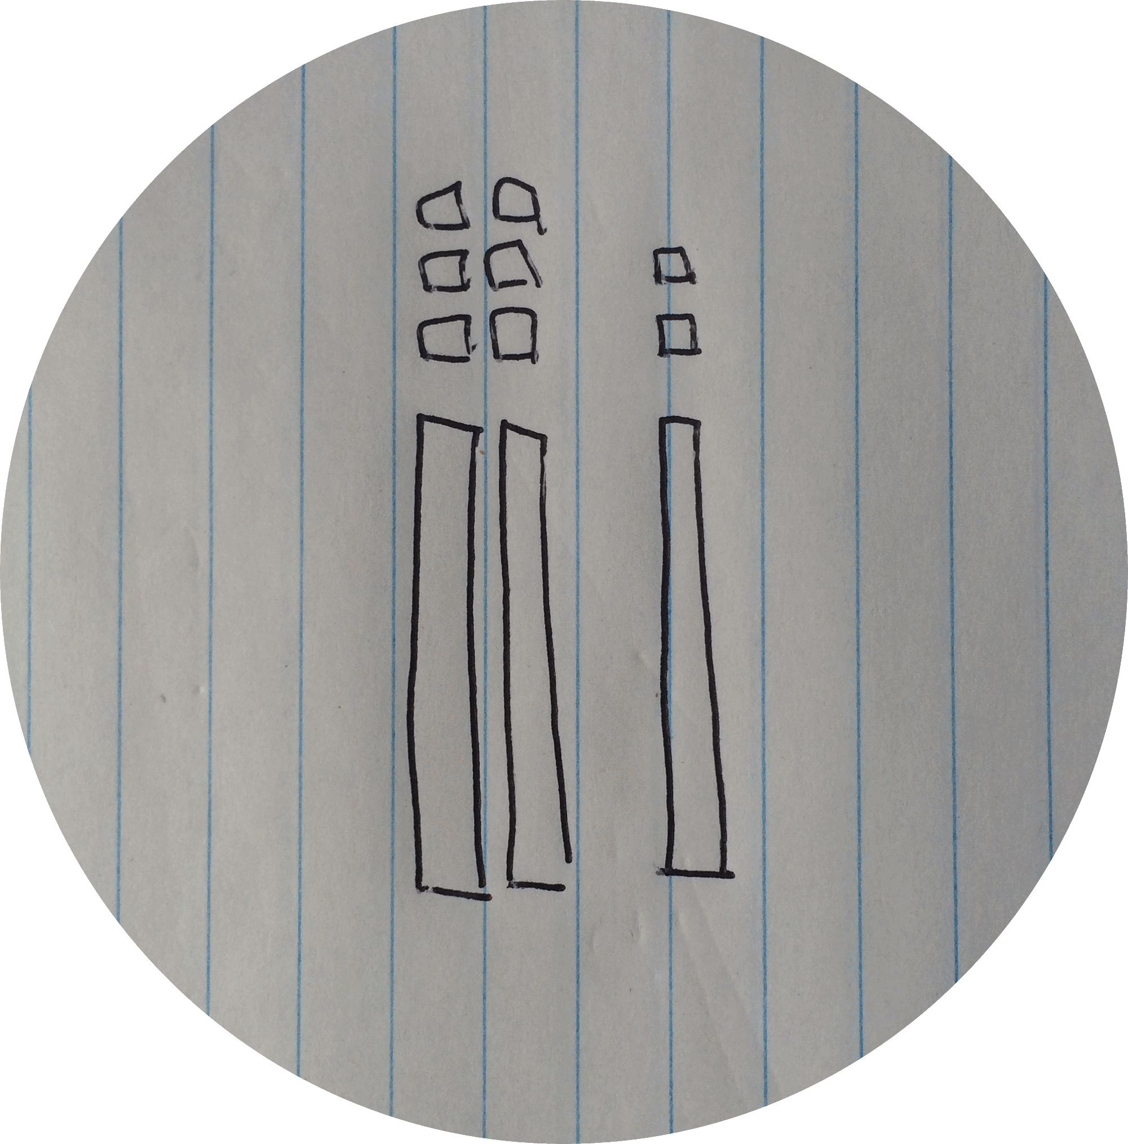
Using Manipulatives
Notes:
Pictorial refers to the use of pictures of the manipulatives, or diagrams, or images. In my own lessons, whenever students are using base ten blocks at their desks, I have a smart notebook file open on the screen with base ten blocks that can be manipulated. Virtual manipulatives would also be considered pictorial.
The concrete and pictorial representations help make the math more visible and meaningful as they move towards a symbolic representation.
This means that we need to connect the concrete to the pictorial because we need to move away from only using a concrete representation.
And the pictorial should SHOW and SUPPORT the ideas behind the symbolic representation and the answer.

Slide 18
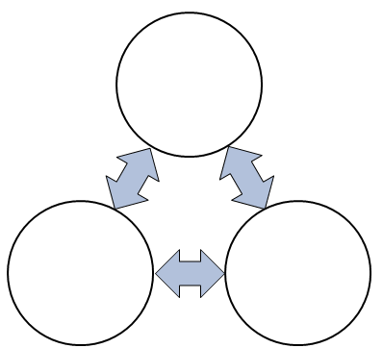
Using Manipulatives
26 + 12
Notes:
Symbolic representations include numbers and symbols.
It’s important to remember that symbolic representations come from a need to be more efficient and effective from concrete and pictorial representations.
At any point in time, a student should be comfortable going back and forth between the three representations if this is necessary for better understanding. For example, they may go back to a pictorial model before they solve it symbolically. Some may need to go back to the concrete model in order to trust that the pictorial representation will lead to the correct answer.
In the end, the math may provoke images or a model and the model can show and support the math.

Slide 19
Using Manipulatives
Math learning and performance are optimized when the two sides of the brain are communicating – “brain crossing”
~Park & Brannon, 2013
Notes:
The left side of the brain handles factual and symbolic information; the right side brain handles visual and spatial information. Researchers have found that math learning and performance are optimized when the two sides of the brain are communicating. You could call this “brain crossing” (Park & Brannon, 2013) Additionally, they found that training students through visual representations improved students’ math performance significantly, even on numerical tasks, and that visual training helped students more than numerical training.

Slide 20
Big Idea 1

Slide 21
Flexible Thinking
Once students trust “the count”, they can flexibly manipulative numbers in order to make solving problems easier by
Using Parts and Wholes
Decomposing / Recomposing
Partitioning
Compensating
Using Constant Difference
Notes:
Write out big idea and explain why it’s a big idea.

Slide 22
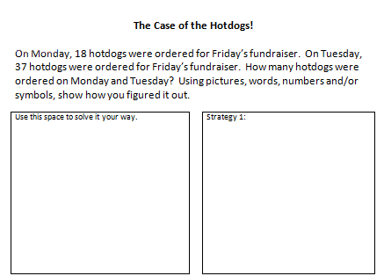
Activity: Intro
Notes:
Handouts:
The Case of the Hotdogs – multiple ways – multiple grades (only print the grade levels you need for the participants)
Handout the “Case of the Hotdog – Activity” page that matches each participant’s grade level. Explain that each person has received a grade specific question. However, they are all related to each other and follow the same format. Just the numbers are different.
Participants read their word problem and solve it in the FIRST box (see arrow), however they want.
<Link for presenter to download document: https://docs.google.com/document/d/1DYc5HqsqD-MzoK8BXsxES7ym_ccyQexjAxmcxuRVLa4/edit?usp=sharing >
We’re going to explore 3 additive thinking strategies that promote flexible mathematical thinking. You may be familiar with some of these.
As with all mathematics, it is very important that we progress through the concrete, pictorial and symbolic stages. We build it, without writing anything down until we can do it concretely without support. I almost always do the pictorial at the same time because I’ve got smartboard manipulative files for all of my manipulatives. So they are seeing the pictorial right away. Once students are extremely comfortable, then we move on to the symbolic. Research shows that when a student puts pen to paper, their stress level will increase and make it more challenging to understand the math.

Slide 23
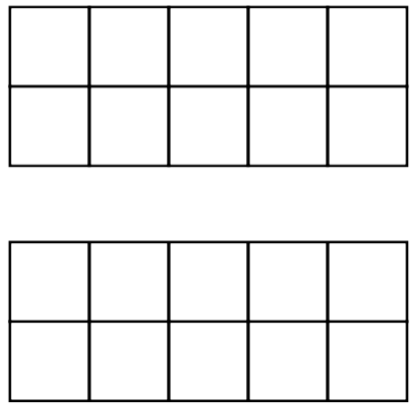
Intro: Making Ten
Click to reveal
Notes:
Put your pencils down. I’m going to click on the box. It will flash two sets of dots very quickly. You have to figure out how many there are altogether. Ready? <click the box>
Take a moment to think. How many are there? I’ll click it again so you can check it again. <click>
Does anyone need another peek? <If so, click again>
Tell your partner, how many dots did you see altogether and how did you figure it out?
<Give time to discuss then group share strategies.>
<Hopefully someone says that they say a ten…if not, you say “I imagined moving one red dot to make ten so that left me with 10 and 3”>
Making ten is a powerful additive thinking strategy. This is a simple activity you could do with students to help them become aware of that strategy. But what do you do if students don’t understand it? You can build it with concrete materials! The next activity helps students build the Making Ten strategy.

Slide 24
Intro: Making Ten
9 + 4
Notes:
Materials:
15-20 square or round approximately 1” tiles per person (or other similar type manipulatives)
Making Ten – Two Ten Frames handout
The first strategy we’ll look at is “Making Ten”. How many of you are familiar with the images on the screen?
Using ten frames is just one tool that you can use in order to help students build their understanding of ten. You’re also probably familiar with Power of Ten which is a great resource but you don’t have to spend money and buy the program. Just look for Ten Frame activities.
<click>
Build me 9 in the first ten frame and 4 in the second ten frame.
Materials needed:
2 blank ten frames <Link for presenter downloading: https://docs.google.com/document/d/1xlqHIfj4wmSBjQ3LMyol2earrh6a7GC8LvT-55SrzdY/edit?usp=sharing >
About 20 integer tiles (or other manipulatives that would fill up most of the square)

Slide 25
Intro: Making Ten
9 + 4
Notes:
Mathematicians are a little OCD. When they see a ten frame that’s not full but could be, it really bothers them so they will do whatever they can to fill it up without changing the total value of what’s there. So, steal from one ten frame to fill the other one. <wait for them to do this>

Slide 26
Intro: Making Ten
9 + 4
Notes:
How many of you stole form the 4 to fill the 9?

Slide 27
Intro: Making Ten
9 + 4
Notes:
How many of you stole from the 9 to fill the 4? You’ll have kids who do this…but who cares? Still gets them the right answer in the end. It’s actually a good conversation to have that it doesn’t matter which one you still from. However, a mathematician would usually move the fewest amount of tiles as possible. It’s less work.

Slide 28
Intro: Making Ten
9 + 4 = 10 + 3
Notes:
When writing out your new equation, make sure to write it in this format…9 + 4 is the same as 10 + 3. We want to make sure to use the phrase “is the same as” as often as we use the phrase “is equal to”. This will help them have a better understanding of the equals sign.

Slide 29
Intro: Try This
8 + 7
Notes:
Now participants try: 8 + 7

Slide 30
Extending: Making Ten
29 + 43
247 + 389
Notes:
Can you use the “Making Ten” strategy to solve this one mentally? Explain to your partner what you did. <give time>
Having students explain to their process or strategy to their seat partner is an important aspect in mathematics. Students must be able to communicate their strategy. Remember that 3rd E? Explainable? This helps students to practice their communication skills and reasoning skills. As the teacher, when students are sharing their strategy with the entire class, I would be recording it on the board so that they can see it in a written form. After a lot of practice with verbally explaining their strategy, they can then write down what they just told their partner. This will help them improve their written communication.
If a student ever says to you, I just knew the answer, it’s possible they did. If you’re asking a grade 1 student to add single digit numbers, they might have mastered that fact. I just tell them “I’m sorry. I gave you a question that you didn’t have to think about…you already knew it. Try this question…” However, if it’s a question that typically students can’t just rattle off a fact for, you will have to guide them through the explanation. For example, don’t ask “what did you do to get the answer?” Instead, ask “what was the first thing you did?”

Slide 31
MODULE ALERT
Notes:
<Notes for presenter>
It’s now time for a game to practice this concept! Go and select your game:
Open the “Making Ten” games section.
Choose an appropriate grade-level game for all of your participants.
Replace this slide with the new slide(s) provided.

Slide 32
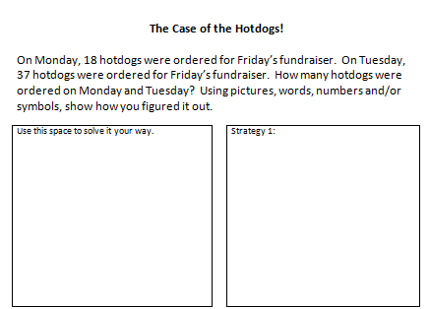
Consolidating Your Learning
Notes:
Participants write “Making Ten” beside “Strategy 1” and use the Making ten strategy to solve their question for “The Case of the hotdogs”.

Slide 33
Intro: Partition by Place Value
23 + 41
Notes:
Let’s explore a second strategy: Partitioning by Place Value.

Slide 34
Intro: Partition by Place Value
23 + 41
Notes:
Materials:
Base Ten Blocks – approximately 15-20 ones, tens and could include hundreds if you want to add a 3 digit example afterwards
Let’s build the 23.
<click>
Then the 41.

Slide 35
Intro: Partition by Place Value
23 + 41
20
+ 40
60
Notes:
They may say 20 + 40 = 60

Slide 36
Intro: Partition by Place Value
23 + 41
20
+ 40
60
3
+ 1
4
Notes:
3 + 1 = 4

Slide 37
Intro: Partition by Place Value
23 + 41
20
+ 40
60
3
+ 1
4
60
+ 4
64
Notes:
60 + 4 = 64

Slide 38
Intro: Partition by Place Value
23 + 41
Notes:
OR, they may start with

Slide 39
Intro: Partition by Place Value
23 + 41
3
+ 1
4
Notes:
3 + 1 = 4

Slide 40
Intro: Partition by Place Value
23 + 41
20
+ 40
60
3
+ 1
4
Notes:
20 + 40 = 60

Slide 41
Intro: Partition by Place Value
23 + 41
20
+ 40
60
3
+ 1
4
4
+ 60
64
Notes:
4 + 60 = 64

Slide 42
Intro: Partition by Place Value
23 + 41
23
+ 41
4
60
64
Notes:
This could be written like this: Starting with 3 + 1 = <cliquez> 4, 20 + 40 = <cliquez> 60, 4 + 60 = <cliquez> 64
Notice that I said 20 + 40 NOT 2 + 4. That’s not 2. That’s 2 tens which is 20.

Slide 43
Intro: Partition by Place Value
23 + 41
23
+ 41
60
4
64
Notes:
They could also start with 20 + 40 = <click>60, 3 + 1 = <click>4, 60 + 4 = <click>64. This would be correct as well.

Slide 44
Intro: Try This
29 + 43
247 + 389
Notes:
Try using partitioning by place value to solve this question.

Slide 45
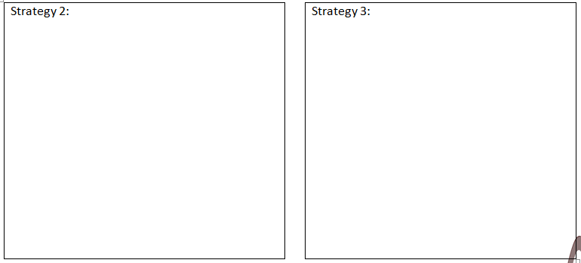
Consolidating Your Learning
Notes:
On your Hotdog handout, go to the box labelled Strategy 2.
Write the name of the strategy: Partition by place value
Solve your hotdog question by partitioning by place value.

Slide 46
Intro: Open Number Lines
23 + 41
+10
+10
+10
+10
+1
23
33
43
53
63
64
+40
+1
23
63
64
Notes:
The third strategy is open number lines.
Start by building 23 in a straight line using base ten blocks.
<click>Then add 41 to the end. Now, figure out how much you have altogether? When students respond, you’ll represent their explanations on the board. For example,
<click>Start by drawing a line. Do not put 0 or any other number on the line. Many students will use a counting on strategy, saying something like “I knew this was 23 so I didn’t recount it.”
<click>so you draw the line and label it 23. Then they might say, “then I skip counted by 10s”. Ask them to walk you through each skip count.
<click>One more ten is
<click>33
<click>one more ten is
<click>43
<click>one more ten is
<click>53
<click>one more ten is 63
<click>I counted the 4 tens. Now I have a one left.
<click>and end up at 64. Ask if anyone else skip counted by 10’s and then added one more. Ask for different strategies. Did anybody else skip count by a different number?
<click>Another student may say,
<click>I know that 23 + 40 is
<click>63
<click>plus one more
<click>is 64. Again, ask if others counted the same way.
If other students skipped counted different, for example by 20, 20 and 1, show that way. You want to show all of the ways that students do it. This helps them see that there are many ways to get there. Some will be easier for them. Some will be harder. That’s ok. They just have to find the one that works for them best right. Maybe they’ll try a different, more challenging one later.

Slide 47
Intro: Open Number Lines
23 + 41
+20
+3
41
61
64
Notes:
After students are confident, you can give them the question and tell them they can build it with the blocks first and then draw the open number line, or they can go straight to the open number line.
You should expect to see them <click>Build 41 and then add 23<click 4 times> to the end if they are very comfortable with the commutative property. If they don’t, you can give them 41 + 23, have them predict / estimate the answer, solve it and discuss what they found. Will this happen every time or is it just a fluke? Then, you could have one half of the classroom always start with the smaller number and add the bigger number. The other half of the class could always start with the bigger number and add the smaller number. Ask them why this will always work.

Slide 48
Intro: Try This
29 + 43
247 + 389
Notes:
Use an open number line to solve this question.

Slide 49
Consolidating Your Learning
Notes:
On your hotdog handout, write “Open number line” as your strategy 3. Solve your hotdog question using an open number line.

Slide 50
Student Exemplar
How does this teacher help this student successfully answer 12 + 9?
Notes:
Let’s look at one more strategy.
(Note: When you are in presentation mode, you will be have to click on the image of the boy and a play button will appear at the bottom of the image. Click play)
(After watching) Discuss the way the teacher helps this student use what they know in order to solve this question. Ask “What is this strategy called?” Compensation – you make one number bigger to make it easier to work with – example: 9 became 10. Then solve the question – example: 12 + 10. Then remove the extra – example 22 – 1.
Having trouble with video: Video has been included in the “All Files for Presentations➔BI1. It’s called “12+9 and 12+10, student B”

Slide 51
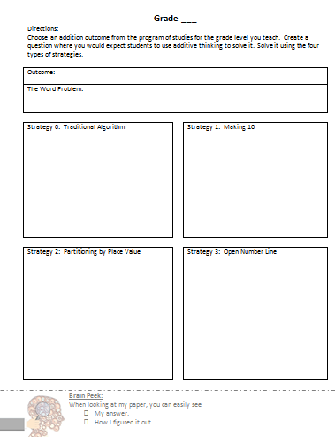
Activity Adaptation
Notes:
Handouts:
* Grade Level Outcome – multiple ways
Participants create a new word problem focusing on their grade level outcomes. They fill in each of the Strategy boxes, solving the question using the applicable strategy. This, in essence, becomes an answer key when assessing student work. Other strategies can be included by writing on the back of this page.
<Link for presenter downloading https://docs.google.com/document/d/1dJ682s801sX3wKVNr-_lls_bxyA-jl1yF51TsjAGkCg/edit?usp=sharing >

Slide 52
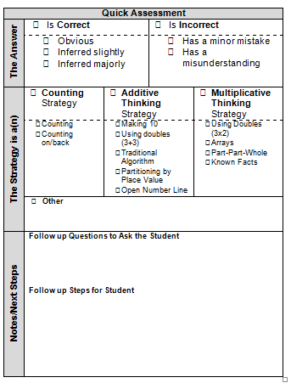
Quick Assessment
Notes:
The EMPLO group created a simple quick assessment tool to keep track of students’ strategies. It is meant to be used as a formative assessment tool that will guide our next steps with this particular student. This can be downloaded from the EMPL website in the Try This section. Let’s look closer at each of the sections.
<Link for presenter downloading: https://drive.google.com/open?id=0B-I5D9zVEge0RW1qQXdLa3RNeXM >

Slide 53
Quick Assessment
Notes:
First, we’ll look at the answer. Is it correct or incorrect? If it’s correct - was the answer obvious, inferred slightly or inferred majorly? If we have to infer, then we know to have a conversation with this student regarding communication of answers. If it’s incorrect, was it because of a minor mistake, or a mathematical misunderstanding? This will also guide further conversations with this student and the next lesson.

Slide 54
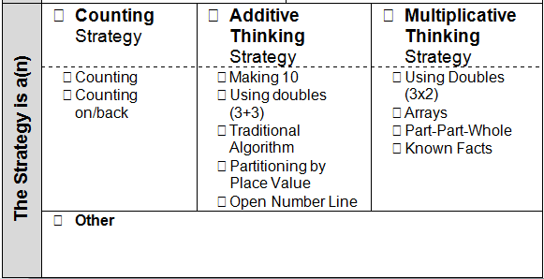
Quick Assessment
Notes:
Now, let’s find out what type of strategy the student is using - counting, additive thinking, or multiplicative thinking. There’s also space to write down a different type of strategy.

Slide 55
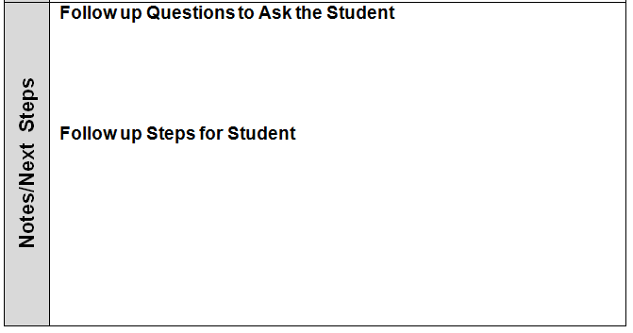
Quick Assessment
Notes:
There’s also space for us to write down notes and next steps. What follow up questions should I ask this student to clarify understanding? What are the next steps that I will take with this student to help them develop their additive thinking skills? When we continue to look at student work, you’ll see a version of this at the bottom of the screen. Ask yourself these questions when considering the student’s work.
You can download this from the Additive Thinking Try This Sections on the EMPL online learning guide.

Slide 56
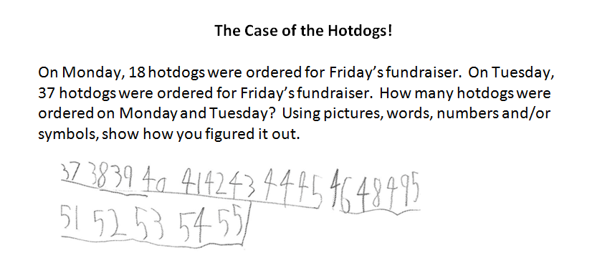
Quick Assessment
Notes:
Ask “How would you use the Quick assessment to assess this student?” <give time>
Ask “Did you notice anything about this students’ response <skipped #47 so must have counted #37 so fluked into the correct answer>

Slide 57
MODULE ALERT
Notes:
<Notes for presenter>
If you would like to add more Assessment exemplars:
Open the section “BI1: Extra Assessments”.
Choose an appropriate slide for all of your participants.
Replace this slide with the new slide(s) provided.

Slide 58
Quick Assessment: Assess Yours
Notes:
<Notes for presenter>
Use this module (BI1: Assess Yours) if you had teachers download one of the “Try This” off the website and administer to students ahead of time. During this time, they’ll go through their students’ work and use the quick assessments.

Slide 59
Instructional Practices
Number Talks
Open-ended questions
Use of manipulatives
Problem Solving
Notes:
There are many instructional practices you can and should be using to help students develop their ability to think flexibility with numbers.

Slide 60
Parent Communication
Notes:
Handout:
Parent Letter – Big Idea 1
The EMPL group created letters to parents to talk about each of the big ideas in equality, additive thinking and multiplicative thinking.
You can send this letter home with parents at the beginning of a unit, middle of a unit, end of a unit. However, if it’s at the beginning of the unit, then you are proactively providing parents with information about what they will be seeing their child doing.
It’s in word, so you can even make smaller versions and only send home one “Pop Quiz” question and answer (on the reverse side) so you are not overwhelming the parent.
Take a moment to read and answer a question, then read the matching response on the back.
Discuss.

Slide 61
Big Idea 2

Slide 62
Using Inverse Operations
Students use mathematical reasoning to build connections between inverse problems.
Addition is not just adding. It’s subtraction as well.
Notes:
Write out big idea and explain why it’s a big idea. Insert shortened version in title and longer version in body

Slide 63
Activity: Intro
827 + ____ = 1564
Solve this.
Share your strategy with a partner.
Notes:
Have participants solve this and share their strategies.

Slide 64
Activity: Intro
827 + ____ = 1564
How many of you added?
How many of you subtracted?
Notes:
Have participants solve this and share their strategies.

Slide 65
Activity: Counting Birds
There were 7 birds at the birdfeeder. A number of other birds flew in and there are now 15 birds at the feeder. How many birds flew in?
How would your students solve this?
Notes:
Let’s look at a simpler question you could use in a grade 1 classroom. Discuss how your students would solve this.
Let’s look at 2 different examples.

Slide 66
Activity: Counting Birds
One student’s solution
1
2
7
8
9
10
11
12
13
14
15
3
4
5
6
7
8
Notes:
The student starts at 7, maybe they draw circles, maybe they use manipulatives. <click>Then they add more circles or manipulatives until they reach 15.
<click> Then they go back and count how many manipulatives they added.
<after going through animations>
You’ll see some students counting on their fingers to get the answer. Please keep in mind that counting on is not actually an additive thinking strategy.

Slide 67
Activity: Counting Birds
Another student’s solution
7
1
2
3
4
5
6
7
8
9
10
11
12
13
14
15
6
5
4
3
2
1
Notes:
Another student might start by representing the 15. <click> Then they remove the 7 objects that represent the original amount. Now they can count what’s left.

Slide 68
Activity: Counting Money
Pat has $117 in her savings jar. She did some chores, placing the money in her savings jar. She now has $135. How much did she make for doing her chores?
Solve this.
Share your strategy with a partner.

Slide 69
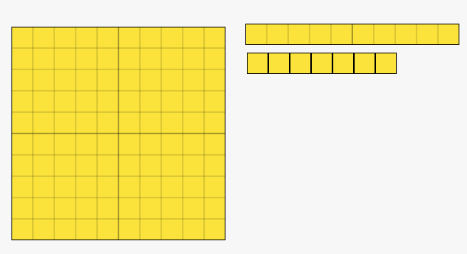
Activity: Counting Money
One student’s solution
Notes:
This student starts by building 117.

Slide 70
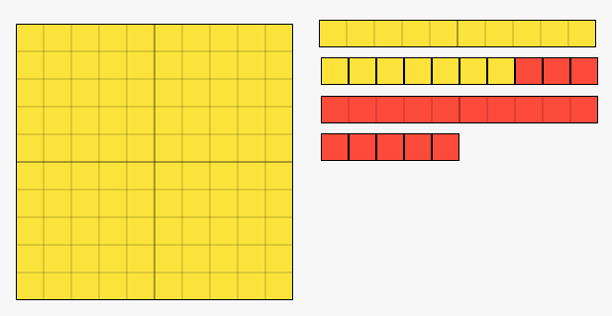
Activity: Counting Money
One student’s solution
3
10
5
Notes:
Then adds more until they have 135. <click> They count how many they added.

Slide 71
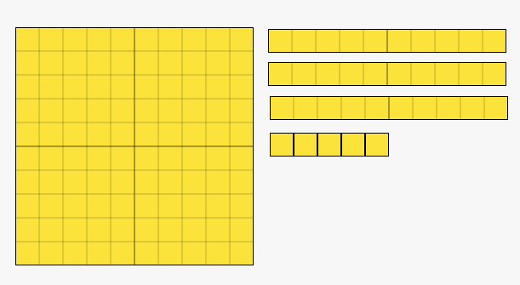
Activity: Counting Money
Another student’s solution
x
x
x
3
10
x
x
x
x
x
5
Notes:
They remove blocks until they only have 117 left. <click> They count how many they removed.

Slide 72
Open Number Lines
Notes:
If you did NOT do the open number line from Big Idea 1, insert the “BI2: open number line intro” Module.
If you did, just delete the folder image on this screenn and use it as a title page.

Slide 73
Activity: Open Number Lines
Solve 117 + ____ = 135 using
Open Number Lines
Show both ways!
117
135
Notes:
Participants show addition from 117 to 135.
Then, they create another open number line and show subtraction from 135 to 117.
Ask “Which way did you prefer?”
<Presenter Notes: You could change this to 1.17 and 1.35 when working with Grades 4-6 Participants>

Slide 74
Question Adaptation
How would you adapt this question to meet the needs of your students?
Notes:
“This question may not meet your (the participant’s) grade level needs.”
<Provide time for them to adapt the question for their grade level.>

Slide 75
Assessment
On your assessment, you provide the following question:
____ + 43 = 81
One student correctly solves it using addition. A different student correctly solves it using subtraction. They both show their work. How do you mark them?

Slide 76
Important Message
Students are meeting the outcome regardless of whether they solve a question using an addition or a subtraction strategy.

Slide 77
Important Message
The Program of Studies suggests that addition and its corresponding subtraction be taught at the same time.

Slide 78
Important Message
Grade 2

Slide 79
Important Message
Grade 2

Slide 80
Important Message
Grade 4

Slide 81
Important Message
Grade 4

Slide 82
Instructional Strategies
Number Tiles
Number Talks
Open-ended questions
Use of manipulatives
Problem Solving
Notes:
What are other ways you could use to develop this topic?

Slide 83
Open Number Lines
Notes:
Note to Presenter:
If you have time, you can add any of these modules with BI2: Instructional Practices here for further discussion.
Number Talks (BI2: Instructional Practices)
Open-ended questions
Use of manipulatives
Non-permanent surfaces
Problem Solving

Slide 84
Parent Communication
Notes:
Handout:
Parent Letter – Big Idea 2
The EMPL group created letters to parents to talk about each of the big ideas in equality, additive thinking and multiplicative thinking.
You can send this letter home with parents at the beginning of a unit, middle of a unit, end of a unit. However, if it’s at the beginning of the unit, then you are proactively providing parents with information about what they will be seeing their child doing.
It’s in word, so you can even make smaller versions and only send home one “Pop Quiz” question and answer (on the reverse side) so you are not overwhelming the parent.
Take a moment to read and answer a question, then read the matching response on the back.
Discuss.

Slide 85
Big Idea 3

Slide 86
Activity: Intro
Write a simple addition or subtraction word problem that you would use at your grade level.
We’ll come back to this question later.
Notes:
<Presenter note: We’ll come back to these questions later>

Slide 87
Sorting Activity
Read the 9 word problems found in your envelope.
Sort them into groups as you see fit.
Create categories for your sorts.
Can you find another way to sort them?
Notes:
<Presenter Note: Prepare the “BI3: Joining, Separating and Comparing Sorting Activity”. Do NOT mention the full name of the activity to participants as this will give some info away. Just refer to it as a sorting activity>

Slide 88
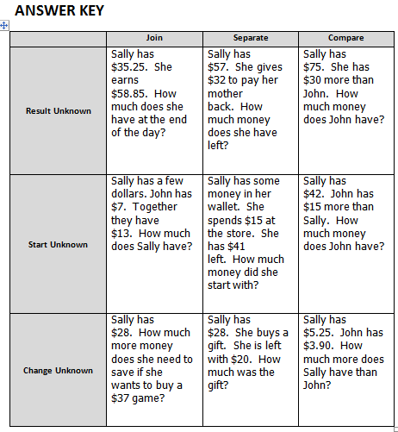
Sorting Activity
Where does the word problem you created earlier fit in the grid?
Notes:
Discuss the answer key.
<click> Ask participants to figure out where the question they wrote earlier would fit. Survey all participants to determine if there is a tendency or trend. (Most likely, most questions will fit in the Join Result Unknown box)

Slide 89
Sorting Activity
How could you modify your question to hit a different row?
A different column?
Notes:
Instinctively, teachers tend to create questions that belong in the top row under Join and Separate. Discuss the impact this will have on their teaching of word problems.
<click>Give time for participants to rewrite their question to hit a different row and then different column. They can share with elbow partners. In a longer workshop, you could give time for them to create a new question for each box. You could give them a blank template with only the row and column headers where they have space to write questions in.

Slide 90
Important Message
All of these question formats are equally important and students should be exposed to all of them in equal proportions, regardless of grade level.

Slide 91
Big Idea 3
Additive Thinking deals with questions where the start, change or result is unknown. It is joining, separating and comparing.

Slide 92
Important Message
Subtraction is not just “take away”. It is also comparison (how many more, how many less, what is the difference?)

Slide 93
Subtraction as Comparison
Renée ran a 64 km race.
Sandi ran a 23 km race.
How much further did Renée run?

Slide 94
Subtraction as Comparison
Typical Solution
-3
-20
41
44
64
So Renée ran 41 km more than Sandi.
Notes:
Student uses an open number line.
<click>Starts at 64.
<click>Jumps back 20 and lands at
<click>44.
<click>Jumps back 3.
<click> Lands at 41.
<click>and says that Renee ran 41 km more than Sandi.

Slide 95
Subtraction as Comparison
Another Solution
+40
+1
23
63
64
So Renée ran 41 km more than Sandi.
Notes:
However, we aren’t “taking away” Sandi’s km. We’re comparing how much further Renee ran. So we should look at it as <click> Renee running 64 km compared to <click> Sandi’s 23 km. We could start at the 64 or 23. Let’s start at 23. We add <click> 40 to get to 63 and then <click> 1 more to get to 64 so <click> Renee ran 41 km more than Sandi.

Slide 96
Putting it in Context
Generate a list of life situations where subtracting is actually comparing instead of taking away.
Remember to use these contexts in your math word problems.
Notes:
Give time to , brainstorm. Share.
Here are some other ideas: comparing salaries, heights, weight, distance you hit a ball, distances between cities (ex. Red to Edmonton vs Red Deer to Calgary. Which is further?)

Slide 97
Instructional Practices
Number Talks
Open-ended questions
Use of manipulatives
Non-permanent surfaces
Problem Solving
Notes:
There are many instructional practices you can and should be using to help students develop their ability to think flexibility with numbers.

Slide 98
Module Alert
Notes:
To include a process for teaching “comparing” as subtraction, moving between concrete, pictorial and symbolic representations, check out the module BI3: Comparing CPS

Slide 99
Parent Communication
Notes:
Handout:
* Parent Letter – Big Idea 3
The EMPL group created letters to parents to talk about each of the big ideas in equality, additive thinking and multiplicative thinking.
You can send this letter home with parents at the beginning of a unit, middle of a unit, end of a unit. However, if it’s at the beginning of the unit, then you are proactively providing parents with information about what they will be seeing their child doing.
It’s in word, so you can even make smaller versions and only send home one “Pop Quiz” question and answer (on the reverse side) so you are not overwhelming the parent.
Take a moment to read and answer a question, then read the matching response on the back.
Discuss.

Slide 100
Conclusion

Slide 101
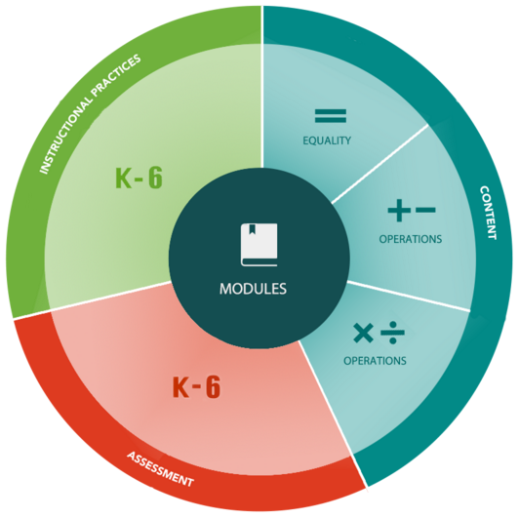
The Website
http://learning.arpdc.ab.ca

Slide 102
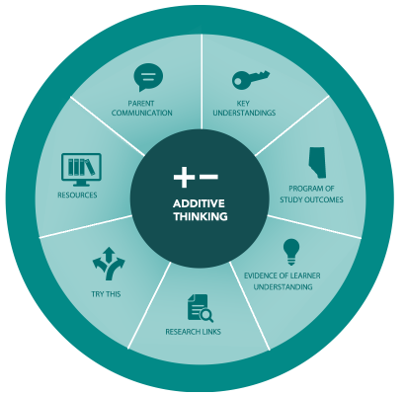
The Website
http://learning.arpdc.ab.ca

Slide 104
Our Partners
www.crcpd.ab.ca
www.learning-network.org
www. carcpd.ab.ca
www.nrlc.net
www.sapdc.ca
www.cpfpp.ab.ca
www.erlc.ca

Slide 105
Challenge Yourself
Download and implement a “Try This” activity in their classroom.
Notes:
<The website will have a Call to Action added to the “Try This” section.
“Call to Action: Choose one of the “Try This” tasks in your classroom. “Click Here” to share your experience and reflection in order to be entered in a draw for a $50 gift card.”
“Try This” Contest:
The Process:
Participants download and implement a “Try This” activity in their classroom.

Slide 106
Challenge Yourself
Use the “Quick Assessment” tool from the EMPL website to assess your students’ work.
Notes:
They use the “Quick Assessment” tool from the EMPL website to assess their students’ work.

Slide 107
Challenge Yourself
Using the entry form, teachers include 10 or more
examples of student work
the completed “Quick Assessments” for the above work.
Notes:
Using the entry form, teachers include 10 or more
examples of student work
the completed “Quick Assessments” for the above work.

Slide 108
Challenge Yourself
You will then be entered into a monthly draw for a $50 electronic gift certificate to your choice of:
Tim Hortons, Starbucks or Amazon.ca.
Notes:
Participants will then be entered into a monthly draw for a $50 electronic gift certificate to their choice of: Tim Hortons, Starbucks or Amazon.ca.

Slide 109
Challenge Yourself
You can complete a different “Try This” activity for a second monthly entry.
Entries are valid only for the month they were submitted.
Notes:
Participants can complete a different “Try This” activity for a second monthly entry.
Entries are valid only for the month they were submitted.
Select student work and assessments will anonymously made available within the EMPL website.
This slide will give participants a “Call to Action” task to try in their classroom>

Slide 110
Challenge Yourself
Participants download and implement a “Try This” activity in their classroom.
They use the “Quick Assessment” tool from the EMPL website to assess their students’ work.
Using the entry form, teachers include 10 or more
examples of student work
the completed “Quick Assessments” for the above work.
Participants will then be entered into a monthly draw for a $50 electronic gift certificate to their choice of: Tim Hortons, Starbucks or Amazon.ca.
Participants can complete a different “Try This” activity for a second monthly entry.
Entries are valid only for the month they were submitted.
Notes:
Presenter: You can just use this slide if you want, instead of the previous slides OR if printing handouts for participants, delete all of the previous slides for the handout version and just use this one.
<The website will have a Call to Action added to the “Try This” section.
“Call to Action: Choose one of the “Try This” tasks in your classroom. “Click Here” to share your experience and reflection in order to be entered in a draw for a $50 gift card.”
“Try This” Contest:
The Process:
Participants download and implement a “Try This” activity in their classroom.
They use the “Quick Assessment” tool from the EMPL website to assess their students’ work.
Using the entry form, teachers include 10 or more
examples of student work
the completed “Quick Assessments” for the above work.
Participants will then be entered into a monthly draw for a $50 electronic gift certificate to their choice of: Tim Hortons, Starbucks or Amazon.ca.
Participants can complete a different “Try This” activity for a second monthly entry.
Entries are valid only for the month they were submitted.
Select student work and assessments will anonymously made available within the EMPL website.
This slide will give participants a “Call to Action” task to try in their classroom>

Slide 111
Monthly Twitter Contests
Follow @EMPL_AB on twitter
Monthly question posted
Respond on Website
Enter in a draw for $10 electronic gift certificate to their choice of: Tim Hortons, Starbucks or Amazon.ca

Slide 112
Session Evaluation
Notes:
Have participants complete survey or indicate how they will be able to do so electronically.

Slide 113
Notes:
END OF PRESENTATION!

Slide 114
Making Ten Games
You can find some games in this section related to Big Idea 1: Making Ten
If you have time, choose one or more games that are grade level appropriate.
Move them to the appropriate location in the powerpoint and delete the placeholder slide.

Slide 115
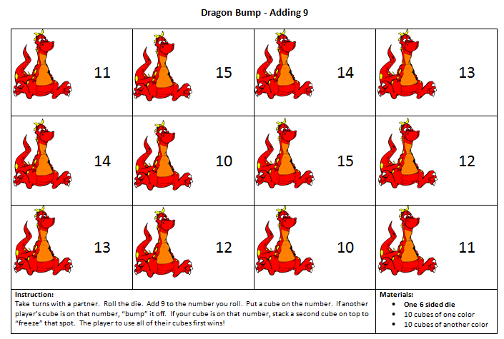
Practicing: Making Ten
Notes:
Option 1:
Play “Dragon Bump – adding 9 or 8”
<need 6 or 9 sided dice>
<Link for presenter downloading: https://drive.google.com/file/d/0B-I5D9zVEge0X0p2Qkp6Q3hsakk/view?usp=sharing>

Slide 116
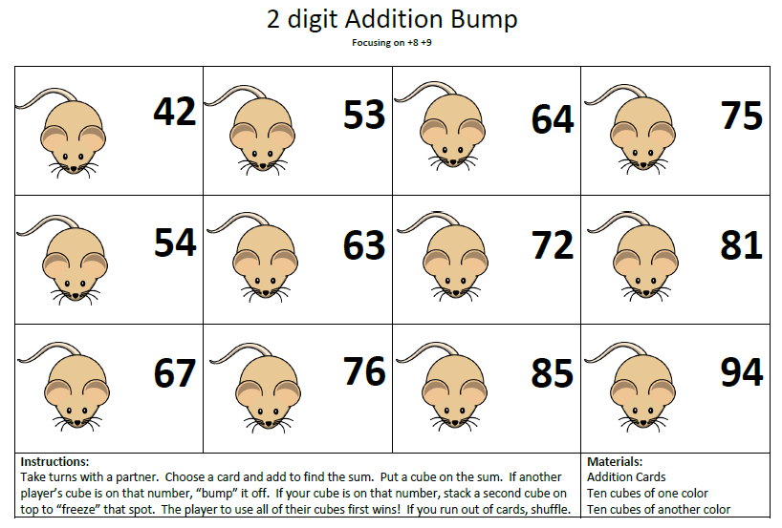
Practicing: Making Ten
Notes:
Option 2:
Play “Mouse Bump – adding 2 digit numbers ending in 8 or 9”
<Link for presenter downloading: https://drive.google.com/file/d/0B-I5D9zVEge0X0p2Qkp6Q3hsakk/view?usp=sharing>

Slide 117
Open Number Line Games
You can find some games in this section related to Big Idea 1: Open Number Lines
If you have time, choose one or more games that are grade level appropriate.
Move them to the appropriate location in the powerpoint and delete the placeholder slide.

Slide 118
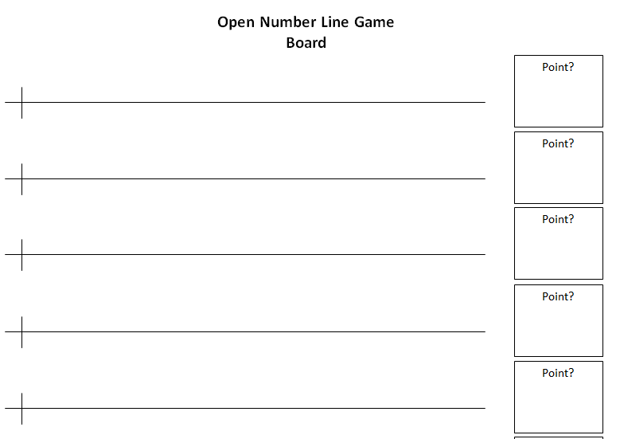
Game: Open Number Line
Notes:
<Notes for presenter>
Materials:
2 six or nine sided dice
Open Number Line Board Game

Slide 119
BI1: Extra Assessments
You can find some more assessments that participants can use to practice using the “Quick Assessment” related to Big Idea 1.
If you have time, choose one or more exemplars that are grade level appropriate.
Move them to the appropriate location in the powerpoint and delete the placeholder slide.

Slide 120
INSERT THIS IN Assessment MODULE

Slide 121
BI1: Assess Yours
Use the “Quick Assessment” tool to assess your students’ work.
Notes:
Materials:
* Extra Quick Assessments
If you have asked participants ahead of time to download and administer (but not assess) some of the Additive Thinking “Try This” questions from the EMPL website, use this slide in order to give them time to assess their students’ work and ask for support in regards to “questions to ask students” and “next steps”.

Slide 122
BI2: Number Tiles
If you have time, choose one or more activities that are grade level appropriate.
Move them to the appropriate location in the powerpoint and delete the placeholder slide.

Slide 123
Intro: Open Number Lines
23 + 41
+10
+10
+10
+10
+1
23
33
43
53
63
64
+40
+1
23
63
64
Notes:
Build 23 and then add 41 to the end.

Slide 124
Intro: Open Number Lines
23 + 41
+20
+3
41
61
64
Notes:
Build 23 and then add 41 to the end.

Slide 125
Intro: Open Number Lines
64 - 23
-3
-20
41
44
64

Slide 126
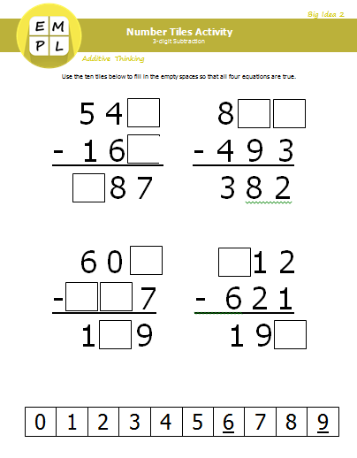
Activity: Number Tiles
Use the numbers
0-9
to fill in the questions correctly.
Notes:
Handout:
Number Tiles Activity
Optional: Scissors
<Presenter: Photocopy one handout per group and either provide one set of ”0-9” number tiles or photocopy and cut out the “0-9” number tiles>
After the activity, discuss “How does this help students develop this big idea?”

Slide 127
Module Alert
If there’s time, have participants create their own version of the Number Tiles activity using an outcome from their grade level. You can find a slide for this in BI2: Number Tiles Extension

Slide 128
Number Tiles Extension
Create a Number Tiles activity that matches one of your grade level outcomes.
Give to a partner to try / check your work.
Notes:
Suggest that students should also create these activities as well.

Slide 129
Teaching Comparison
Lisa goes to the zoo and sees 5 monkeys and 8 bananas.

Slide 130
Teaching Comparison
5 monkeys
?
8 bananas

Slide 131
Important Message
Students need to be confident in
one-to-one correspondence
Notes:
Beginning Understanding: counting objects one by one
Next Level: (Could even be called one for one correspondence) Comparing 2 piles of objects, removing one from each pile at a time until there are no more pairs left, in order to determine which pile has more.

Slide 132
Teaching Comparison
5 monkeys
?
8 bananas

Slide 133
Teaching Comparison
5 monkeys
?
8 bananas

Slide 134
Teaching Comparison
Smaller Quantity
Difference
Large Quantity
Notes:
If we remove the numbers and just look at generic “quantitities”, we can move beyond simple numbers and solve much more complex questions, including algebra.
Can you represent the relationship among the larger quantity, the smaller quantity and the difference as mathematical equations?

Slide 135
Teaching Comparison
Larger quantity – Smaller quantity = Difference
Smaller quantity + Difference = Larger quantity
Larger quantity – Difference = Smaller quantity

