Slide 1
Competencies
Early Learning Programs are a means of advocating for children as active meaning-makers of the world around them.
Prepared by SAPDC Early Learning Collaboration based on work by Judy Hillier and Joanne Stockman,
MHSD76 and their incredible teachers
Notes:
The foundation for strong and healthy children is set in the early years. Therefore, our first and most important goal is to inspire delight, curiosity, and inquiry in the classroom. Doing so has been proven to build intrinsic motivation and a long-term love of learning. These are the greatest gifts our teachers can give a child in preparation for their primary school experience.

Slide 2
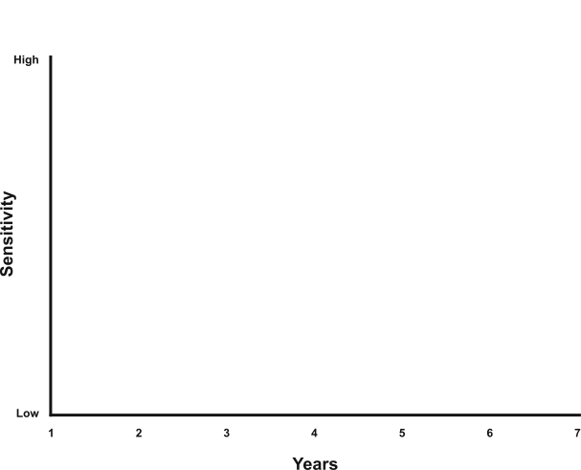
Sensitive periods
in early brain development
Vision
Hearing
Habitual ways of responding
Language
Emotional Control
Symbol
Peer social skills
Numbers
Graph developed by Council for Early Child Development (Nash, 1997; Early Years Study, 1999; Shonkoff, 2000.)
Notes:
We know a great deal more about the importance of the early years thanks to the explosion of research since the 1990s. The brain is extremely sensitive to environmental influences, both physical and social, at this time. A child’s early experiences shape the structure of the brain as it adapts to its environment. The quality of these early experiences, positive or negative, lays the foundation for all later development. And it affects how well children will do at school and at work, self-confidence, ability to cope, behaviour, relationships, and lifelong physical and mental health.
This slide shows the sensitive periods in early brain development. For example, the years between three and four are a highly sensitive period for the development of peer social skills. Each stage of brain development is affected by previous development and becomes increasingly complex. The brain acquires the tool kit it needs for all later development and learning during the early years. The potential to affect positive change during this time is enormous. A positive early start is essential to a child’s future success and well-being.

Slide 3
An Educated Albertan
Notes:
An educated Albertan is an engaged thinker and an ethical citizen with an entrepreneurial spirit. The Ministerial Order on Student Learning sets the Goals and Standards applicable to the Provision of Education in Alberta. The foundation for developing educated Albertans is established in the early years coinciding with the sensitive periods in early brain development. The focus for early education is learning how to learn and the illustrated competencies provide a vehicle for developing a child’s experiences through play. These foundational skills are critical for other learning areas and are built through developmentally appropriate, hands on, playful experiences. If our goal is about having successful learners in the future, it seems we should give the right start. The next slides will show the competencies in action within our Early Learning Programs.

Slide 4
Problem Solving
Notes:
When children are engaged in play they are challenged to identify and solve complex problems.
Loris Malaguzzi, the Founder of the Reggio Emilia Schools in Italy said, “Once children are helped to perceive themselves as authors or inventors, once they are helped to discover the pleasure of inquiry, their motivation and interest explode.”

Slide 5
Collaborating
Notes:
Children are provided with materials and presented with the opportunity to identify situations or challenges that would benefit from collaboration. Children between the ages of one and five do not learn because they are taught. They learn as a result of their own doing…through actions, relationships, inquiries, opportunities and repetition.
They also have the opportunity to confidently apply a wide range of literacies including reading, writing, math, technology, languages and media.
Our teachers become research partners with children, seeking answers to questions and supporting investigation. Our school is their laboratory, offering the materials and tools to inspire each child.

Slide 6
Manage Information
Notes:
Children are encouraged to apply strategies as they creatively and effectively process information for a range of purposes. We know that the “academics” will come more easily later if a broad foundation is built in the early years.
Learning is a lifelong endeavor and children prepare for career opportunities as they commit to health attitudes and actions. When children experience delight and a sense of success during these activities, their brain cells establish permanent “connections” between the activity and the feelings of delight and success it inspires.

Slide 7
Demonstrate communication skills
Notes:
Play encourages collaboration and teamwork as children develop their communication skills. We value the development of curiosity and social competency in the early years.
Countries such as Finland and Singapore, which are consistently near the top in international rankings (PISA scores), value a social-competency model, holistic development, and a play-based structure over academics in the early years. This demonstrates the fact that social skills and expressions of communication are of paramount importance. In fact, while mathematical skills may be similarly developing, when students start algebra there is a surge in success for students who spent the most time in block play.

Slide 8
Personal Growth and Well Being
Notes:
Children draw on personal and community resources, interact with others and reflect on their experiences. educators of young children have a unique opportunity to allow children to pursue learning activities at different paces, using different materials, and with entirely different guiding questions and outcomes. Teachers must understand how and what children learn and how to recognize moments when they can support children by asking a provoking question, providing a tool, sharing a story, helping seek and answer and guiding their learning as it emerges naturally.

Slide 9
Demonstrate global and cultural understanding
Notes:
Children appreciate how individuals or groups with diverse social and cultural identities collaborate to strengthen communities. They learn to respect and value diversity and inclusion.

Slide 10
Think critically
Notes:
Provocations set the stage for children to engage in critical thinking, capturing an idea and drawing conclusions. Our goal is to allow children to develop long-term projects, deep concentration and the ability to redirect themselves by seeking another activity that will inspire them. This is fundamental to development of the positive associations that will support learning throughout their lifespan.

Slide 11
Create and Innovate
Notes:
Children are encouraged to take risks, imagine possibilities to transform ideas into actions. Our teachers become research partners with children, seeking answers to questions and supporting investigation. Our school is their laboratory, offering materials and tools to inspire each child.

Slide 12
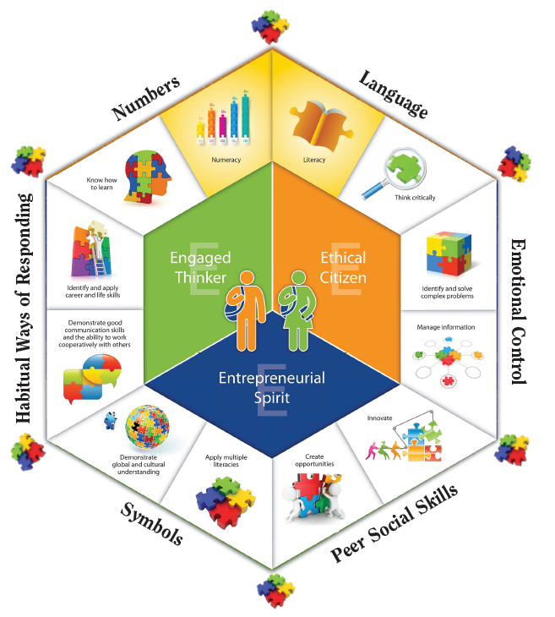
Under Construction
Notes:
The critical periods of brain development that occur in the early years are essential to developing educated Albertans. This graphic provides a visual that shows how they wrap around the Inspiring Education model to support ongoing learning.

Slide 13
I will understand
Problem solving, self-exploration, decision making, number relationships, structures, complex vocabulary, healthy living, cause and effect, creativity, imaginative thinking, and my natural world
when I am big because of my early experiences that inspired delight, curiosity and inquiry.
Unknown
Notes:
The image we hold of children shapes our interactions with them and influences the environments and the tasks we create for them.

