Slide 1
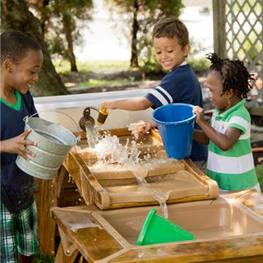
Early Learning Across Alberta Collaboration
John Loree
Executive Director
Cynthia Parr
Learning Facilitator (West)
Vicki Glass
Learning Facilitator (East)

Slide 2
Territorial Acknowledgement

Slide 3
Welcome
“Professional learning communities support a culture of self-improvement through the identification and sharing of best practices of highly effective teachers, mentorship, and peer collaboration.”
The Daggett System for Effective Instruction

Slide 4
Organization of the Day
9:00 - 9:45 Introduction to the Day
9:45-9:50 Wellness Activity
9:50 - 10:50 Topic A or Topic B
10:50 - 11:00 Break
11:00 - 12:00 Topic C or Topic D
12:00 - 12:45 Lunch
12:45 - 1:45 Topic E or Topic F
1:45 - 2:00 Break
2:00 – 2:45 Open Spaces Topics
2:45 – 3:00 Gallery Walk
3:00 – 3:30 Wrap Up

Slide 5
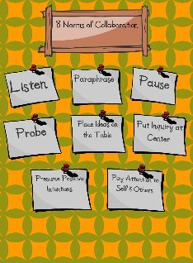
Norms of Collaboration
Everyone has wisdom.
We need everyone’s wisdom.
Everyone will hear others and
everyone will be heard.
Notes:
Introductions of people at your table
Keep the conversation moving, progressing, and evolving
Ensure everyone gets a chance to speak
What are you doing well as related to the topic?
What are your questions or concerns related to the topic?
What are your next steps?

Slide 6
Great Beginnings
A Multi-Jurisdictional Project
Facilitated by SAPDC

Slide 7
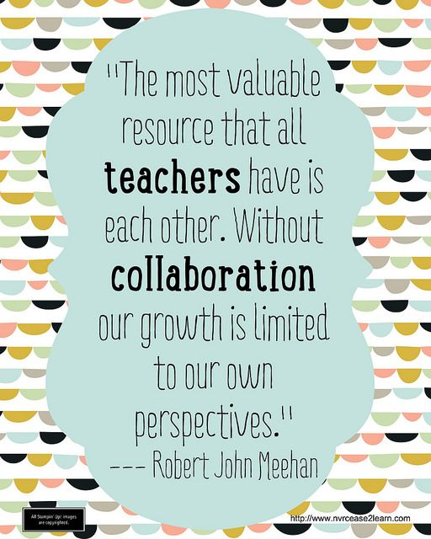
Collaboration
Notes:
The Early Learning Advisory Committee is a group of educators who are passionate about Early learning and the important foundations it provides to ensuring lifelong success.
Given the myriad of competing priorities that instructional leaders are juggling, how could we ensure that the area that we truly believe in receives appropriate support?
Believing that “The best way to predict the future is to create it” , this dedicated group, began working collaboratively on this project 5 years ago.
The project has included 10 partner jurisdictions and community stakeholders like the U of L and the Early Childhood Development Mapping Coordinator, and has resulted in a resource that will support administrators in their instructional leadership roles as they work with teachers, parents and the community.
Our goals are to build understanding of the unique nature of early learning programs, (Pre-K to Gr. 3) and
promote evidence based practices to ensure children are provided with a rich and stimulating program focused on total child development.

Slide 8
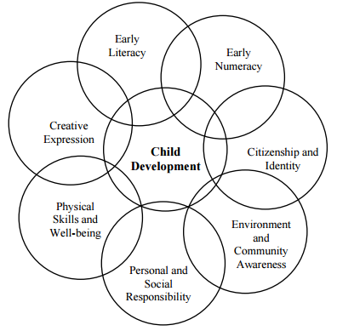
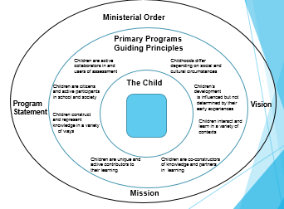
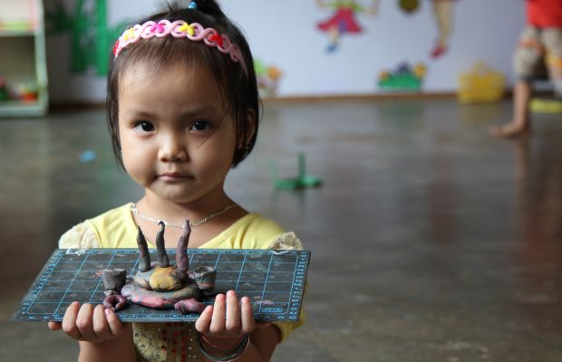
Influencing Practice
Developing a shared understanding
Vision: Collect/create resources that support
Teachers
Administrators
Co-ordinators and
Parents/Community
in understanding the importance of holistic, play based programming for Early Learners (Pre-K to Gr. 3).
Notes:
Vicki
We know that the early years are foundational for future learning, health and general well-being. Ensuring that young children are provided supportive programming that addresses all areas of development appropriately is imperative for maximizing their potential.
The SAPDC Early Learning Advisory Committee embarked on a project to influence practice through supporting teacher professional learning which grew to supports for all stakeholders. As with any great project, we continue to add supports in response to identified needs in the field.
What began as a project to support teachers who are providing Early Learning Programs often without the support of an Early Childhood Education background, keeps growing.
Administrators were also looking for support in understanding why early years settings are so unique, and wondered how they could support teachers in these crucial early years. Overextended school administrators, in their role of instructional leaders, also often without an Early Childhood background asked for condensed documents that might help them understand what to look for when recruiting early years teachers and what kinds of best practices should be evident in the classroom and the activities provided.
Many teachers who are implementing research informed practice are often feeling pressured to incorporate more of a narrowed academic focus, as colleagues appear to be responding to the increasing challenges in the classroom with a “push down” of expectations, or at least a questioning of play-based practices.
Many parents, trustees and community members are unsure of what might be appropriate expectations for young children.
Many co-ordinators of Early Learning Programs were appreciative of any co-ordinated support, that could help them influence practice, given the myriad of responsibilities these positions typically entail.
The dedicated professionals of Southern Alberta decided that collaboratively they could make a difference. By sharing their expertise and building on that of others, they are creating a support site for Early Learning, that has the potential to build both capacity and understanding.

Slide 9
Key Understandings
Discussion Questions
Links
Learning Guides
Notes:
Michelle
Our work started with a three part professional development series that was focused on bringing the neuroscience research into the early years classroom. Researchers from the U of L shared their expertise around brain development, rough and tumble play and maximizing potential through enriched environments. Teachers from the field shared how they embed the research findings into their practice. A follow-up project was the development of video supports to provide a visual of inclusive supports, the environment and emergent curriculum. The neuroscience department at the University of Lethbridge and teachers in the field collaborated to create the video series supported by SAPDC.
We are going to have a quick look at a clip from the Emergent Curriculum video - this conversation was with Melissa Gogolinski a principal of a Pre K to Grade 3 school in Redcliff, Alberta

Slide 10
Poster Project
Print your own!
https://goo.gl/yN5ZJz
Link to poster order form - https://goo.gl/forms/GLyAlfyut772Uod33
Notes:
The team created two sets of posters to provide a visual for learning in the early years. The first set includes four common types of play that are found in all early learning environments including art, construction, dramatic play and physical literacy. The second set of posters were developed around the seven learning areas outlined in the Kindergarten Program Statement: early literacy ,early numeracy, creative expression, personal and social responsibility, environment and community awareness, citizenship and identity, physical skills and well being. The Guiding Principles were included along with a visual of the competencies and curriculum outcomes to provide the reader with a quick reference for making connections. Photographs were included with “I Can” statements connected to curriculum to show learning in action.
Templates have been provided to personalize posters that include pictures of the children in your school. Note - you will need to choose photos that fit the spaces on the template.
The PDF will be shared.
Posters that you may wish to use in your classroom or on your bulletin board have also been included. If you wish to substitute your own photographs, you may use the placeholder version. A list of suggested photographs you might use is included.
Links to sites that provide videos, webinars and articles for teacher professional learning are included here.

Slide 11
Powerpoint Presentations
Notes:
Joanne
Currently two PPt Templates and speakers notes are prepared:
Ensuring Success in the Early Years - An Excellent Start to Learning - purpose is to support early learning, understanding with teachers, parents, administrators, community partners to ensure that our youngest citizens have a opportunity to build strong foundations that will ensure their success now and in the future.
Competencies in Early Years - this powerpoint identifies the competencies and provides visuals and an explanation of what they look like in the early users.
We have generic pictures from the internet inserted into one template so that it will be ready to use or customize
Early Learning Supports Project - this is a powerpoint that was developed to share the work going on in Alberta and is also available on the website
You will also find two PowerPoints, both with speaker notes. The Medicine Hat Ensuring Success In The Early Years PowerPoint may be used as an exemplar. The SAPDC version has placeholders so you can insert photographs and statistics from your own community and school. There is also a PowerPoint and speaker notes which explains Alberta Education’s Competencies with regards to Early Childhood Education. This too has placeholders for your pictures. (An exemplar from Medicine Hat has been provided for this topic, too). WE ARE IN THE PROCESS OF REVISING THIS TO REFLECT THE 8 COMPETENCIES

Slide 12
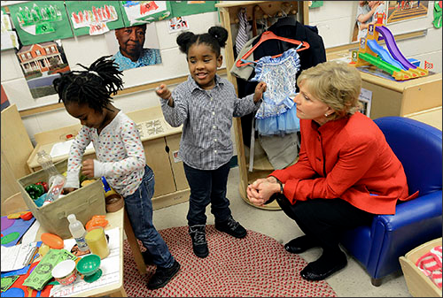
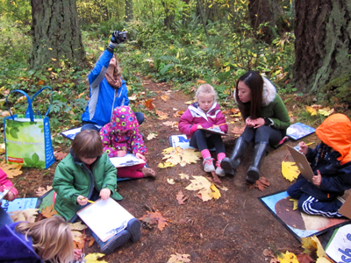
Administrators/Instructional Leaders
What kinds of learning opportunities respond to the needs of this particular group of children?
What are the indicators of a quality program that should be evident in a Pre-K to Grade 3 environment?
What kind of interactions am I looking for from the adults in this unique learning environment?
How are the adults scaffolding the learning?
Notes:
Michelle
In this section you will find materials that might support your instructional leadership in determining the skills and knowledge you will be looking for in an early learning teacher or assistant in your school. There are possible interview questions you could use, with suggested responses and a draft document which outlines some key characteristics to look for in an early learning teacher. In the programming folder you will find a document that will provide information regarding what planning looks like in an early learning classroom, along with an explanation of what emergent curriculum is. You will also find a checklist of “look fors” in an early learning classroom. A list of helpful Alberta Education links is included in this section. Links to some age appropriate assessment resources have been included as well as a link to the Alberta Assessment Consortium’s Early Learning Assessment Project.

Slide 13
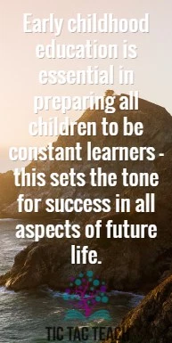
Additional Supports for
Educators and Families
Powerpoints
Webinars
Learning guides
Videos
Links
Notes:
In this section along with some of the videos we have mentioned, you will also find webinars that you can use to support professional learning. There are professional supports links to other resources such as the Alberta Family Wellness initiative and the Galileo network. Here you will find examples of pamphlets from other jurisdictions (Ontario) and also an outline of a binder which you may wish to make for your own Instructional Leaders. An example of the one that Medicine Hat #76 assembled and used to provide regular in-services to their school and district administrators is here for you to have a look at.
This is provided as an exemplar of one that you may wish to develop in your jurisdiction.

Slide 14
Website
Sapdc.ca
Learning Facilitators
Check It Out
Learning Portal
https://learning.arpdc.ab.ca/course/view.php?id=355
Notes:
Joanne
We have been exploring the website already - you may have noticed that the resources are categorized into four areas:
Administrators
Teachers
Parents
Other Resources
You will find many of the resources in multiple sections as they are applicable to a variety of areas.

Slide 15
ARPDC Resources
sapdc.ca
Resources

Slide 16
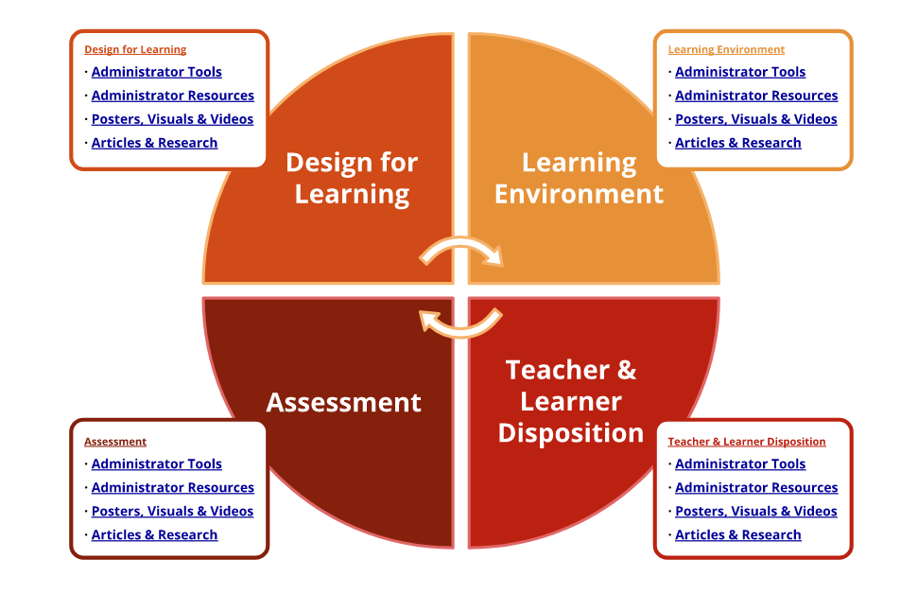
Link

Slide 17
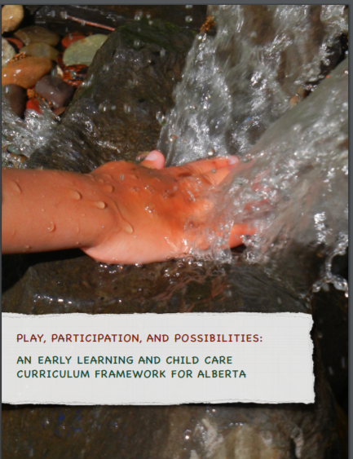
Play, Participation, and Possibilities Framework
CMEC Early Learning and Development Framework
Co-constructing Curriculum
Co-learners
Co-researchers
Co-imaginers
Image of the Child
Guide for Reflective Thinking
Notes:
2012- Statement Importance of Play 2014 -CMEC Early Learning and Development Framework Defines Early Learning 0-8 - AB 0-5- which includes ECS/Primary Programs includes 0-8
2014 AB- 9 Provinces -http://www.oise.utoronto.ca/atkinson/UserFiles/File/Resources_Topics/Resources_Topics_CurriculumPedagogy/Review_of_Early_Learning_Frameworks_in_Canada-all.pdf
Invited each province to create own framework
AB’s based on NB, Australia and many others
Rather than implementing a curriculum, we began to think about children, families, and educators in early childhood programs participating together in co-constructing curriculum
In order to maintain an image of the child as a mighty learner and citizen, educators must take on new roles—as co-learners, co-researchers, and co-imaginers of possibilities alongside children and their families and with/in community
image of the child as a strong, resourceful, capable learner, recognize each child as a mighty learner?
Moving from thinking of curriculum as something that is done to children toward curriculum as a way of thinking about what children are doing in relationships of care, play, learning, and development.
The UN Convention on the Rights of the Child inspires our ongoing efforts to consider children’s participation as citizens in early childhood communities.
Acknowledging that young children are already co-constructing curriculum and that educators are already making curriculum decisions is at the heart of curriculum meaning making. Play, Participation, and Possibilities is a guide for reflective thinking and an interpretive tool for imagining possibilities, one that helps each of us to see and think about children as mighty learners and citizens always and already
Each document was locally constructed using a variety of approaches. Their uses vary. In Quebec, Prince Edward Island and New Brunswick, the ELF is the designated guide for early childhood settings. BC’s framework is required for its school-based Strong Start Centres. PEI and NB mandate certified training in their respective frameworks. While Ontario’s ELF is not mandated, the City of Toronto has tied its approaches to its quality assessment criteria. Despite their different paths to development, the frameworks host many similarities. Families and communities are viewed as partners who strengthen the program’s ability to meet the needs of young children. Respect for diversity, equity and inclusion are embraced as essential for optimal development. A planned curriculum, anchored by play, is recognized as best able to capitalize on children’s natural curiosity and exuberance to learn. Most jurisdictions continue to add to their frameworks with resources to enrich programming.

Slide 18
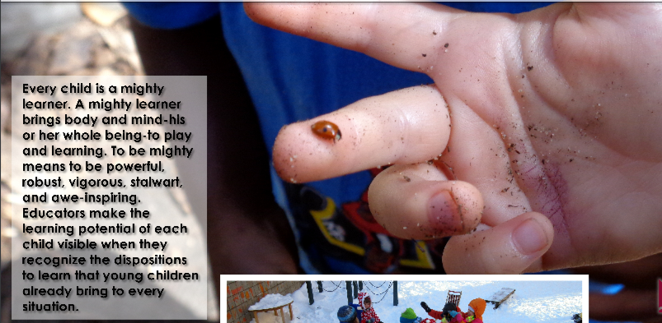
Reflect on practices
Documentation
Guide
Planning
Notes:
As outlined in section 3.1 Holistic Goals, there are many ways to use Play, Participation and Possibilities to support your daily work with young learners.
You may use the reflective questions to examine your current practices.
Educators may use the curriculum framework holistic goals and dispositions to learn as a lens to interpret children’s experiences and then share their interpretation and documentation with other team members and children’s families.
The curriculum framework may act as a guide to a way of being with children as a co-learner, co-researcher and co- imaginer of possibilities.
It may help educators to engage in a co- inquiry process and curriculum meaning making to support their emergent curriculum planning.
Currently the curriculum framework is not mandatory. It is available free of charge to any educator who wants to voluntarily engage with the ideas and concepts as a way to support their evolving practices, planning and provisions for young children’s learning.

Slide 19
Future
Curriculum
Future Curriculum
Notes:
Subject Introductions describe the spirit and nature of each subject and explains why the subject is learned.
• Scope and Sequences outline what students will learn (scope) and when they will learn it (sequence). • These have been validated by AB Ed
Essential Understandings or big ideas, are broad statements that frame what students will learn.
• Guiding Questions help create engaging and challenging learning opportunities for students.
• Subject Learning Outcomes indicate what students are expected to know, understand, and be able to do in each subject and grade. They include subject content and skills and are built on a foundation of literacy and numeracy.

Slide 20
Notes:
A conceptually organized, or concept-based, curriculum departs from “traditional” curriculum, which is based primarily on topics, skills, and facts.
A concept-based curriculum brings in another dimension because it includes a focus on the transfer of the important conceptual ideas of a discipline…
When key concepts (ideas) of a discipline become the “drivers” for learning, we lead students to deeper understandings that transfer across different situations (pp. 6–7 ). (Lanning, L.A., 2013. Designing a Concept-based Curriculum for English Language Arts. Thousand Oaks, CA: Corwin)

Slide 21
Wellness Break- Norah Fines, AHS

Slide 22
Overarching Questions Discussion 1
Topic A: Programming Approach | Topic B: Strengths and Challenges
Introductions | Introductions
What early learning programming structures do you currently have in place? | What is working well in Early Learning in your area?
How do we provide optimal early learning programming in today’s diverse classrooms? | What challenges are you facing?
How is Reggio inspired programming reflected in your Early Learning programs? | How can we work together to overcome these challenges?

Slide 23
Overarching Questions Discussion 2
Topic C: Supports and Services | Topic D: Early Literacy and Numeracy
Introductions | Introductions
How are you addressing mental health, emotional and behavioural needs? | What is working well in Early Literacy/Numeracy in your area?
What are the responsibilities of educational assistants in providing for student medical needs? | What challenges are you facing?
What do OT/PT and SLP interventions look like in your programs? | How can we work together to overcome these challenges?

Slide 24
Overarching Questions Discussion 3
Topic E: Play Based Learning | Topic F: Parent and Community Awareness
Introductions | Introductions
How are you promoting development through play? | How do we advocate with families for appropriate earling learning practices?
How do we support risky play in our classroom communities? | How are we advocating with the community on the importance of appropriate early learning programming?
How are you incorporating outdoor play in your learning environments? | How can we work together to enhance community awareness?

Slide 25
Open Spaces Topics (2:00 to 2:45)
Group 1 - Roles and Responsibilities
Group 2 - Applications for Program Unit Funding (PUF)
Group 3 - Early Development Instrument (EDI)
Group 4 - Family Oriented Programming (FOP)
Group 5 - English Language Learners (ELL)
Group 6 - Education for Reconciliation (EFR)
Group 7 - Supporting Inclusive Early Learning Environments
Notes:
Alberta completed the province-wide collection of Early Development Instrument (EDI) data in February/March 2016.
A second province-wide collection is being planned for 2019. (AB ED Website)

Slide 26
Gallery Walk
2:45-3:20
Reflection on the Day
Exit Slips

Slide 27
Exit Slips
What did you appreciate about gathering together
today to discuss Early Learning?
What was your biggest take away from today?
What wonderings do you still have?
What recommendations would you make for a
future early learning day?
Notes:
Hang up a few large post its around the room with the above prompts

