Slide 1
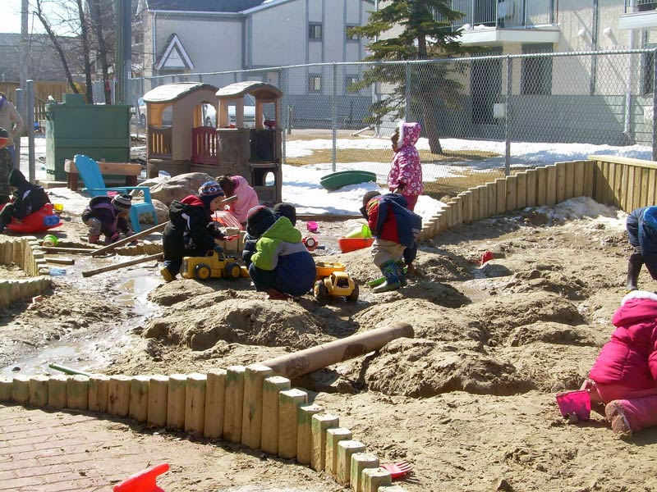
Early Learning Supports Project
Prepared by the SAPDC Regionals
2014-2016
Notes:
https://www.google.ca/search?q=images+of+play+in+kindergarten&espv=2&biw=935&bih=646&tbm=isch&imgil=cAWJXj8JyYoO2M%253A%253BqugIq-mwSU8DvM%253Bhttp%25253A%25252F%25252Fearlylearningcentral.ca%25252F%25253Fpage_id%2525253D1192&source=iu&pf=m&fir=cAWJXj8JyYoO2M%253A%252CqugIq-mwSU8DvM%252C_&usg=__16Yeld1EBwqWjKzJLNrBXhh6IBg%3D&ved=0ahUKEwix2MmQ1aDLAhUDKGMKHdtSD0EQyjcILg&ei=7ijWVrGpI4PQjAPbpb2IBA#imgrc=N7sM9x1-rrWJhM%3A

Slide 2
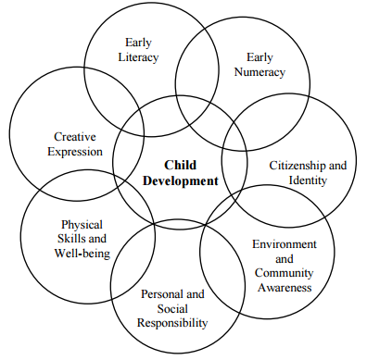
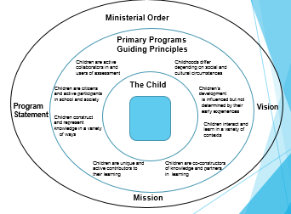
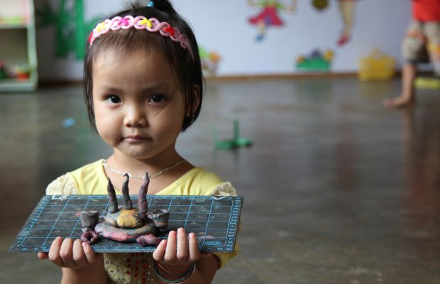
Influencing Practice “Those who know better-do better”
Developing a shared understanding
Vision: Collect/create resources that support
Teachers
Administrators
Co-ordinators
Parents/Community
in understanding the importance of holistic,
play based programming for Early Learners.
Notes:
The early years influence development in future learning, health and general well-being. Ensuring that young children are provided supportive programming that addresses all areas of development appropriately is imperative for maximizing their potential. The SAPDC Early Learning Advisory Committee identified the following needs:
Many teachers providing Early Learning Programs are doing so without the support of an Early Childhood Education background. Those who are implementing research informed practice are often feeling pressured to incorporate more of a narrowed academic focus.
Many administrators are also looking for support in understanding why early years settings are so different, and wondering how they could support teachers in these crucial early years.
Many colleagues appear to be responding to the increasing challenges in the classroom with a “push down” of expectations, or at least a questioning of play-based practices.
Many parents, trustees and community members are unsure of what might be appropriate expectations for young children.
Many co-ordinators of Early Learning Programs were appreciative of any co-ordinated support, that could help them influence practice, given the myriad of responsibilities these positions typically entail.
The dedicated professionals of SE Alberta decided that collaboratively they could make a difference. By sharing their expertise and building on that of others they are creating a support site for Early Learning, that has the potential to build both capacity and understanding.

Slide 3
What has Evolved
Compilation of Quality Resources
Alberta Education
CMEC, ECEC, AAC
Models of District Documents and Resources
Evidence of Exemplary Early Learning Practices
Environmental Supports –the Third Teacher
Adaptable materials
Visual Supports
Presentation Materials
Posters
Assessment Supports
On-line Professional Learning Opportunities
Notes:
Still in the process of creating supports for understanding of this site and how it might be utilized with/by various stakeholder groups

Slide 4
Generic Powerpoints and poster templates will allow local customization
Notes:
Currently two PPt Templates and speakers notes are prepared:
Ensuring Success in the Early Years
Competencies in Early Years
We plan to have generic pictures from the internet inserted into one template so that it will be ready to use or customize
Posters will be linked to developing curricular outcomes through play.
These have been created with FOIPed pictures and will be posted in a printable form so that informative displays in parent waiting areas can be displayed.
The PDF will be shared.
(Still investigating printing options- may make them available at cost through SAPDC ?)

Slide 5
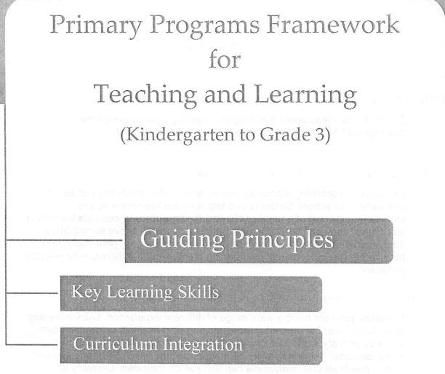
School Administrator Support
Sometimes school administrators do not have a background in Early Childhood Education – but they do have early childhood programs in their schools
Notes:
One goal was to provide the administrators with tools they might use to help them as they support the teachers in their schools and the learning of children. As the group reviewed some of these current documents, they realized that this might also be supportive of teachers who are new to ECS.
To support teachers as they help parents to understand the value of play, posters have been commissioned and are available in PDF format. These will demonstrate the Literacy, Numeracy and Competency connections to play in the early years.

Slide 6
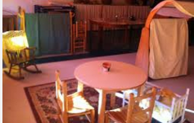
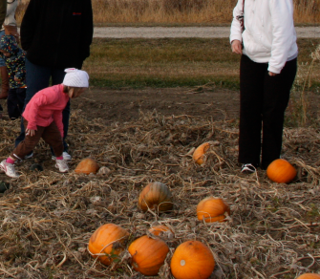
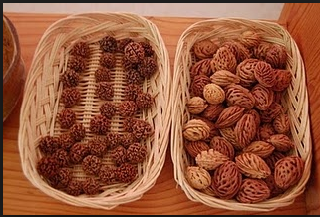
Administrator “Look Fors”
Notes:
Look fors have also been developed. The idea is that an administrator would have a list of some best practices and could then determine that these are happening in their programs. The look fors come as a quick checklist as well as a longer list that has illustrative examples.
Some administrators might be less familiar with the model of an emergent curriculum; which begins with the interests and experiences of the children and encourages children to challenge ideas, explore, invent create and play in active ways.
Knowing that the expectation is that the environment is the third teacher would remind administrators to observe how spaces and materials are organized and how natural objects are brought in.
Knowing that the classroom environment needs to address the social, emotional, physical and cognitive needs of the children, reminds the administrator to look for diverse spaces and opportunities for various types of group work and individual work. The administrator will know to look for artifacts that demonstrate that the teachers are observing, documenting, reflecting and interpreting the play of the children.

Slide 7
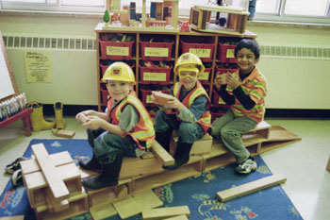
Still to Come
Links to TQS for evaluations
Learning guides
Suggestions for Community Engagement
“Play nourishes every aspect of children’s development-
It forms the foundation of intellectual, social, physical, and emotional skills necessary for success in school and in life.”
Canadian Council on Learning
Notes:
It is our hope that sharing these materials provincially will allow others to build upon this foundation as well as share the great work that is happening around the province.
We encourage you to share with your LF’s and invite them to contact SAPDC if they would like to contribute to the work.

