Slide 1
Ensuring Success in the Early Years
Notes:
Our purpose is to share a continuous adventure that we are on in Medicine Hat with our teachers, parents, administrators, community partners and youngest citizens.

Slide 2
Leading the Learning Transformation
Notes:
Across the nation and around the world, efforts are being made to improve early childhood policies and practices. What happens to children in their first few years of life has a profound influence on their relative success or failure in school and in life in general. Refer to research page Galileo - Research That informs Action notes

Slide 3
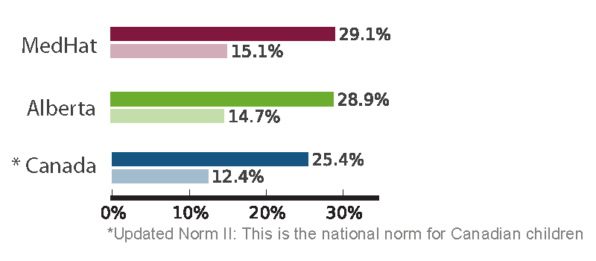
Experiencing great difficulty in one or more and two or more areas of development
Source: ECMap Early Development Instrument, baseline results, April 2014
Notes:
The Early Child Development Mapping Project (ECMap) funded and led by Alberta Education was a 5 year research initiative to provide a better understanding of how young children are doing and to help communities support positive early development.
April 2014, the provincial overview and community profiles were published.
By age five, 25 per cent of kindergarten-aged children in Canada are considered developmentally vulnerable. One of out every four five-year-olds struggles with basic age-appropriate tasks, such as holding a pencil, climbing stairs, following instructions and getting along with other children. (1)
Results show that in Alberta, 29 per cent are struggling developmentally. (2)
In Medicine Hat we see results from the EC Map project that indicates our children are above both the provincial and national average in developmental delays in one or more areas of development.
This percentage does not include children with severe disabilities. (3) The number of children receiving PUF were not entered in to the data.
Many experts say that a great deal of early childhood development vulnerability and many development-related problems may be preventable. (4)
In your binder of resources you have the Medicine Hat Data and we can provide another presentation around this.

Slide 4
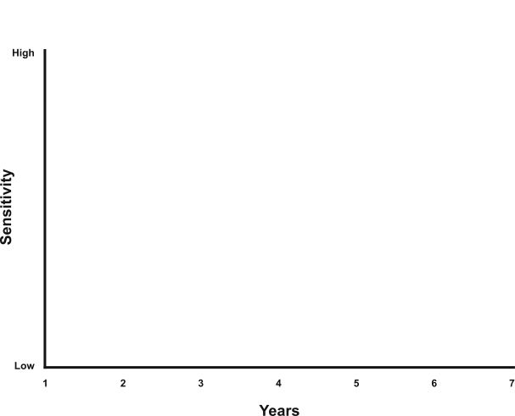
Sensitive periods
in early brain development
Vision
Hearing
Habitual ways of responding
Language
Emotional Control
Symbol
Peer social skills
Numbers
Graph developed by Council for Early Child Development (Nash, 1997; Early Years Study, 1999; Shonkoff, 2000.)
Notes:
We know a great deal more about the importance of the early years thanks to the explosion of research since the 1990s. The brain is extremely sensitive to environmental influences, both physical and social, at this time. A child’s early experiences shape the structure of the brain as it adapts to its environment. The quality of these early experiences, positive or negative, lays the foundation for all later development. And it affects how well children will do at school and at work, self-confidence, ability to cope, behaviour, relationships, and lifelong physical and mental health.
This slide shows the sensitive periods in early brain development. For example, the years between three and four are a highly sensitive period for the development of peer social skills. Each stage of brain development is affected by previous development and becomes increasingly complex. The brain acquires the tool kit it needs for all later development and learning during the early years. The potential to affect positive change during this time is enormous. A positive early start is essential to a child’s future success and well-being.

Slide 5
Notes:
Alberta Education recognizes that early childhood is a significant period in human development and therefore have committed resources to ensure that all children are given the opportunity to maximize their potential.

Slide 6
Notes:
Alberta Education provides funding for children with assessed mild/moderate and severe developmental disabilities and delays. It is because of this funding we are able to provide programming choices that ensure families can choose the most enabling environment for their child.

Slide 7
Inspiring Education
Primary Programs Guiding Principles
Children are active
collaborators in and users of assessment
Childhoods differ depending on social and cultural circumstances
The Child
Children are citizens and active participants in school and society
Children’s development
is influenced but not
determined by their
early experiences
Vision
Program Statement
Children construct
and represent
knowledge in a variety
of ways
Children interact and
learn in a variety of
contexts
Children are unique and
active contributors to their learning
Children are co-constructors
of knowledge and partners
in learning
Mission
Notes:
Inspiring Education, our School District Mission and Vision along with the AB Ed. Primary Programs Guiding Principles and Kindergarten Program Statement form the foundation for the inclusive education practices that we are promoting in the early years.
Refer to Hand Out

Slide 8
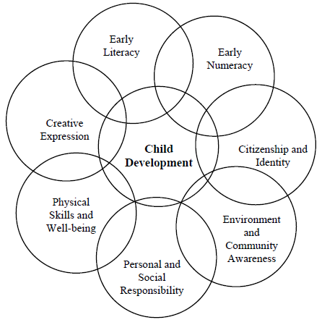
Kindergarten Program Statement Alberta Education
Notes:
The Kindergarten Program Statement provides learner expectations in 7 learning areas that should be adapted and modified to meet the needs of each child.

Slide 9
Inspiring Education
“An educated Albertan is one who is an Engaged Thinker and Ethical Citizen with an Entrepreneurial Spirit.”
Alberta Education (2013)
Notes:
In keeping with Alberta Education, we create an environment of exploration, in a variety of quality early learning settings, that respects the natural development of children as well as the close relationships that they share with their surroundings. Through a Play Based environment we can ensure that all children will have equitable opportunity to be successful.

Slide 10
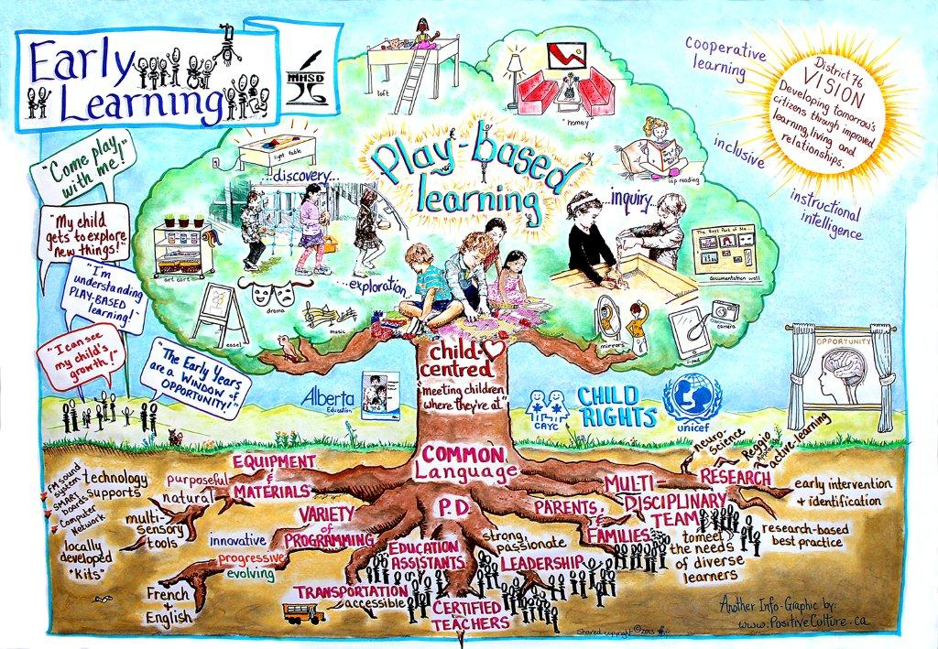
Notes:
This is what Early Learning looks like in MHSD 76 – this story board was generated by our ELP and Kindergarten teachers and we were really impressed and delighted that this is their vision for our youngest children 2.6 to 6 years of age.
You can see that Play Based Learning is the central piece of their early learning pedagogy.

Slide 11
The importance of play!
Notes:
Children are natural learners, full of wonder and curiosity about their world

Slide 12
Play is what children do best!
Notes:
It has been defined as an activity that is done for its own sake because it is flexible and positive

Slide 13
Notes:
All areas of development are tended to as children engage in play. They are provided endless opportunities to work through social/emotional interactions developing their ability to make friends and a better understanding of themselves.
At least 60 minutes per day should be spent in uninterrupted play.

Slide 14
Notes:
Play is essential for learning how to make friends and how to get along. These are the building blocks for school readiness and academic learning. Brain research tells us that children who experience play based environments have stronger social skills, less aggression, less anger, more prepared to take risks, more prepared to be imaginative

Slide 15
Executive Functioning
Notes:
Brown, Diamond, Pellis & Pellis state that
the ability to self-regulate - social, emotional and cognitive behaviours - has a stronger association with academic achievement than IQ or entry-level reading or math skills. - rough and tumble play is an essential building block for developng self regulation.

Slide 16
Brain Architecture is built through “Serve and Return”
Notes:
Scientists now know a major ingredient in this developmental process is the “serve and return” relationship between children and adults. A young child’s natural curiosity and desire to learn and the teacher’s encouraging response shapes the quality of the child’s early learning experience.

Slide 17
Ask any child what they want to do and the answer is unanimous – they want to play!

Slide 18
It’s every child’s right!
http://www.bing.com/videos/search?q=children+speaking+about+the+importance+of+play+video&FORM=VIRE1#view=detail&mid=E1F24763CA17E87E0709E1F24763CA17E87E0709
Notes:
Hand out brief overview

Slide 19
We have a tremendous responsibility to provide the best possible environments and experiences for children to construct both knowledge and relationships.

Slide 20
The image we hold of children shapes our interactions with them and influences the environments and the tasks we create for them.
Staples (2013)
Notes:
Therefore our most important goal is to inspire delight, curiosity, and inquiry in the classroom. These are the greatest gifts our teachers can give a child.

Slide 21
Medicine Hat School District 76 Approach
Classroom Environment
Emergent Curriculum
Documentation
Notes:
Our focus over the past 5 years has been to pay close attention to building the classroom environment and nurturing our teacher’s understanding of the emergent curriculum and documentation.

Slide 22
The journey begins with an exploration of how an environment communicates and shapes a set of values. Harvest Resource (2006)
Notes:
The next slides will depict 5 key elements of early childhood environments.

Slide 23
Notes:
Cozy and homelike elements for building relationships

Slide 24
Notes:
Flexible space and open-ended materials in the environment

Slide 25
Notes:
Natural elements that engage our senses and connect us to nature

Slide 26
Notes:
Objects to provoke wonder, curiosity and intellectual engagement

Slide 27
Notes:
And lastly, creating authentic learning experiences.

Slide 28
Emergent Curriculum
The Early Childhood curriculum has a profound and long term effect on how children learn and, just as important, on how they enjoy the process.
Notes:
Educators believe that children are creative and capable thinkers,
They respond to curricular goals in meaningful and authentic ways
Their wondrous questions become the seeds for learning and
encourage children to invent theories and seek out answers.
Teachers move past observing to studying children and their development, interests and thoughts.

Slide 29
A Culture of Collaboration and Provocation
Notes:
While framed by the teacher, it is child initiated, allowing for collaboration between children and teachers, giving everyone a voice.
It is responsive to the child, thereby allowing teachers to build upon existing interests.
In it’s practice, the teacher takes on the role of facilitator, taking what she sees and hears, and bringing to children the opportunity to discover more, dig deeper, and construct further knowledge.
It is flexible in that curriculum planning, rather than being done well in advance, is constantly developing. Curriculum is dynamic!
It enables children’s learning and thinking to be made visible through varied forms of documentation.

Slide 30
Documentation
Making Learning and Learners Visible – the practice of observing, recording, interpreting, and sharing the processes and products of learning through a variety of media in order to deepen and extend that learning.
MLV (2005)
Notes:
Documentation is a powerful tool for assessment and communication that inspires children and educators to reflect upon their experiences as learners.

Slide 31
Features of Documentation
Notes:
Documentation involves a specific question that guides the process and that question is more authentic if it comes from the children.
Collectively analyzing, interpreting, and evaluating individual and group observations; it is strengthened by multiple perspectives.
The use of multiple languages (different ways of representing and expressing thinking in various media and symbol systems).
It is not only retrospective, it is also prospective. It shapes the design of future contexts for learning.
MLV (2005)

Slide 32
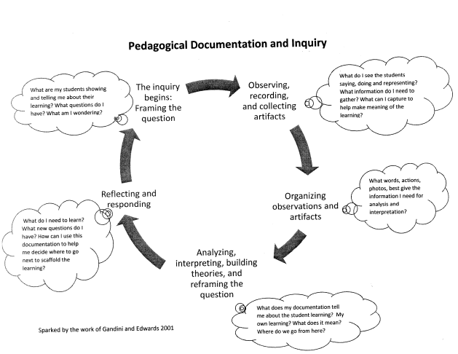

Slide 33
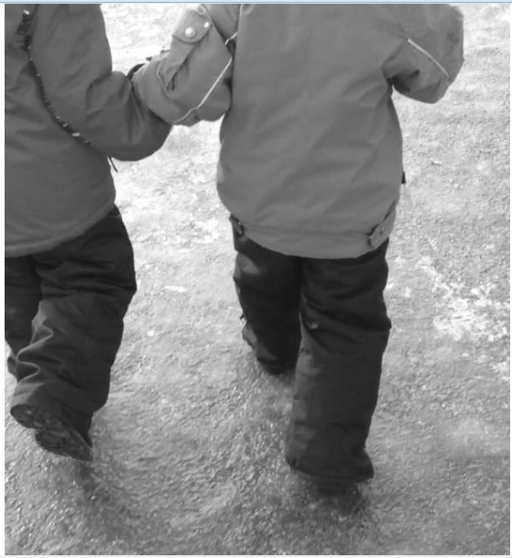
Notes:
Moving forward with Documentation requires our teachers to support and guide learning as it emerges naturally inside the school, in the natural world, and in our community as a whole. An Excellent start to learning.

Slide 34
Notes:
From the earlier document – the Kindergarten Program Statement – an overview of the kindergarten curriculm has been created to support teachers in planning.

Slide 35
Planning for the Early Years ELP K Beyond

Slide 36
Assessment - Portfolios

Slide 37
The Crucial Role of Play in Early Childhood
https://www.youtube.com/watch?v=8KtUhKVFjJI

Slide 38
References
(2005). Making learning visible project at the Harvard graduate school of education.
Stacey, S. (2009). Emergent curriculum in early childhood settings from theory to practice. St. Paul MN: Redleaf Press
Krechevsky, M., Mardell, B., Rivard, M., Wilson, D.. (2013). Visible learners promoting Reggio-inspired approaches in all schools. San Francisco, CA: Jossey-Bass.
Stables, J. (2013). Starting points. Calgary, AB: jennydaledesigns.
Harvest Resources. (2006). A study of early childhood program environments. Mechanicsburg, PA: Harvest Resources.

