Slide 1
Additive Thinking in Grade 1
Presenter Info
http://learning.arpdc.ab.ca

Slide 2
Introduction

Slide 3
What is Additive Thinking?
Notes:
Give participants post it notes. Generate a list of keywords that you believe are directly related to additive thinking. In small groups, they collate their responses, combining matching sticky notes, making sure to actually stick matching ones together. Don’t just keep one of each.
They place on board, collating again if applicable. Speaker finds the largest piles and reads them to the group.
Alternative: Participants are asked to reflect individually for a minute. Then their share their thoughts with a partner. Then with the group.

Slide 4
What is Additive Thinking?
Students are able to manipulate numbers by joining, separating, and comparing while engaging in flexible mathematical reasoning. It is
a capacity to work flexibly with the concepts, strategies and representations of addition and subtraction as they occur in a wide range of contexts. (mathematical reasoning)
going beyond memorization of basic arithmetic skills
the means to communicate additive understanding effectively in a variety of ways (for example, words, diagrams, symbolic expressions, and written algorithms).
EMPLO, 2015
Notes:
What words would you highlight as the key ideas in the definition? Where do the ideas from our stickies/discussion fit in within this definition?

Slide 5
Why is it important?
Research says
Both mathematical reasoning and arithmetic skills are predictors of mathematical achievement, however, students ability to reason mathematically was the stronger predictor of success.
Nunes, Bryant, Barros, & Sylva, 2011

Slide 6
Why is it important?
Research says
Early literacy success is directly linked to later literacy success.
Early numeracy success is directly linked to later numeracy AND literacy success.
Early numeracy is a better predictor of school success than early literacy.
Study: School Readiness and Later Achievement
Notes:
Explain why this topic is important.

Slide 7
What are the Big Ideas?
Once students trust “the count”, they can flexibly manipulative numbers in order to make solving problems easier by
Using Parts and Wholes
Decomposing / Recomposing
Partitioning
Compensating
Using Constant Difference

Slide 8
What are the Big Ideas?
Students use mathematical reasoning to build connections between inverse problems.
Addition is not just adding. It’s subtraction as well.

Slide 9
What are the Big Ideas?
Additive Thinking deals with questions where the start, change or result is unknown. It is joining, separating and comparing.

Slide 10
Activity: Relating to POS
MATHEMATICS
KINDERGARTEN TO
GRADE 9
What Strategies Do Students Need?
Notes:
Think – Pair: Participants brainstorm a list of Additive Thinking strategies they believe their students need at their grade level. Don’t worry about the “proper” name for the strategy.
Optional for longer workshops: Participants could be provided with their grade specific Program of Studies to look through

Slide 11
Activity: Suggested Strategies
Standard / Traditional Algorithm
Doubles /
Near Doubles
Facts of 10
Making Ten
Reordering
Partitioning by place value
Compensating
Think Addition for Subtraction
Keeping a Constant Difference
Notes:
AB Education does NOT dictate which strategies you are required to teach in your classroom. However, when looking at the POS, these are the strategies that stand out for me. Please note that counting forwards and backwards is NOT an additive thinking strategy. It is just a counting strategy.

Slide 12
Mastery of Facts
What facts do Grade 1 students need to master?
Recall addition facts to a sum of 5 and related subtraction facts.

Slide 13
But Strategies For…
What facts do Grade 1 students need to have strategies for?
Understand and apply strategies for addition facts up to and including 9 + 9 and related subtraction facts.

Slide 14
Alberta Education says…
“
Students investigate a variety of strategies, including standard/traditional algorithms, to become proficient in at least one appropriate and efficient strategy that they understand.
Over time, students refine their strategies to increase their accuracy and efficiency.
“
https://education.alberta.ca/media/464621/k_to_9_math_pos.pdf, pg. 9, 2016
Notes:
How many strategies do students need to master?

Slide 15
Just a Reminder
Notes:
Strategies must be
Efficient: You must be able to get to the answer in a reasonable amount of time.
Effective: It must get you the right answer every time.
Explainable: You have to be able to explain what you are doing and why it works.
This is available as a poster.

Slide 16
Planning Instruction
“Students learn by attaching meaning to what they do, and they need to construct their own meaning of mathematics.”
(Alberta Mathematics Kindergarten to Grade 9 Program of Studies, 2016)

Slide 17
Planning Instruction
“This meaning is best developed when learners encounter mathematical experiences that proceed from the simple to the complex and from the concrete to the abstract. “
(Alberta Mathematics Kindergarten to Grade 9 Program of Studies, 2016)
“Because the learner is constantly searching for connections on many levels, educators need to orchestrate the experiences from which learners extract understanding.… Brain research establishes and confirms that multiple complex and concrete experiences are essential for meaningful learning and teaching” (Caine and Caine, 1991, p. 5).
Notes:
Note: The Caine and Caine research is quoted directly within the Alberta Program of Studies.

Slide 18
Planning Instruction
“Through the use of manipulatives and a variety of pedagogical approaches, teachers can address the diverse learning styles, cultural backgrounds and developmental stages of students, and enhance within them the formation of sound, transferable mathematical understandings. At all levels, students benefit from working with a variety of materials, tools and contexts when constructing meaning about new mathematical ideas.”
(Alberta Mathematics Kindergarten to Grade 9 Program of Studies, 2016)

Slide 19
Planning Instruction
“Meaningful student discussions provide essential links among concrete, pictorial and symbolic representations of mathematical concepts.”
(Alberta Mathematics Kindergarten to Grade 9 Program of Studies, 2016)

Slide 20
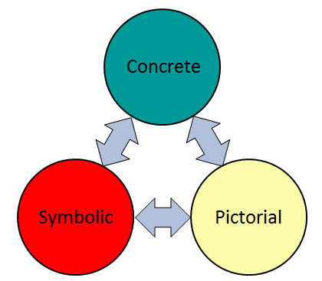
Using Manipulatives
Notes:
When using manipulatives as an instruction strategy, my students should be able to make connections between concrete, pictorial and symbolic representations.
The Concrete Stage focuses on…

Slide 21
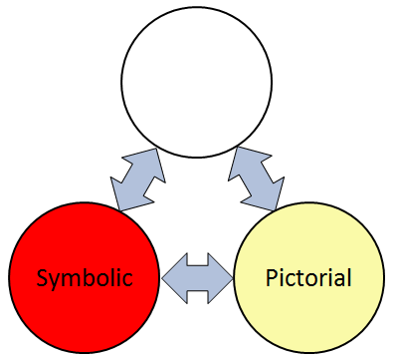
Using Manipulatives
Notes:
The use of physical models to represent the mathematical thinking. Models are tools that can be manipulated and adapted in order to find possible solutions to problems. This stage allows students to develop their visualization skills, enabling students to use concrete means to grapple with abstract concepts. Don’t rush through the use of manipulatives. Students need time to develop understanding.

Slide 22
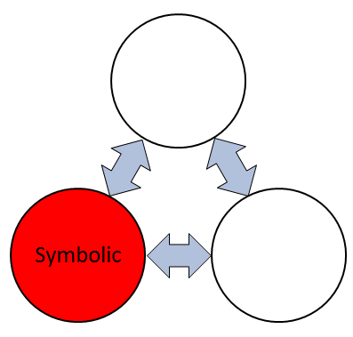
Using Manipulatives
Notes:
Pictorial refers to the use of pictures of the manipulatives, or diagrams, or images. In my own lessons, whenever students are using base ten blocks at their desks, I have a smart notebook file open on the screen with base ten blocks that can be manipulated. Virtual manipulatives would also be considered pictorial.
The concrete and pictorial representations help make the math more visible and meaningful as they move towards a symbolic representation.
This means that we need to connect the concrete to the pictorial because we need to move away from only using a concrete representation.
And the pictorial should SHOW and SUPPORT the ideas behind the symbolic representation and the answer.

Slide 23
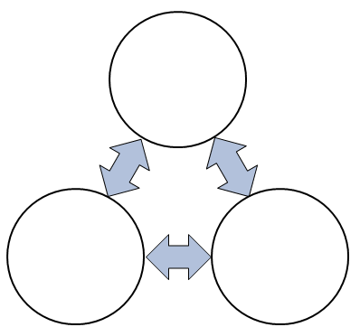
Using Manipulatives
4 + 5
Notes:
Symbolic representations include numbers and symbols.
It’s important to remember that symbolic representations come from a need to be more efficient and effective from concrete and pictorial representations.
At any point in time, a student should be comfortable going back and forth between the three representations if this is necessary for better understanding. For example, they may go back to a pictorial model before they solve it symbolically. Some may need to go back to the concrete model in order to trust that the pictorial representation will lead to the correct answer.
In the end, the math may provoke images or a model and the model can show and support the math.

Slide 24
Using Manipulatives
Jo Boaler on “Brain Crossing”
Notes:
This video is playable when in presentation mode.
Video Souce: https://www.youcubed.org/wim-day-2-videos/
Jo Boaler allows you to download the video from her website.

Slide 25
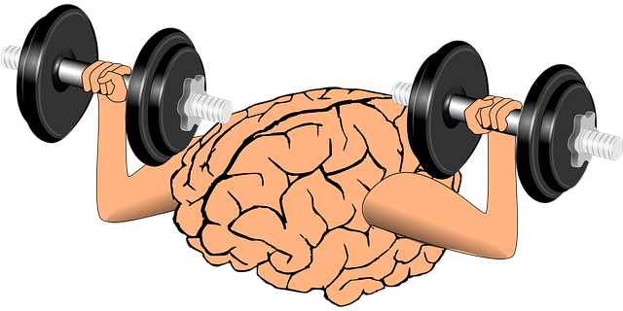
Using Manipulatives
Math learning and performance are optimized when the two sides of the brain are communicating – “brain crossing”
~Park & Brannon, 2013
Notes:
The left side of the brain handles factual and symbolic information; the right side brain handles visual and spatial information. Researchers have found that math learning and performance are optimized when the two sides of the brain are communicating. You could call this “brain crossing” (Park & Brannon, 2013) Additionally, they found that training students through visual representations improved students’ math performance significantly, even on numerical tasks, and that visual training helped students more than numerical training.

Slide 26
Big Idea 1

Slide 27
Flexible Thinking
Once students trust “the count”, they can flexibly manipulative numbers in order to make solving problems easier by
Using Parts and Wholes
Decomposing / Recomposing
Partitioning
Compensating
Using Constant Difference
Notes:
Write out big idea and explain why it’s a big idea.

Slide 28
What do you do…
If they don’t trust the count?
Alberta K-9 Mathematics Achievement Indicators, https://education.alberta.ca/media/3115247/2016_k_to_9_math_ach_ind.pdf, 2016

Slide 29
What do you do…
How many are there? How do you know?
Notes:
Start with a familiar arrangement of dots, using magnets on a whiteboard, bingo chips if you’re in front of a student, or circles infinitely cloned in Smart Notebook.
<click>Ask, “How many are there? How do you know?”
If they have not subitized this arrangement, they will count. That’s ok.

Slide 30
What do you do…
Did I add any dots?
Did I remove any dots?
How many dots are there now?
How do you know?
Notes:
<Animation will complete on its own>
Say “Move the dots. Make sure they see that you haven’t added or removed any.”
Ask, did I add any dots? (no) Did I remove any dots?” (no)
<click>”How many dots are there now? How do I know?”
They may count again. If they do, they do not trust the count. Repeat this exercise several times using the same number of dots.

Slide 31
What do you do…
Did I add any dots?
Did I remove any dots?
How many dots are there now?
Can you make a guess without counting?
Notes:
Say “You’ll move the dots to a different spot. Again, make sure they see that you haven’t added or removed any.”
Ask, did I add any dots? (no) Did I remove any dots?” (no)
“How many dots are there now? Can you make a guess without counting? (guess) Now check”
Keep repeating this process with the same number of dots until they stop counting. Repeat with other numbers. Repeat on other days. Trusting the count does not come easily. It needs time and experience.

Slide 32
What do you do…
Which set has more?
Notes:
Show students two sets of dots that have the same quantity. Ask them which set has more. This will help them develop the idea that spread out does not mean more.

Slide 33
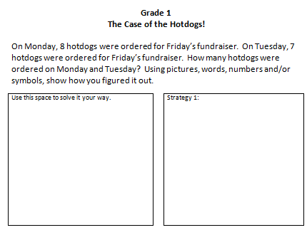
Activity: Intro
Notes:
Handouts:
The Case of the Hotdogs – multiple ways – multiple grades (only print the grade 1 pages double sided)
Handout the “Case of the Hotdog – Activity” page for Grade 1
Tell them that there are two versions. One is regular grade 1 that meets grade 1 outcome expectations. The back side is grade 1 (advanced) – this goes above the expectations of grade 1. However, you may have students who are working at this level. As we go through these activities, feel free to apply the strategies to both documents but definitely do it to the side that focuses on grade level expectations.
Participants read their word problem and solve it in the FIRST box (see arrow), however they would normally solve it. For the teacher participants, this should be a known fact and that’s ok to just know it. If a student just knows this fact, that’s great! However, it means you didn’t make them think, so you would apologize to them, tell them that you are sorry, you didn’t give them something that would help them learn and then give them a different set of numbers – either different single digit numbers or make one of them a 2 digit number.
We’re going to explore 3 additive thinking strategies that promote flexible mathematical thinking. You may be familiar with some of these.
As with all mathematics, it is very important that we progress through the concrete, pictorial and symbolic stages. We build it, without writing anything down until we can do it concretely without support. I almost always do the pictorial at the same time because I’ve got smartboard manipulative files for all of my manipulatives. So they are seeing the pictorial right away. Once students are extremely comfortable, then we move on to the symbolic. Research shows that when a student puts pen to paper, their stress level will increase and make it more challenging to understand the math.

Slide 34
How might a student solve this question?
1
2
3
4
5
6
7
8
9
10
11
12
13
14
15
This is a
Counting Strategy
Notes:
How might a student solve this question?
They might draw out <click> 8 hotdogs.
And then draw out <click> 7 more.
And then count out <click> all of the hotdogs.
<click> This is a counting strategy. This is NOT additive thinking. However, this is where most students will begin their understanding of addition.

Slide 35
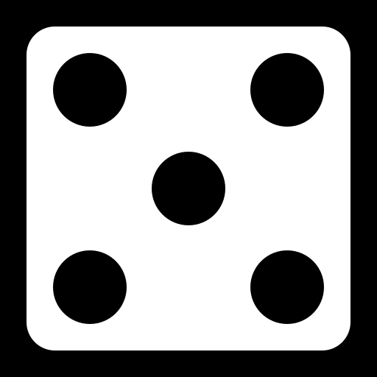
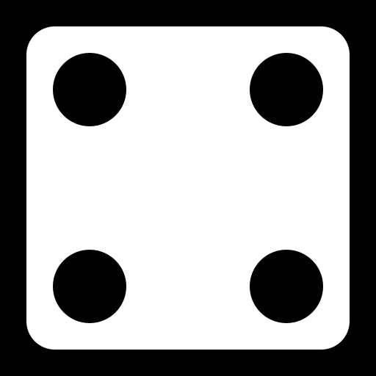
How might a student solve this question?
This is a
Counting Strategy
Notes:
You’ll see this strategy used when they are counting dots on a dice.

Slide 36
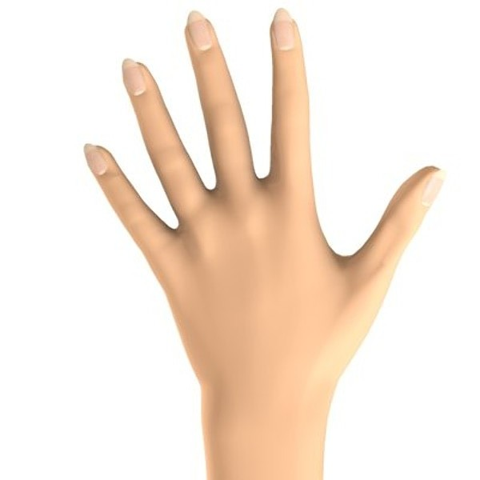
How might a student solve this question?
This is a
Counting On Strategy
How do we help students move past
just counting?
Notes:
How do we help students move past just counting?
Roll the dice. Ask them to tell you how many is on the biggest number. (5)
<click>Cover it with your hand. Ask how many dots there were. (5) If they’re not sure, uncover it so they can recount and then cover it again. Keep asking until they are sure there are 5.
Then ask them to continue counting the rest of the dots. They might start at one again. If they do, ask them again how many are under the hand (5) then say 5, point to the next dot and say siiiiiiiiix (yes spread the word out when saying it), hopefully they’ll help you finish the number six, then seeeeeeeveeeen, and hopefully they will continue the counting for you.
Repeat this process with other rolls. Always covering the bigger number. After a while, you could ask which number to cover. Ask, why they chose the bigger number. Less dots to count!

Slide 37
How might a student solve this question?
8
9
10
11
12
13
14
15
This is a
Counting On Strategy
Notes:
How might a student who has been through the previous activity solve this question?
They might draw out <click> 8 hotdogs.
And then draw out <click> 7 more.
And then starting at 8, they count out <click> the rest of the hotdogs.
<click> This is a counting ON strategy. This is still not additive thinking. However, this is a natural next step in their understanding of addition.

Slide 38
How might a student solve this question?
This is a
Counting On Strategy
Notes:
They might use a number line. <click> Again, this is a counting on strategy. However, the number line leads beautifully into open number lines in later grades.

Slide 39
Consolidating Your Learning
NOT Additive Thinking
COUNTING ON
Notes:
Participants write “counting on” beside Strategy 1 but also put a big star that says “NOT ADDITIVE THINKING!” We don’t want to leave students at this stage.

Slide 40
How might a student solve this question?
They might use their fingers!
Penner-Wilger et al. (2007) and Penner-Wilger et al. (2013) found that finger [perception] was related to children’s number system knowledge and calculation skill concurrently in Grade 1. Moreover, Penner-Wilger et al. (2009) found that finger [perception] in Grade 1 predicted performance on tasks designed to assess number representations – number comparison and estimation – in Grade 2.
Notes:
Teachers often ask if counting on fingers is ok. Current research is showing that using your fingers builds finger perception and finger perception is related to number system knowledge and calculation skill. In fact, it is actually a better predictor than tests of cognitive processing in grade 2 students.
Penner-Wilger, M., Anderson, M. (2013). “The relation between finger gnosis and mathematical ability: why redeployment of neural circuits best explains the finding,” in Frontiers in Psychology Volume 4, 877. Retrieved from http://journal.frontiersin.org/article/10.3389/fpsyg.2013.00877/full
Penner-Wilger, M., Fast, L., LeFevre, J., Smith-Chant, B. L., Skwarchuk, S., Kamawar, D., et al. (2007). “The foundations of numeracy: subitizing, finger gnosia, and fine-motor ability,” in Proceedings of the 29th Annual Cognitive Science Society, eds D. S. McNamara and J. G. Trafton (Austin, TX: Cognitive Science Society), 1385–1390.
Penner-Wilger, M., Fast, L., LeFevre, J., Smith-Chant, B. L., Skwarchuk, S., Kamawar, D., et al. (2009). “Subitizing, finger gnosis, and the representation of number,” in Proceedings of the 31st Annual Cognitive Science Society (Austin, TX: Cognitive Science Society), 520–525.

Slide 41
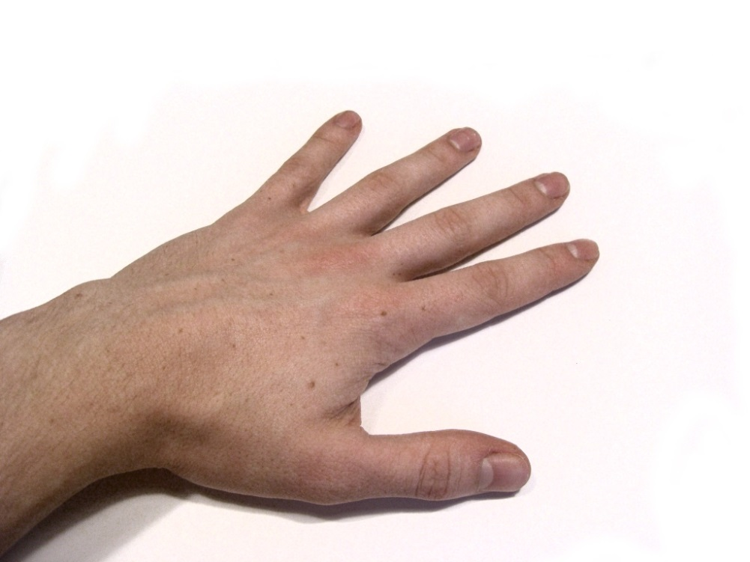
Developing finger perception
Hold out one hand.
Close your eyes.
Partner touches one of your fingertips.
Can you name the finger?

Slide 42
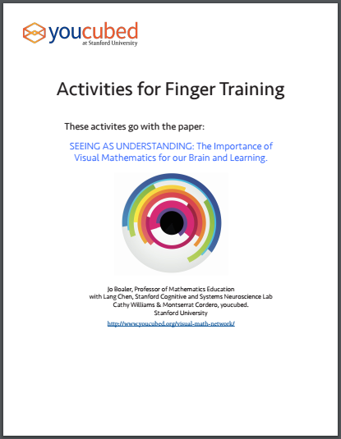
Developing finger perception
https://www.youcubed.org/finger-activities/
Notes:
https://www.youcubed.org/finger-activities/

Slide 43
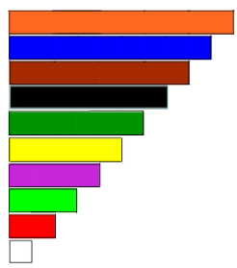
Manipulatives: Cuisenaire Rods
Building 10
Aka Facts of 10
Notes:
Materials:
Smart Notebook File: Cuisenaire Rods
Teacher Instructions: “Introducing Cuisenaire Rods”
Only do intro activity and Building 10. We’ll come back to this later!

Slide 44
Mad Minutes
Agree or Disagree?
Mad Minutes help students learn math facts.
Mad Minutes encourage students to practice.
Notes:
Do you agree or disagree with the following statement? Discuss with a seat partner.
<click> Mad Minutes help students learn math facts.
Do you agree or disagree with the following statement? Discuss with a seat partner.
<click> Mad Minutes encourage students to practice.

Slide 45
Mad Minutes
Mad Minutes encourage the belief that you are only good at math if you are fast.

Slide 46
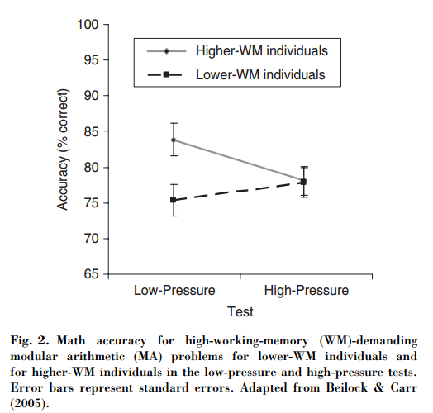
Research
Results
Under low-pressure conditions, high WM participants outperformed low WM participants.
Under high-pressure conditions, high WM participants fell to the level of low WM participants. Low WM participants results did not change much.
Beilock & DeCaro, 2007
WM: Working Memory
Notes:
Sian Beilock and colleagues studied how situation-induced pressures undermine math performance by creating a high-stakes testing environment in their laboratory. Situations were setup where some individuals were simply told to try their best. Others were given scenarios based on common pressures.
Research Article: https://hpl.uchicago.edu/sites/hpl.uchicago.edu/files/uploads/Beilock_CurrDir_2008.pdf

Slide 47
Research
Why?
When not under pressure,
Highs used demanding procedures
Lows used “shortcuts”
When under pressure,
Highs used “shortcuts”
Lows used “shortcuts”
Beilock & DeCaro, 2007
Notes:
Research Article: https://hpl.uchicago.edu/sites/hpl.uchicago.edu/files/uploads/Beilock_CurrDir_2008.pdf

Slide 48
Mad Minutes
How can we turn “Mad Minutes” into a useful tool?
Notes:
Let’s turn Mad Minutes on their head and turn them into a useful learning tool.
<click>

Slide 49
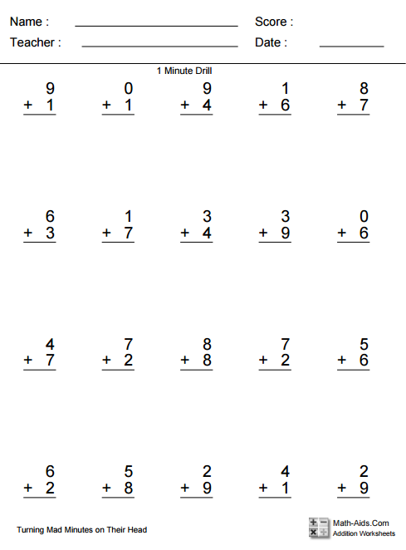
Mad Minutes
Facts of 10
1 minute to circle (you only get 30 seconds)
~2 minutes to answer (you only get 30 seconds)
How does this help students?
Notes:
Early, we talked about how knowing your facts of ten are super important. I’m going to give you <click>30 seconds although you would give students 1 minute, to find and circle only the questions that are facts of 10. Don’t write any answers down. Just circle. Go. <give about 30 seconds>Stop. Now, don’t panic if you didn’t get them all circled. That’s totally ok. Now <click> I’ll give you 30 seconds, though you would give your students about 2 minutes, to answer just the questions you circled. Don’t worry about any of the questions you didn’t circle. Go.
<click>How does this help students? <discuss> So often, we teach a specific strategy and then give 50 questions for them to practice but they don’t have to think. They know exactly what strategy to use. Whereas, doing it this way asks students to look for questions where knowing their facts of 10 are helpful. They aren’t asked to do all the questions, just the facts of 10 questions. Answering these ones should be quick because they all have an answer of 10 but give students the time they need.
We’ll come back to this paper again later.

Slide 50
New Strategy
Doubles
Notes:
(Title Screen)
Knowing your doubles is important! Students should be very comfortable knowing all the doubles up to 9+9.

Slide 51
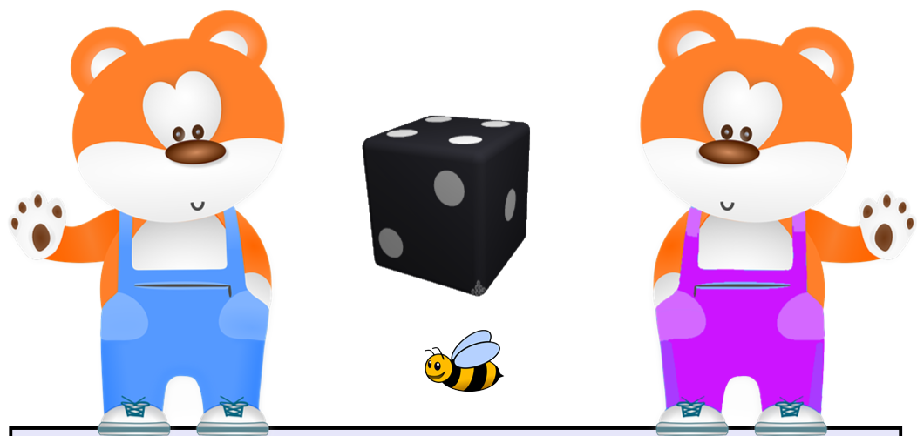
Intro: Doubles
Notes:
Materials:
“Intro to Doubles and Near Doubles” Smart Notebook File
“Intro to Doubles and Near Doubles – Bears handout”
“Bears Doubles and Near Doubles Game”
Note: The instructions are in the “Intro to Doubles and Near Doubles – Bears handout”
Follow the instructions for “Intro to Doubles” in the “Intro to Doubles and Near Doubles – Bears handout”.
Play the “Doubles” game. Use the “Doubles” game slide in “Intro to Doubles and Near Doubles” Smart Notebook file to introduce using a six sided dice.
Show participants how to play the “Doubles” game using a ten sided dice.
STOP THERE!

Slide 52
Manipulatives: Cuisenaire Rods
Doubles
Notes:
Materials:
Smart Notebook File: Cuisenaire Rods
Teacher Instructions: “Introducing Cuisenaire Rods”
Only do doubles activity. We’ll come back to this later!

Slide 53
Mad Minutes
Doubles
1 minute to box
~2 minutes to answer (you only get 1 minute)
Notes:
We just focused on learning about doubles. I’m going to give you <click>1 minute, to find and draw a box around only the questions that are doubles. Don’t write any answers down. Just draw a box. Go. <give about 1 minute>Stop. Now, don’t panic if you didn’t get them all boxed. That’s totally ok. Now <click> I’ll give you 1 minute, though you would give your students about 2 minutes, to answer just the questions you boxed. Don’t worry about any of the questions you didn’t box. Go.
We’ll come back to this paper again later.

Slide 54
New Strategy
Near Doubles
Notes:
(Title Screen)
Near Doubles are also very important.

Slide 55
Intro: Near Doubles
How are these two questions…
similar?
different?
3 + 3 =
3 + 4 =
Notes:
Ask participants to tell you how 3 + 3 and 3 + 4 are the same or similar. Ask participants to tell you how they are different.
What’s the answe4 to the first question?
How does that help us figure out the second question?

Slide 56
Intro: Near Doubles
Notes:
Materials:
“Intro to Doubles and Near Doubles” Smart Notebook File
“Intro to Doubles and Near Doubles”– Bears handout”
Rest of the games in “Bears Doubles and Near Doubles Game”
Note: The instructions are in the “Intro to Doubles – Bears handout”
Complete the “Intro to Near Doubles” activity in the “Intro to Doubles” instructions.
Play the “Doubles +1” game. Use the “Doubles” game slide to introduce using a six sided dice.
Show participants how to play the “Doubles +1” game using a ten sided dice.
Repeat for “Doubles -1” games.
STOP THERE!

Slide 57
Manipulatives: Cuisenaire Rods
Near Doubles
Notes:
Materials:
Smart Notebook File: Cuisenaire Rods
Teacher Instructions: “Introducing Cuisenaire Rods”
Only do doubles activity. We’ll come back to this later!

Slide 58
Mad Minutes
Near Doubles
1 minute to triangle
~2 minutes to answer (you only get 1 minute)
Notes:
We just focused on learning about doubles +1. I’m going to give you <click>1 minute, to find and draw a triangle around only the questions that are near doubles. Don’t write any answers down. Just draw a triangle. Go. <give about 1 minute>Stop. Now, don’t panic if you didn’t get them all triangled. That’s totally ok. Now <click> I’ll give you 1 minute, though you would give your students about 2 minutes, to answer just the questions you triangled. Don’t worry about any of the questions you didn’t triangle. Go.
We’ll come back to this paper again later.

Slide 59
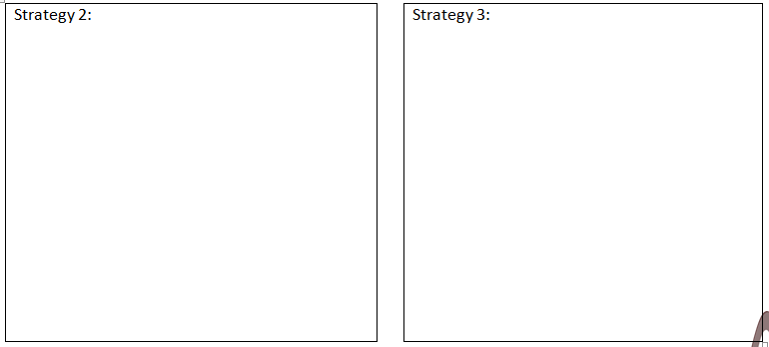
Consolidating Your Learning
Doubles / Near Doubles
Notes:
On your Hotdog handout, go to the box labelled Strategy 2.
Write the name of the strategy: Doubles / Near Doubles
Solve your hotdog question using doubles / near doubles.

Slide 60
New Strategy
Making Ten
Notes:
(Title Screen)

Slide 61
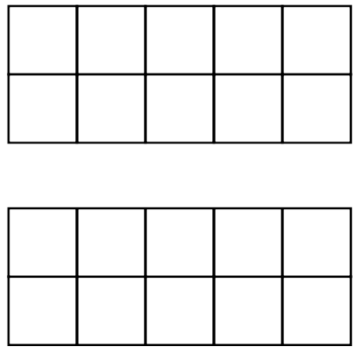
Intro: Making Ten
Click to reveal
Notes:
Put your pencils down. I’m going to click on the box. It will flash two sets of dots very quickly. You have to figure out how many there are altogether. Ready? <click the box>
Take a moment to think. How many are there? I’ll click it again so you can check it again. <click>
Does anyone need another peek? <If so, click again>
Tell your partner, how many dots did you see altogether and how did you figure it out?
<Give time to discuss then group share strategies.>
<Hopefully someone says that they say a ten…if not, you say “I imagined moving one red dot to make ten so that left me with 10 and 3”>
Making ten is a powerful additive thinking strategy. This is a simple activity you could do with students to help them become aware of that strategy. But what do you do if students don’t understand it? You can build it with concrete materials! The next activity helps students build the Making Ten strategy.

Slide 62
Intro: Making Ten
9 + 4
Notes:
Materials:
15-20 square or round approximately 1” tiles per person (or other similar type manipulatives)
Making Ten – Two Ten Frames handout
The first strategy we’ll look at is “Making Ten”. How many of you are familiar with the images on the screen?
Using ten frames is just one tool that you can use in order to help students build their understanding of ten. You’re also probably familiar with Power of Ten which is a great resource but you don’t have to spend money and buy the program. Just look for Ten Frame activities.
<click>
Build me 9 in the first ten frame and 4 in the second ten frame.
Materials needed:
2 blank ten frames <Link for presenter downloading: https://docs.google.com/document/d/1xlqHIfj4wmSBjQ3LMyol2earrh6a7GC8LvT-55SrzdY/edit?usp=sharing >
About 20 integer tiles (or other manipulatives that would fill up most of the square)

Slide 63
Intro: Making Ten
9 + 4
Notes:
Mathematicians are a little OCD. When they see a ten frame that’s not full but could be, it really bothers them so they will do whatever they can to fill it up without changing the total value of what’s there. So, steal from one ten frame to fill the other one. <wait for them to do this>

Slide 64
Intro: Making Ten
9 + 4
Notes:
How many of you stole form the 4 to fill the 9?

Slide 65
Intro: Making Ten
9 + 4
Notes:
How many of you stole from the 9 to fill the 4? You’ll have kids who do this…but who cares? Still gets them the right answer in the end. It’s actually a good conversation to have that it doesn’t matter which one you still from. However, a mathematician would usually move the fewest amount of tiles as possible. It’s less work.

Slide 66
Intro: Making Ten
9 + 4 = 10 + 3
Notes:
When writing out your new equation, make sure to write it in this format…9 + 4 is the same as 10 + 3. We want to make sure to use the phrase “is the same as” as often as we use the phrase “is equal to”. This will help them have a better understanding of the equals sign.

Slide 67
Intro: Try This
8 + 7
Notes:
Now participants try: 8 + 7

Slide 68
Extending: Making Ten
29 + 43
247 + 389
NOT a Grade 1 outcome
Notes:
Can you use the “Making Ten” strategy to solve this one mentally? Explain to your partner what you did. <give time>
Having students explain to their process or strategy to their seat partner is an important aspect in mathematics. Students must be able to communicate their strategy. Remember that 3rd E? Explainable? This helps students to practice their communication skills and reasoning skills. As the teacher, when students are sharing their strategy with the entire class, I would be recording it on the board so that they can see it in a written form. After a lot of practice with verbally explaining their strategy, they can then write down what they just told their partner. This will help them improve their written communication.
If a student ever says to you, I just knew the answer, it’s possible they did. If you’re asking a grade 1 student to add single digit numbers, they might have mastered that fact. I just tell them “I’m sorry. I gave you a question that you didn’t have to think about…you already knew it. Try this question…” However, if it’s a question that typically students can’t just rattle off a fact for, you will have to guide them through the explanation. For example, don’t ask “what did you do to get the answer?” Instead, ask “what was the first thing you did?”

Slide 69
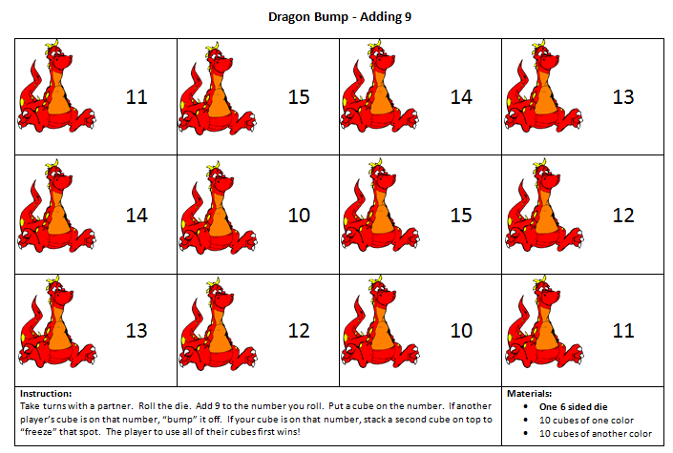
Practicing: Making Ten
Notes:
Option 1:
Play “Dragon Bump – adding 9 or 8”
<need 6 or 9 sided dice>
<Link for presenter downloading: https://drive.google.com/file/d/0B-I5D9zVEge0X0p2Qkp6Q3hsakk/view?usp=sharing>

Slide 70
Manipulatives: Cuisenaire Rods
Making 10
Notes:
Materials:
Smart Notebook File: Cuisenaire Rods
Teacher Instructions: “Introducing Cuisenaire Rods”
Only do Making 10 activity. We’ll come back to this later!

Slide 71
Consolidating Your Learning
Making Ten
Notes:
On your hotdog handout, write “Making Ten” as your strategy 3. Solve your hotdog question using Making Ten

Slide 72
Student Exemplar
How does this teacher help this student successfully answer 12 + 9?
Notes:
Let’s look at one more strategy.
(Note: When you are in presentation mode, you will be have to click on the image of the boy and a play button will appear at the bottom of the image. Click play)
(After watching) Discuss the way the teacher helps this student use what they know in order to solve this question. Ask “What is this strategy called?” Compensation – you make one number bigger to make it easier to work with – example: 9 became 10. Then solve the question – example: 12 + 10. Then remove the extra – example 22 – 1.
Having trouble with video: Video has been included in the “All Files for Presentations➔BI1. It’s called “12+9 and 12+10, student B”

Slide 73
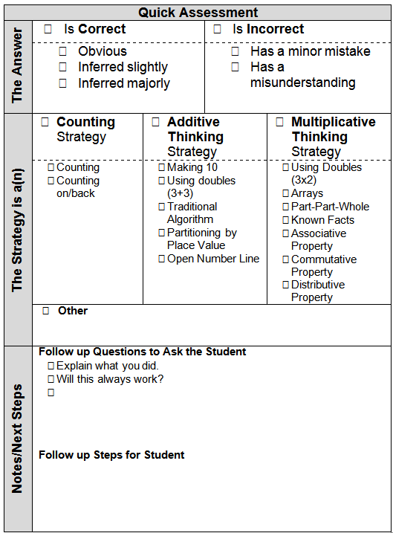
Quick Assessment
Notes:
The EMPLO group created a simple quick assessment tool to keep track of students’ strategies. It is meant to be used as a formative assessment tool that will guide our next steps with this particular student. This can be downloaded from the EMPL website in the Try This section. Let’s look closer at each of the sections.
<Link for presenter downloading: https://drive.google.com/open?id=0B-I5D9zVEge0RW1qQXdLa3RNeXM >

Slide 74
Quick Assessment
Notes:
First, we’ll look at the answer. Is it correct or incorrect? If it’s correct - was the answer obvious, inferred slightly or inferred majorly? If we have to infer, then we know to have a conversation with this student regarding communication of answers. If it’s incorrect, was it because of a minor mistake, or a mathematical misunderstanding? This will also guide further conversations with this student and the next lesson.

Slide 75
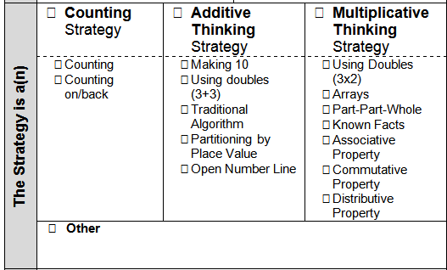
Quick Assessment
Notes:
Now, let’s find out what type of strategy the student is using - counting, additive thinking, or multiplicative thinking. There’s also space to write down a different type of strategy.

Slide 76
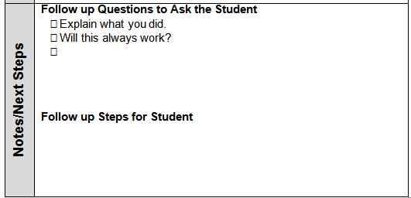
Quick Assessment
Notes:
There’s also space for us to write down notes and next steps. What follow up questions should I ask this student to clarify understanding? These are 2 questions you should always be asking students. “Explain what you did.” and “Will this always work?” What are the next steps that I will take with this student to help them develop their additive thinking skills? When we continue to look at student work, you’ll see a version of this at the bottom of the screen. Ask yourself these questions when considering the student’s work.
You can download this from the Additive Thinking Try This Sections on the EMPL online learning guide.

Slide 77
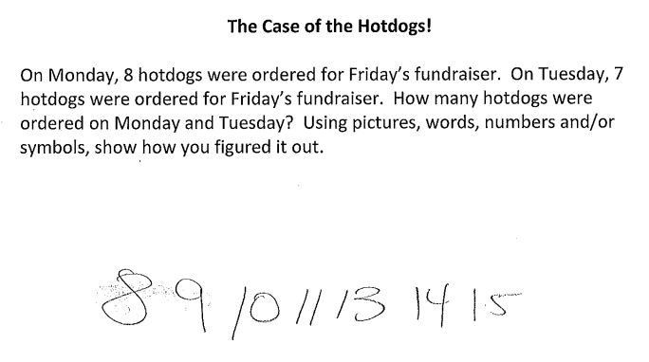
Quick Assessment
Notes:
Ask “How would you use the Quick assessment to assess this student?” <give time>
Ask “Did you notice anything about this students’ response <skipped #12 so may have counted #8 and fluked into the correct answer>
We can’t make any assumptions about what this student did. What is our next step? (We MUST ask them to explain their work)

Slide 78
Parent Communication
Notes:
Handout:
Parent Letter – Big Idea 1
The EMPL group created letters to parents to talk about each of the big ideas in equality, additive thinking and multiplicative thinking.
You can send this letter home with parents at the beginning of a unit, middle of a unit, end of a unit. However, if it’s at the beginning of the unit, then you are proactively providing parents with information about what they will be seeing their child doing.
It’s in word, so you can even make smaller versions and only send home one “Pop Quiz” question and answer (on the reverse side) so you are not overwhelming the parent.
Take a moment to read and answer a question, then read the matching response on the back.
Discuss.

Slide 79
Big Idea 2

Slide 80
Using Inverse Operations
Students use mathematical reasoning to build connections between inverse problems.
Addition is not just adding. It’s subtraction as well.
Notes:
Write out big idea and explain why it’s a big idea. Insert shortened version in title and longer version in body

Slide 81
Activity: Intro
827 + ____ = 1564
Solve this.
Share your strategy with a partner.
Notes:
Have participants solve this and share their strategies.

Slide 82
Activity: Intro
827 + ____ = 1564
How many of you added?
How many of you subtracted?
Notes:
Have participants solve this and share their strategies.

Slide 83
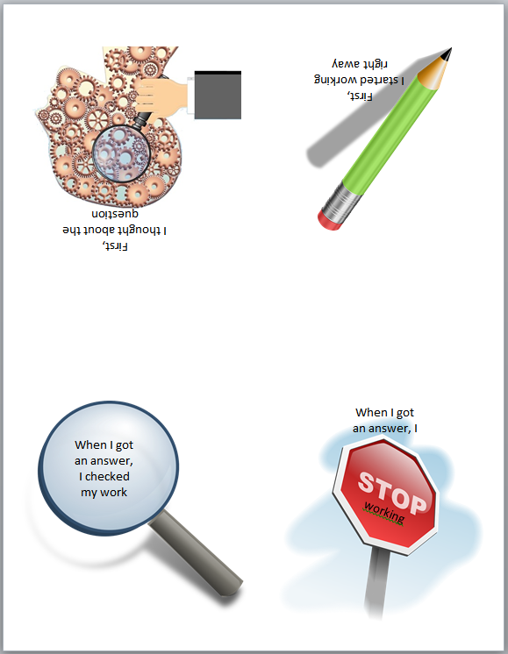
Self Reflection
Fold into a 4 sided “card”

Slide 84
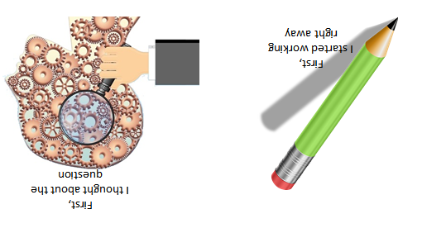
Self Reflection
When solving the question
827 + ____ = 1564

Slide 85
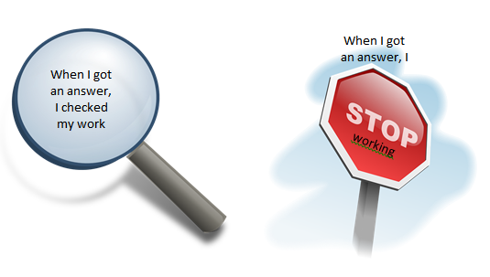
Self Reflection
When solving the question
827 + ____ = 1564

Slide 86
Activity: Counting Birds
There were 7 birds at the birdfeeder. A number of other birds flew in and there are now 15 birds at the feeder. How many birds flew in?
How would your students solve this?
Notes:
Let’s look at a simpler question you could use in a grade 1 classroom. Discuss how your students would solve this.
Let’s look at 2 different examples.

Slide 87
Activity: Counting Birds
One student’s solution
1
2
7
8
9
10
11
12
13
14
15
3
4
5
6
7
8
Notes:
The student starts at 7, maybe they draw circles, maybe they use manipulatives. <click>Then they add more circles or manipulatives until they reach 15.
<click> Then they go back and count how many manipulatives they added.
<after going through animations>
You’ll see some students counting on their fingers to get the answer. Please keep in mind that counting on is not actually an additive thinking strategy.

Slide 88
Activity: Counting Birds
Another student’s solution
7
1
2
3
4
5
6
7
8
9
10
11
12
13
14
15
6
5
4
3
2
1
Notes:
Another student might start by representing the 15. <click> Then they remove the 7 objects that represent the original amount. Now they can count what’s left.

Slide 89
Assessment
On your assessment, you provide the following question:
____ + 8 = 17
One student correctly solves it using addition. A different student correctly solves it using subtraction. They both show their work. How do you mark them?

Slide 90
Important Message
Students are meeting the outcome regardless of whether they solve a question using an addition or a subtraction strategy.

Slide 91
Important Message
The Program of Studies suggests that addition and its corresponding subtraction be taught at the same time.

Slide 92
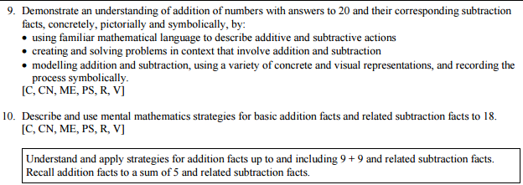
Important Message
Grade 1

Slide 93
Important Message
Grade 1

Slide 94
Parent Communication
Notes:
Handout:
Parent Letter – Big Idea 2
The EMPL group created letters to parents to talk about each of the big ideas in equality, additive thinking and multiplicative thinking.
You can send this letter home with parents at the beginning of a unit, middle of a unit, end of a unit. However, if it’s at the beginning of the unit, then you are proactively providing parents with information about what they will be seeing their child doing.
It’s in word, so you can even make smaller versions and only send home one “Pop Quiz” question and answer (on the reverse side) so you are not overwhelming the parent.
Take a moment to read and answer a question, then read the matching response on the back.
Discuss.

Slide 95
Big Idea 3

Slide 96
Activity: Intro
Write a simple addition or subtraction word problem that you would use at your grade level.
We’ll come back to this question later.
Notes:
<Presenter note: We’ll come back to these questions later>

Slide 97
Sorting Activity
Read the 9 word problems found in your envelope.
Sort them into groups as you see fit.
Create categories for your sorts.
Can you find another way to sort them?
Notes:
<Presenter Note: Prepare the “BI3: Joining, Separating and Comparing Sorting Activity – GRADE 1”. Do NOT mention the full name of the activity to participants as this will give some info away. Just refer to it as a sorting activity>

Slide 98
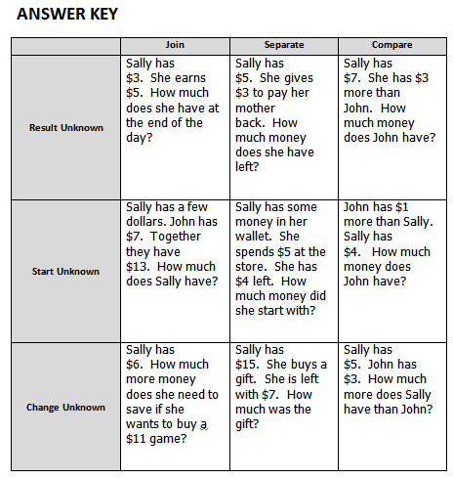
Sorting Activity
Where does the word problem you created earlier fit in the grid?
Notes:
Discuss the answer key.
<click> Ask participants to figure out where the question they wrote earlier would fit. Survey all participants to determine if there is a tendency or trend. (Most likely, most questions will fit in the Join Result Unknown box)

Slide 99
Sorting Activity
How could you modify your question to hit a different row?
A different column?
Notes:
Instinctively, teachers tend to create questions that belong in the top row under Join and Separate. Discuss the impact this will have on their teaching of word problems.
<click>Give time for participants to rewrite their question to hit a different row and then different column. They can share with elbow partners. In a longer workshop, you could give time for them to create a new question for each box. You could give them a blank template with only the row and column headers where they have space to write questions in.

Slide 100
Important Message
All of these question formats are equally important and students should be exposed to all of them in equal proportions, regardless of grade level.

Slide 101
Big Idea 3
Additive Thinking deals with questions where the start, change or result is unknown. It is joining, separating and comparing.

Slide 102
Important Message
Subtraction is not just “take away”. It is also comparison (how many more, how many less, what is the difference?)

Slide 103
Subtraction as Comparison
Renée ran a 6 km race.
Sandi ran a 2 km race.
How much further did Renée run?

Slide 104
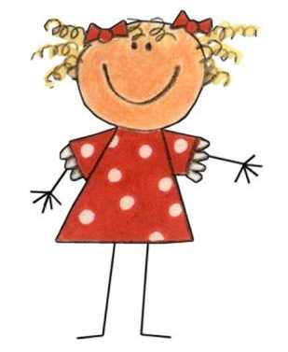
Subtraction as Comparison
Typical Solution
Renée
The answer is 4.
Are we subtracting Sandi’s km from Renée’s race?
Notes:
Student uses an number line.
<click>Starts at 6.
<click>Counts back to Sandi’s 2 km.
<click>And says the answer is 4.
The trouble with this approach is that it <click>almost implies that you are removing Sandi’s 2 km from Renee’s race. Is that really happening?

Slide 105
Subtraction as Comparison
Another Solution
Sandi
Renée
So Renée ran 4 km more than Sandi.
Notes:
Student uses an number line.
<click>Starts at 6.
<click>Counts back to Sandi who is at 2.
And says that Renee ran 4 km more than Sandi.

Slide 106
Subtraction as Comparison
Another Solution
Sandi
Renée
So Renée ran 4 km more than Sandi.
Notes:
Student uses an open number line.
<click>Starts at 2.
<click>Counts forward to 6.
<click>and says that Renee ran 4 km more than Sandi.

Slide 107
Putting it in Context
Generate a list of life situations where subtracting is actually comparing instead of taking away.
Remember to use these contexts in your math word problems.
Notes:
Give time to , brainstorm. Share.
Here are some other ideas: comparing salaries, heights, weight, distance you hit a ball, distances between cities (ex. Red to Edmonton vs Red Deer to Calgary. Which is further?)

Slide 108
Teaching Comparison
Lisa goes to the zoo and sees 5 monkeys and 8 bananas.

Slide 109
Teaching Comparison
5 monkeys
?
8 bananas

Slide 110
Teaching Comparison Important Message
Students need to be confident in
one-to-one correspondence
Notes:
Beginning Understanding: counting objects one by one
Next Level: (Could even be called one for one correspondence) Comparing 2 piles of objects, removing one from each pile at a time until there are no more pairs left, in order to determine which pile has more.

Slide 111
Teaching Comparison
5 monkeys
?
8 bananas

Slide 112
Teaching Comparison
5 monkeys
?
8 bananas

Slide 113
Teaching Comparison
Smaller Quantity
Difference
Large Quantity
Notes:
If we remove the numbers and just look at generic “quantities”, we can move beyond simple numbers and solve much more complex questions, including algebra.
Can you represent the relationship among the larger quantity, the smaller quantity and the difference as mathematical equations?

Slide 114
Teaching Comparison
Larger quantity – Smaller quantity = Difference
Smaller quantity + Difference = Larger quantity
Larger quantity – Difference = Smaller quantity

Slide 115
Numberless Word Problems
There were some mice playing in a field. Some more mice came and started playing, too.
https://bstockus.wordpress.com/numberless-word-problems/
Notes:
Contacted Brian for copyright permission. Awaiting a response.
Taken Directly from: https://docs.google.com/presentation/d/1AXQiocbRxYPX73Vw6qws6P-APkGiyiLSBEym-AK4Cp0/edit#slide=id.g11a0b9da7d_0_100
What are you picturing in your mind when you read this story?
What do the words “some more” mean?

Slide 116
Numberless Word Problems
There were 16 mice playing in a field. Some more mice came and started playing, too.
https://bstockus.wordpress.com/numberless-word-problems/
Notes:
Contacted Brian for copyright permission. Awaiting a response.
Taken Directly from: https://docs.google.com/presentation/d/1AXQiocbRxYPX73Vw6qws6P-APkGiyiLSBEym-AK4Cp0/edit#slide=id.g11a0b9da7d_0_100
What changed? What did we learn from this new information?
If the word “some” in the second sentence changes to a number, what number do you think it could be?

Slide 117
Numberless Word Problems
There were 16 mice playing in a field. Eight more mice came and started playing, too.
https://bstockus.wordpress.com/numberless-word-problems/
Notes:
Contacted Brian for copyright permission. Awaiting a response.
Taken Directly from: https://docs.google.com/presentation/d/1AXQiocbRxYPX73Vw6qws6P-APkGiyiLSBEym-AK4Cp0/edit#slide=id.g11a0b9da7d_0_100
What changed? What did we learn from this new information?
What question could we ask about this situation?

Slide 118
Numberless Word Problems
There were 16 mice playing in a field. Eight more mice came and started playing, too. How many mice were in the field altogether?
https://bstockus.wordpress.com/numberless-word-problems/
Notes:
Contacted Brian for copyright permission. Awaiting a response.
Taken Directly from: https://docs.google.com/presentation/d/1AXQiocbRxYPX73Vw6qws6P-APkGiyiLSBEym-AK4Cp0/edit#slide=id.g11a0b9da7d_0_100
What operation will you use to answer the question? Why?

Slide 119
Parent Communication
Notes:
Handout:
* Parent Letter – Big Idea 3
The EMPL group created letters to parents to talk about each of the big ideas in equality, additive thinking and multiplicative thinking.
You can send this letter home with parents at the beginning of a unit, middle of a unit, end of a unit. However, if it’s at the beginning of the unit, then you are proactively providing parents with information about what they will be seeing their child doing.
It’s in word, so you can even make smaller versions and only send home one “Pop Quiz” question and answer (on the reverse side) so you are not overwhelming the parent.
Take a moment to read and answer a question, then read the matching response on the back.
Discuss.

Slide 120
Conclusion

Slide 121
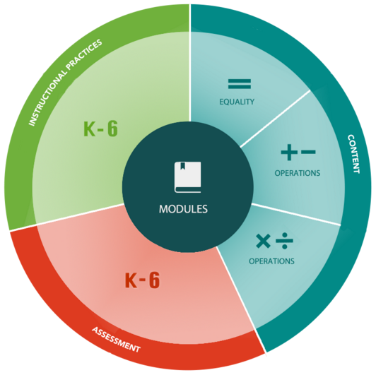
The Website
http://learning.arpdc.ab.ca

Slide 122
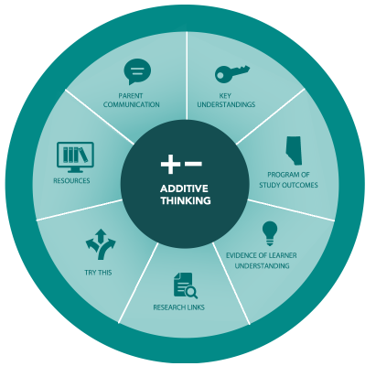
The Website
http://learning.arpdc.ab.ca

Slide 124
Our Partners
www.crcpd.ab.ca
www.learning-network.org
www. carcpd.ab.ca
www.nrlc.net
www.sapdc.ca
www.cpfpp.ab.ca
www.erlc.ca

Slide 127
“Try This” Contest
Download and implement a “Try This” activity in their classroom.
Notes:
<The website will have a Call to Action added to the “Try This” section.
“Call to Action: Choose one of the “Try This” tasks in your classroom. “Click Here” to share your experience and reflection in order to be entered in a draw for a $50 gift card.”
“Try This” Contest:
The Process:
Participants download and implement a “Try This” activity in their classroom.

Slide 128
“Try This” Contest
Use the “Quick Assessment” tool from the EMPL website to assess your students’ work.
Notes:
They use the “Quick Assessment” tool from the EMPL website to assess their students’ work.

Slide 129
“Try This” Contest
Using the entry form, teachers include 10 or more
examples of student work
the completed “Quick Assessments” for the above work.
Notes:
Using the entry form, teachers include 10 or more
examples of student work
the completed “Quick Assessments” for the above work.

Slide 130
“Try This” Contest
You will then be entered into a monthly draw for a $50 electronic gift certificate to your choice of:
Tim Hortons, Starbucks or Amazon.ca.
Notes:
Participants will then be entered into a monthly draw for a $50 electronic gift certificate to their choice of: Tim Hortons, Starbucks or Amazon.ca.

Slide 131
“Try This” Contest
You can complete a different “Try This” activity for a second monthly entry.
Entries are valid only for the month they were submitted.
Notes:
Participants can complete a different “Try This” activity for a second monthly entry.
Entries are valid only for the month they were submitted.
Select student work and assessments will anonymously made available within the EMPL website.
This slide will give participants a “Call to Action” task to try in their classroom>

Slide 132
“Try This” Contest
Participants download and implement a “Try This” activity in their classroom.
They use the “Quick Assessment” tool from the EMPL website to assess their students’ work.
Using the entry form, teachers include 10 or more
examples of student work
the completed “Quick Assessments” for the above work.
Participants will then be entered into a monthly draw for a $50 electronic gift certificate to their choice of: Tim Hortons, Starbucks or Amazon.ca.
Participants can complete a different “Try This” activity for a second monthly entry.
Entries are valid only for the month they were submitted.
Notes:
Presenter: You can just use this slide if you want, instead of the previous slides OR if printing handouts for participants, delete all of the previous slides for the handout version and just use this one.
<The website will have a Call to Action added to the “Try This” section.
“Call to Action: Choose one of the “Try This” tasks in your classroom. “Click Here” to share your experience and reflection in order to be entered in a draw for a $50 gift card.”
“Try This” Contest:
The Process:
Participants download and implement a “Try This” activity in their classroom.
They use the “Quick Assessment” tool from the EMPL website to assess their students’ work.
Using the entry form, teachers include 10 or more
examples of student work
the completed “Quick Assessments” for the above work.
Participants will then be entered into a monthly draw for a $50 electronic gift certificate to their choice of: Tim Hortons, Starbucks or Amazon.ca.
Participants can complete a different “Try This” activity for a second monthly entry.
Entries are valid only for the month they were submitted.
Select student work and assessments will anonymously made available within the EMPL website.
This slide will give participants a “Call to Action” task to try in their classroom>

Slide 133
Monthly Twitter Contests
Follow @EMPL_AB on twitter
Monthly question posted
Respond on Website
Enter in a draw for $10 electronic gift certificate to their choice of: Tim Hortons, Starbucks or Amazon.ca

Slide 134
Session Evaluation
Notes:
Have participants complete survey or indicate how they will be able to do so electronically.

Slide 135
Notes:
END OF PRESENTATION!

