Slide 1
Intro to EMPL
Presenter
http://learning.arpdc.ab.ca

Slide 2
Introduction

Slide 3
Welcome – Who’s Here?
Kindergarten Teachers
Gr. 1 – 2 Teachers
Gr. 3 – 4 Teachers
Gr. 5 – 6 Teachers
Admin
Learning Coaches
Other
Notes:
Click through each job description and have participants raise their hands as their job description pops up on the screen.

Slide 4
Questions
Notes:
Jump in with questions anytime

Slide 5
Who is involved in EMPL?
Notes:
Who’s involved in the project?
The Alberta Regional Professional Development Consortia which consists of 7 consortium across Alberta and other partners have been working to ensure K-6 education stakeholders have a shared understanding of the expectations of the mathematics program of studies.
Our Partners:
Alberta Education
Alberta Assessment Consortium
ATA Teachers
Mount Royal
NAIT
SAIT
University of Lethbridge

Slide 6
Why is it important?
Notes:
There are a lot of initiatives out there for teachers, EMPL was created to assist elementary math teachers with teaching math.... To support teacher math fluency and comfort as not all Elementary teachers have a math background.

Slide 7
Why is it important?
Notes:
If you see a problem like this (and it does not have to be this specific problem, but any math problem with which you are not familiar)
Copyright Notice:
Image from: http://www.rkm.com.au/CALCULATORS/CALCULATOR-circle-sphere.html Permission was given to use this copywritten image in this PowerPoint only and on the Elementary Mathematics Professional Learning portal. Please contact Russell Knightley to request permission to use this image in any other way. “copyright Russell Kightley”. Link to: http://www.scientific.pictures/-/galleries/maths (for images) and http://www. rkm.com.au/CALCULATORS/CALCULATOR-circle-sphere.html (for source). Image as is (from source) http://rkm.com.au.

Slide 8
Why is it important?
Notes:
You may feel like this…...
Copyright Notice:
Image from: http://www.rkm.com.au/CALCULATORS/CALCULATOR-circle-sphere.html Permission was given to use this copywritten image in this PowerPoint only and on the Elementary Mathematics Professional Learning portal. Please contact Russell Knightley to request permission to use this image in any other way. “copyright Russell Kightley”. Link to: http://www.scientific.pictures/-/galleries/maths (for images) and http://www. rkm.com.au/CALCULATORS/CALCULATOR-circle-sphere.html (for source). Image as is (from source)

Slide 9
Why is it important?
Notes:
Or like this….. Or somewhere in between. That’s why EMPL is here, no matter where you are on the math comfort spectrum, EMPL is there to support you in k-6 math
Copyright Notice:
Image from: http://www.rkm.com.au/CALCULATORS/CALCULATOR-circle-sphere.html Permission was given to use this copywritten image in this PowerPoint only and on the Elementary Mathematics Professional Learning portal. Please contact Russell Knightley to request permission to use this image in any other way. “copyright Russell Kightley”. Link to: http://www.scientific.pictures/-/galleries/maths (for images) and http://www. rkm.com.au/CALCULATORS/CALCULATOR-circle-sphere.html (for source). Image as is (from source)

Slide 10
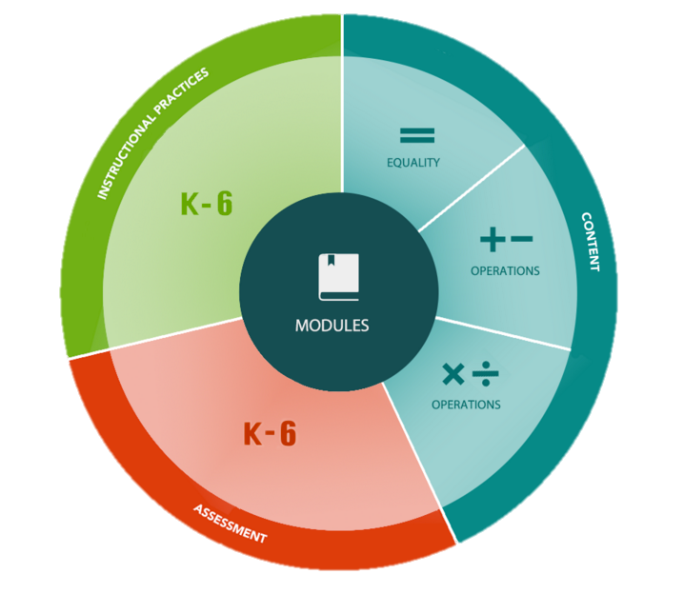
What is it?
Notes:
The EMPL group decided to focus on the big ideas of mathematics.

Slide 11
What is it?
Content
Assessment
Instructional
Practices
Notes:
There are three major sections: Content, Assessment and Instructional Practices.
Content focuses on Equality, Additive Thinking and Multiplicative Thinking.
Assessment focuses on assessment in math. Each of the content sections also focus on assessment but this section focuses on the bigger picture.
Instructional practices focuses on instructional practices overall in math. Each content section also provides instructional practices specific to that content area.

Slide 12
What is it?
Notes:
Each section is split up into 7 sub topics. <read them>
These will be updated throughout 2016-2017.

Slide 13
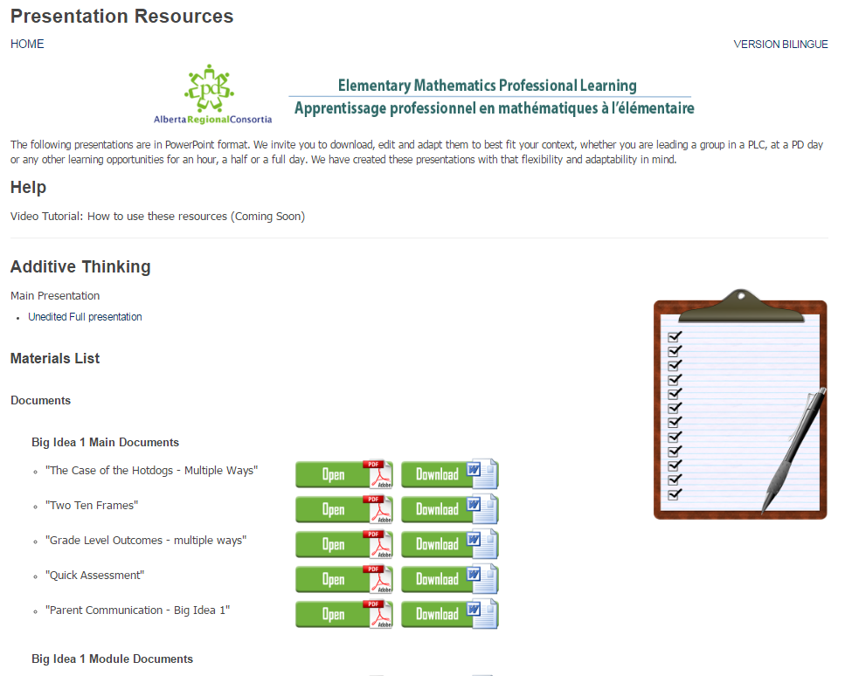
Presentation Resources
Notes:
You’ll be able to access presentation resources from the home page. These are meant for anyone who will be presenting on any of these topics. They include full unedited powerpoints. The idea is that you download the powerpoint for the topic you are focusing on and modify it to fit your needs. In each powerpoint, there is an introduction section which focuses on the topic, for example Additive Thinking, walks you through defining it, as the EMPL group defined it, make connections to the program of studies, and lists the 3 big ideas that the EMPL group selected. Then, each big idea is fleshed out in each of their own sections, again defining it but then providing you with activities you can use with the participants. Each big idea consists of several modules. Our intent is for you to go through and choose the modules that make the most sense to use for the time you have, the audience of participants and any other factors that may come in to play. Each powerpoint ends with a conclusion. Of course, you can always add other items from your own toolkit as well. Within the Presenter resource section, you’ll be able to download all of the participant documents you will need that are used within the modules. There is a short help video you can use to guide you through the process of personalizing your presentation.
All of these resources will be updated throughout the 2016-2017 school year.

Slide 14
Equality

Slide 15
Why start with Equality?
Notes:
So, Why is Equality important? Why start with Equality?
Why start with Equality? Many student difficulties in grades 4 – 12 can be linked back to a lack of understanding the equal sign. It is important that students first understand relationships between numbers before they are asked to operate with those numbers. Operations emerge as a thinking and communication tool to help us (and our students) in our quest to determine and prove equality and inequality.
Equality is mentioned explicitly in grades 1 & 2 P of S and then not again until Grade 6 (but it is still there in grades 3 – 5…)
Determining equality and inequality is the foundation for pretty much everything we do in math. It is used when working with number lines, comparing, ordering and determining magnitude and developing an understanding of commutative, associative and distributive properties. Because determining equality is so important, we compare. and comparison is the reason why equations came about. Equations became an efficient way to communicate comparisons (even when not face to face).
Math is context specific, (numeracy) so you might ask if items are the “same colour” or “same size” but that is different than asking if two set are equal. When you talk about equal or equality without adding any units or qualifiers, you are automatically talking about quantity, and it’s important that students understand equality has to do with the number of things and not the physical attributes such as size, colour, mass, etc.

Slide 16
How might your students answer:
48 - = 47 - = 46 - =
Notes:
http://www.sagepub.com/sites/default/files/upm-binaries/24790_03_Cockburn_Ch_01.pdf
Think of this from your student’s point of view

Slide 17
How might your students answer:
Is this an ok answer?
48 - = 47 - = 46 - =
1
1
1
45
Notes:
http://www.sagepub.com/sites/default/files/upm-binaries/24790_03_Cockburn_Ch_01.pdf

Slide 18
How might your students answer:
According to the equal signs, we are looking at 4 equal groups.
48 - = 47 - = 46 - =
1
1
1
45
Notes:
http://www.sagepub.com/sites/default/files/upm-binaries/24790_03_Cockburn_Ch_01.pdf

Slide 19
How might your students answer:
What would work?
48 - = 47 - = 46 - =
Notes:
What would work?
http://www.sagepub.com/sites/default/files/upm-binaries/24790_03_Cockburn_Ch_01.pdf

Slide 20
Let’s Explore

Slide 21
Let’s Explore Together
http://learning.arpdc.ab.ca

Slide 22
Let’s Explore Together
http://learning.arpdc.ab.ca
Notes:
You can click on the header or on any of the links below it.

Slide 23
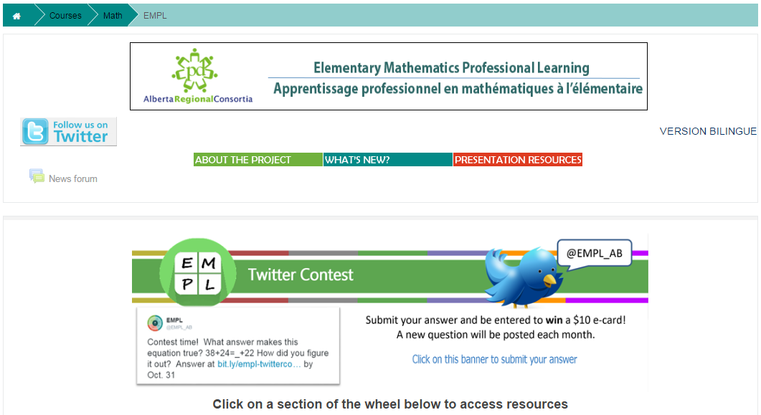
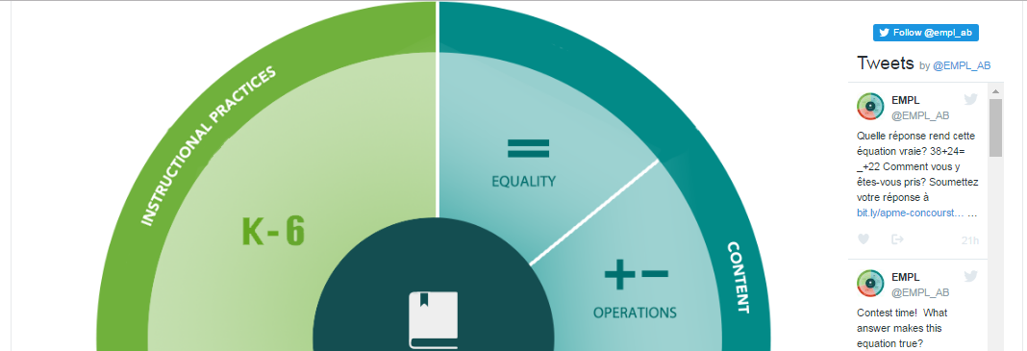
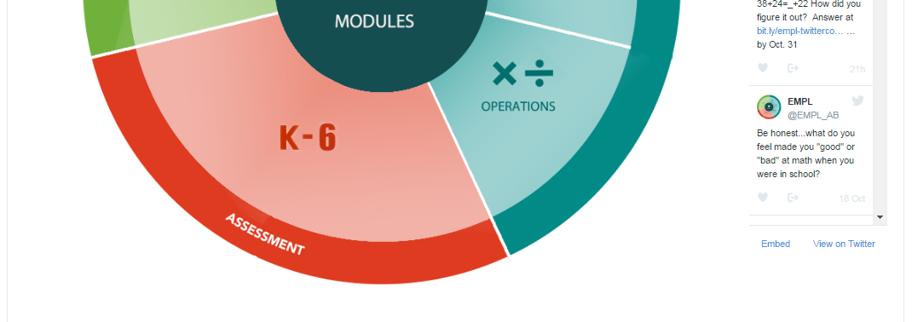
Let’s Explore Together
Notes:
When you go to the website, you’ll see the following:
The “About the Project” section gives you some more information about this project.
Check out “What’s New” on the website in the “What’s new” section.
If you are presenting on one of the EMPL topics, you can access powerpoints, handouts, etc in the Presentation Resources section.
We’re now on Twitter, so make sure to follow us. This way, you can enter our monthly contest!
If you scroll down slightly, <click>
you’ll see the wheel with the three major areas – content, instructional practices, and assessment.
Let’s take a closer look at <click>

Slide 24
Let’s Explore Together
Notes:
Additive Thinking

Slide 25
Let’s Explore Together
Notes:
If you scroll down slightly, you’ll see the links for Foundational Webinar. You can watch it online, download the slides and download the webinar guide. We ask that you complete a short survey after watching the webinar in order to provide feedback. This link can be found just below the webinar guide.

Slide 26
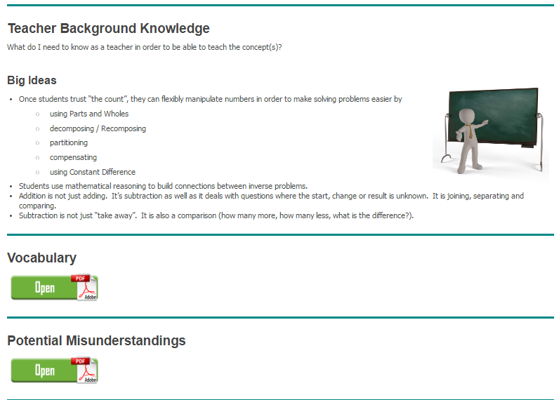
Let’s Explore Together
Notes:
Key Understandings focuses on the definition that the EMPL group created, explaining why we felt it was an important topic, provides teacher background knowledge such as the big ideas the EMPL group believed best fit this topic, key vocabulary and potential misunderstandings.

Slide 27
Let’s Explore Together
Notes:
The EMPL group analyzed the Alberta Program of Studies to determine which K-6 Math outcomes they felt focused on Additive thinking. These outcomes are listed here in the Program of Study Outcomes section.

Slide 28
Let’s Explore Together
Notes:
Evidence of Learner Understanding provides examples of what it looks like if students understand or do not understand the big ideas of this topic.

Slide 29
Let’s Explore Together
Notes:
Research links include summaries of research around this big idea.

Slide 30
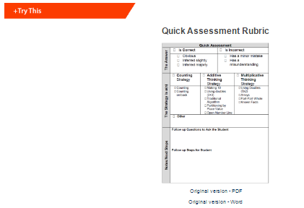
Let’s Explore Together
Notes:
In the Try This section of the three content areas, you will find a quick assessment we created in order to support teachers when formatively assessing students on the big ideas.

Slide 31
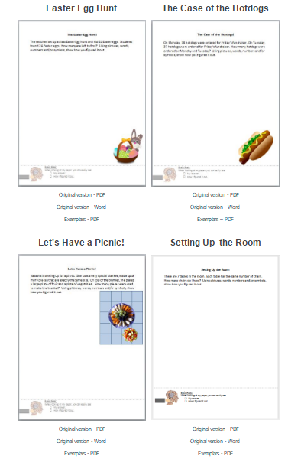
Let’s Explore Together
Notes:
You’ll also find some questions that you can implement in your classroom to check for understanding of the big idea. Not only are these in pdf but they are also in word format so that you can edit the numbers or the wording if need be. These activities were used with a few students and their responses were collected. You can find their responses within the Exemplars section. Students may have demonstrated understanding or misunderstanding of the big idea,

Slide 32
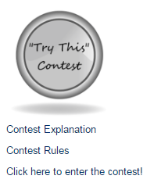
Let’s Explore Together
Notes:
We have a “Try This” contest! If you implement a “try this” question with at least 10 students, use the quick assessment to assess their results and submit their responses and your assessment, after removing all their names, you will be entered into a draw for a $50 gift card. You can enter as many different try this questions as you want as long as it’s always a different question for each submission.

Slide 33
Let’s Explore Together
Notes:
The resource section provides resources for teaching of the outcomes we identified within the “Program of Studies” section. This document will be updated throughout the year. You can also submit a resource for possible inclusion in this section.

Slide 34
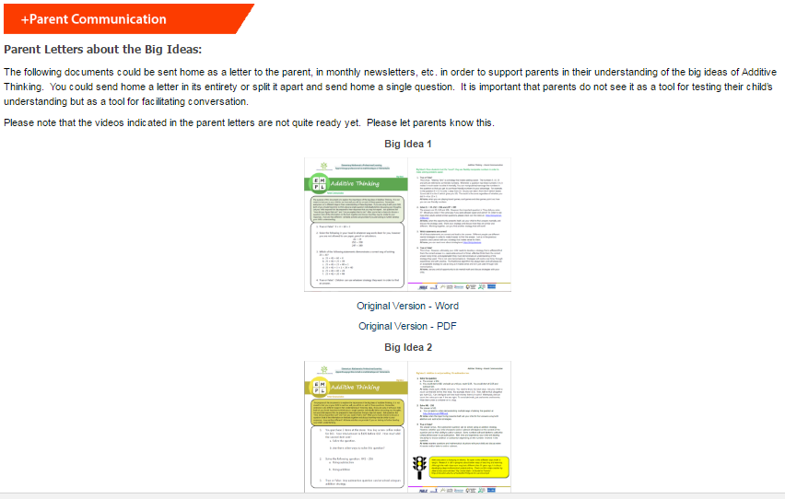
Let’s Explore Together
Notes:
The final section is the Parent Communication section. Within this section, you’ll find a variety of ideas for communicating with parents. Some of the sections have Parent Letters about the Big Ideas. They contain several questions that the parent can answer. They are cautioned not to use it as a way to test their child but it could be used to promote discussion with their child. The back side has answers to the questions and suggestions for ways to develop the big ideas at home. Not every section has these parent letters yet as they are still in development. Check back soon!

Slide 35
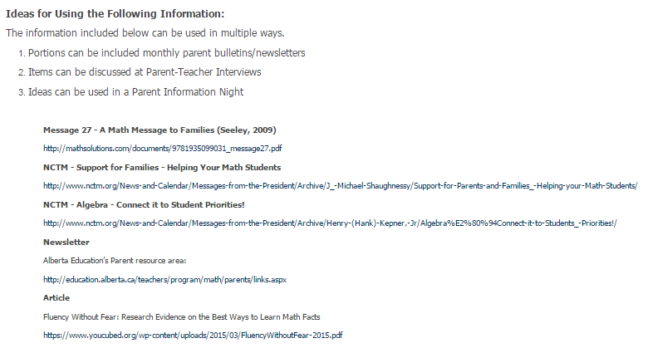
Let’s Explore Together
Notes:
This section also contains links to a variety of newsletters, articles, etc. that have been created for parents from around the world, including Alberta Education’s Parent resource area.

Slide 36
Exploring on Your Own
http://learning.arpdc.ab.ca
In grade level teams, explore the EMPL website.
Notes:
Give participants time to explore the EMPL website individually or in grade level teams.

Slide 37
Exploring on Your Own
What did you find that may be of use to you?

Slide 38
Session Evaluation

Slide 39
Thanks!
Thanks
a
1 x 10⁶

