Slide 1
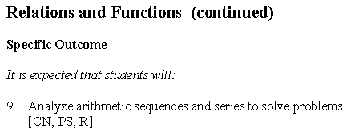
Math 20-1 Chapter 1 Sequences and Series
Teacher Notes
1.2 Arithmetic Series

Slide 2
Reviewing Arithmetic Sequences
Complete the following sentences using your own words. Then, choose symbols from the box below to create true statements.
a) An arithmetic sequence is an increasing sequence if and only if
b) An arithmetic sequence is a decreasing sequence if and only if
c) An arithmetic sequence is constant if and only if
d) The first term of a sequence is
e) The symbol for the general term of a sequence is

Slide 3
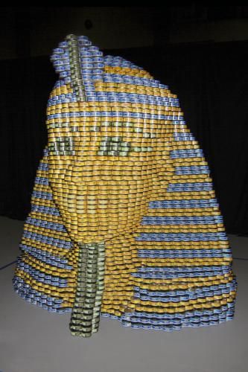
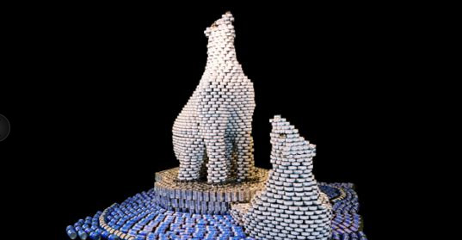
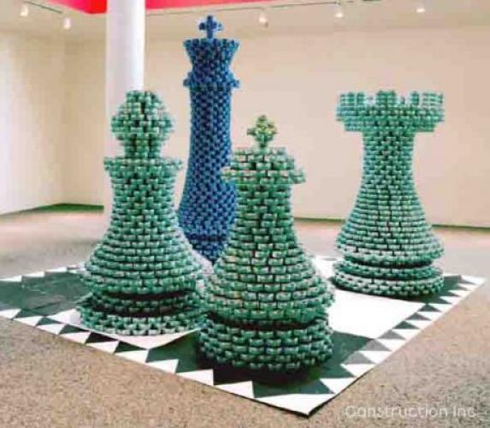
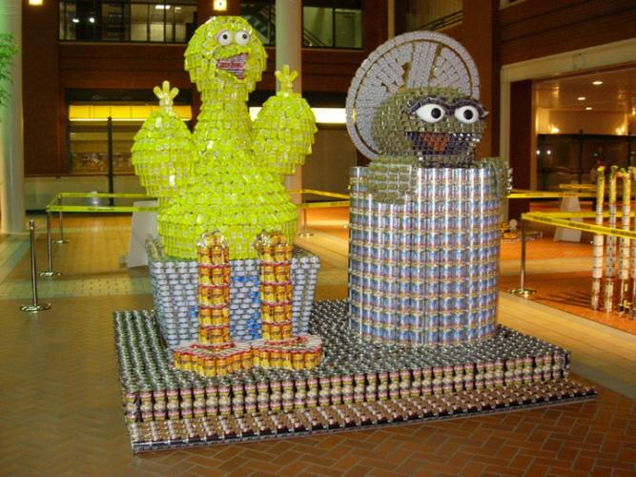
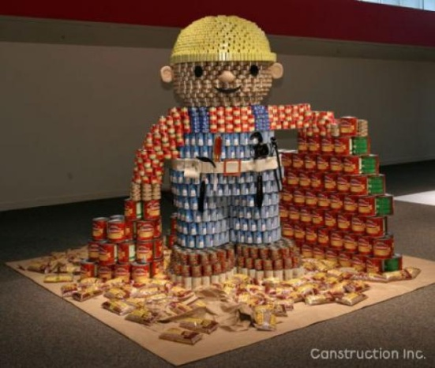
Math 20-1 Chapter 1 Sequences and Series
1.2 Arithmetic Series
1.2.1

Slide 4
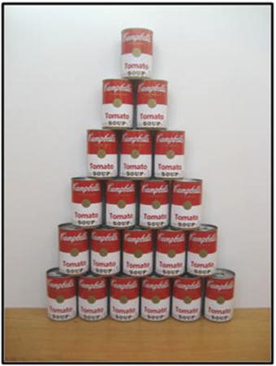
Stacking Cans
A store may stack cans for display purposes.
Suppose cans were stacked in a pattern that has one can at the top and each row thereafter adds one can.
Write the sequence generated by the number of cans in each row.
1, 2, 3, 4, 5, 6
Would this sequence be finite or infinite?
finite
If there were 18 rows in the display, how many cans would be in the 18th row?
18
How many cans in total would be in a stack of 18 rows?
What strategies could you use?
171
What if the stack of cans had 100 rows?
1 + 2 + 3 + 4 + 5 + 6 +…+ 18
The sum of the terms of an arithmetic sequence is called an arithmetic series.
1.2.2

Slide 5
Deriving a Formula for an Arithmetic Series
Solve a Simpler Problem: Consider a stack of 6 rows of cans
1 + 2 + 3 + 4 + 5 + 6
= 21
7
6
1. Shade in the number of cans per row on the grid.
5
2. What is the area of the shaded region?
21
4
Number of cans
3
3. In a different colour, shade in squares to form a rectangle.
What do you notice about the two shaded areas?
2
1
4. a) What is the width of the rectangle?
6
1
2
3
4
5
6
Row
b) What is the length of the rectangle?
7
c) What is the area of the rectangle?
6 x 7 = 42
5. How is the area of the rectangle related to the sum of the sequence?
42/2 = 21
6. Use this idea to find the sum of the 18 rows of cans?
(18 x 19)/2 = 171
1.2.3

Slide 6
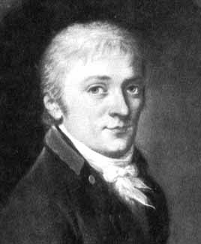
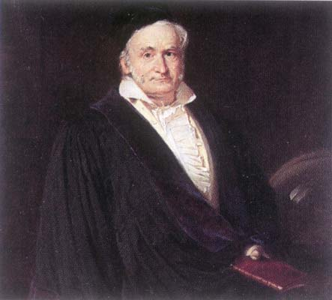
According to an old story, one day Gauss and his classmates were asked to find the sum of the first hundred counting numbers.
1 + 2 + 3 + . . . 98 + 99 + 100.
All the other students in the class began by adding two numbers at a time, starting from the first term. Gauss found a quicker method.
Johann Carl Friedrich Gauss
Since there are 100 of these sums of 101, the total is 100 x 101 = 10 100.
The sum, 10 100, is twice the sum of the numbers 1 through 100, therefore
1 + 2 + 3 + . . . + 100 = 10,100/2 = 5050.
1.2.4

Slide 7
The Sum of the General Arithmetic Series
Consider the series: 3 + 7 + 11 + 15 + 19 + 23
S₆ = 3 + 7 + 11 + 15 + 19 + 23
S₆ = 23 + 19 + 15 + 11 + 7 + 3
2S₆ = 26 + 26 + 26 + 26 + 26 + 26
2S₆ = 6 (26)
2S₆ = 6 (3 + 23)
S₆ =
78
Number of terms
in the sequence
In general:
S_{n} =
(t₁
+ t_{n})
First term
of the
sequence
Last term
of the
sequence
1.2.5

Slide 8
The General Arithmetic Series
In general, the sum of an arithmetic series may be
written as:
Used when you know the first
term, last term, and the number
of terms.
t_{n} = a + (n- 1)d
n - number of terms
t₁ - first term
t_{n} - last term
t_{n}
Used when you know the first term, the common difference, and the number of terms.
1.2.6

Slide 9
Arithmetic Series
Determine the sum of the sequence 17, 12, 7, . . ., -38.
t₁ = 17
t_{n} = -38
d = -5
n = ?
t_{n} = t₁ + (n - 1)d
-38 = 17 + (n - 1)(-5)
-38 = 17 - 5n + 5
-60 = -5n
12 = n
S₁₂ = -126
The sum of the sequence is -126.
1.2.7

Slide 10
Arithmetic Series
The sum of the first two terms of an arithmetic series is 19 and the sum of the first four terms is 50.
a) What are the first four terms of the series?
b) What is the sum of the first 20 terms?
2( )
a) 8, 11, 14, 17
-( )
b)
1.2.8

Slide 11
Assignment
Suggested Questions
Page 27:
1a,d, 2a, 3a, 4d, 5a, 6a, 9, 10, 11, 15, 17
1.2.9

