Slide 1
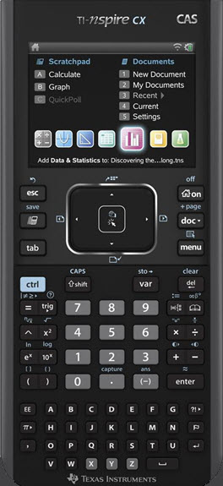
1.4 Inverse of a Relation
1.4 Functions and Inverses
Move to page 1.2
Grab and drag point P.
What changes and what remains the same?
Point P′ is the image of Point P after a reflection called an inverse.
Point P |  | Point P'
x | y | x | y
Record some ordered pairs for point P and point P′ in the table.
Compare the ordered pairs for point P and point P′.
How are they alike or different?
Make a conjecture to predict the coordinates of image point P′ given coordinates of point P.

Slide 2
Move to page 1.3
Grab and drag point P. Notice the coordinates of point P′.
Does your conjecture regarding the relationship between the coordinates of the point and the inverse of the point hold true?
Complete the notation for the inverse of a point in mapping notation. (a, b) →
(b, a)
This type of transformation is actually a reflection through an oblique line.
The equation for the line of reflection is
y = x
Move through pages 1.4 to 1.6.
Is the graph of the inverse of a function also a function?
What does the horizontal line test tell us about the graph of the inverse?

Slide 3
Properties of the Inverse of a Relation
x-int → y-intercept
Every point (x, y) has an inverse (y, x).
y-int → x-intercept
The original domain and range are interchanged for the inverse.
{domain} → {range}
{range} → {domain}
The graph of the inverse of a function is a reflection in the line
y = x
The invariant points for the inverse transformation are
on the line y = x
If the inverse of a function, f(x), also is a function the inverse is
denoted by y = f ⁻¹(x).
If the inverse of a function, f(x), is a non-function, the inverse is denoted by x = f(y).
The Horizontal Line Test can be used to determine if an inverse will also be a function.

Slide 4
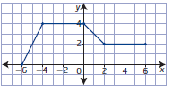
Consider the graph of the relation shown.
Is the relation a function?
Is the inverse a function?
Sketch the graph of the inverse
relation.
Key Points
(y, x)
(x, y) | →
(-6, 0)
→
(0, -6)
(-4, 4)
→
(4, -4)
Compare the domain, range for the relation and the inverse relation.
(0, 4)
→
(4, 0)
(2, 2)
→
(2, 2)
original
inverse
(6, 2)
→
(2, 6)
Identify any invariant points.

Slide 5
Graphing the Inverse Function
Note: If the ordered pair (3, 6) satisfies the function f(x), then the ordered pair (6, 3) will satisfy the inverse, f ⁻¹(x).
Find the inverse of the function f(x) = 4x - 7.
y = 4x - 7
Interchange the
x and y values.
x = 4y - 7
x + 7 = 4y
x + 7 = y
4
f⁻¹(x)
(-3, 1)
(-7, 0)
y = x
f(x)
(1, -3)
Notice the inverse equation undoes or reverses the operations.
(0, -7)

Slide 6
To write the equation of the inverse of a given function:
1. Interchange the variables of x and y.
2. Rearrange the equation in the form y =
Write the equation of the inverse of the following functions
Move to page 2.3
Verify graphically
Isolate the y-variable
Move to page 2.2
Verify graphically
Determine the coordinates of the invariant points.

Slide 7
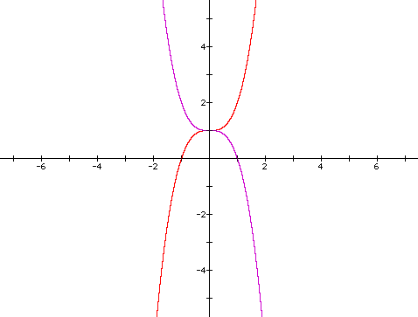
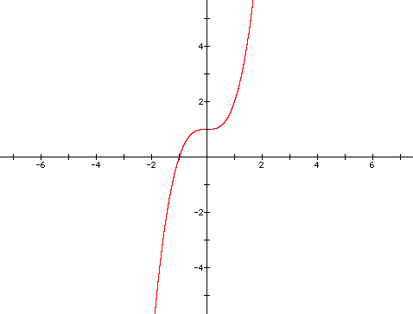
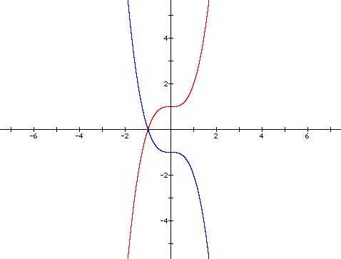
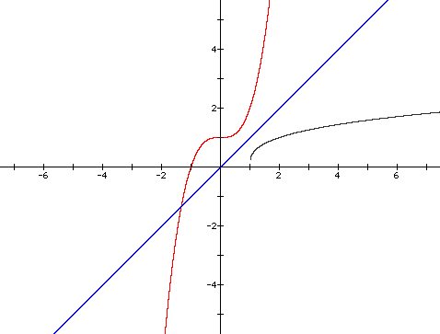
Reflecting y = f(x)
Given f(x) = x³ + 1, which transformation is shown?
Name the invariant points.
y = x
a) y = f(-x)
b) y = f ⁻¹(x)
(-1.32, -1.32)
c) y = -f(x)

Slide 8

Restricting the Domain

Slide 9
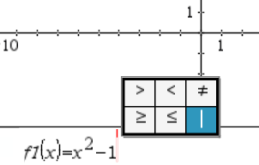
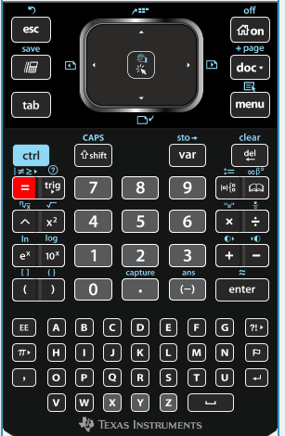
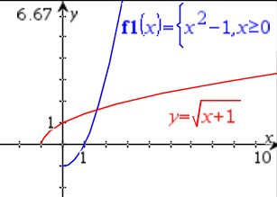
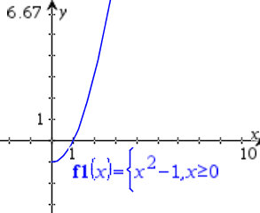
For typical functions, the domain is the set of all real numbers. To restrict the domain, use the “such that” symbol.
The inverse will be a function.

Slide 10
Graphing a Function and Its Inverse
Graph f(x) = x² + 1
and its inverse.
(-2, 5)
(2, 5)
The graphs are
symmetrical about
the line y = x.
For the function:
(1, 2)
(-1, 2)
(5, 2)
Domain
Range
(0, 1)
(2 , 1)
y > 1
(1, 0)
For the inverse:
Domain
Range
x > 1
y = x
(2, - 1)
Is the inverse
a function?
(5, -2)
Given f(x) = x² + 1,
the inverse is
NOT a function.

Slide 11
Graphing a Function and Its Inverse
Considering the graph of
f(x) = x² + 1
and its inverse:
Graph y = x² + 1
where x > 0.
Graph the inverse.
Is this a function?
Graph y = x² + 1
where x < 0.
Graph its inverse
Is this a function?
What are your
conclusions about
restricting the domain
so that the inverse is
a function?

Slide 12
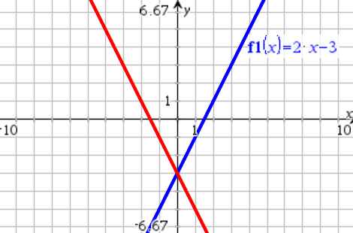
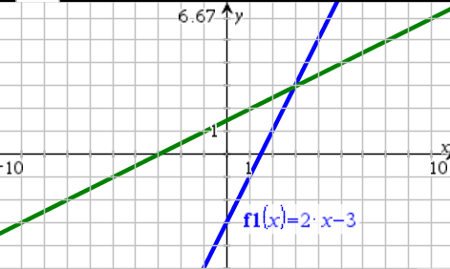
How would the domain of y = (x + 2)² be restricted for the inverse to be a function?
Vertex (-2, 0)
or
Consider the function y = (x – 1)² – 2. If ( a, -1) is a point on the graph of x = f (y), then the value of a is ___.
3
Given the equation of each function, write the equation of the unlabeled graph.

Slide 13
Assignment:
Page 50:
1b, 2b, 3a, 4c, 5b,c,d, 6, 8,
9b,e, 12a,f, 14b, 15, 18

