Slide 1
Radical Functions
Graph a Square Root Function
Transformations
Graph the Square Root of a Function
Solving Radical Eqn’s Graphically

Slide 2
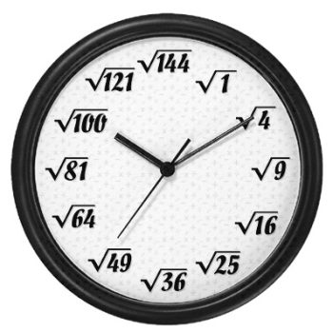
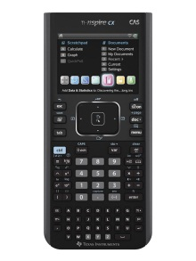
2.1 Radical Functions and Transformations
What does square root mean?
2.1 Can you square root?
How can you estimate a square root
if the value is not a perfect square?
Write the equation for a square root function.
Write the equation for the square root of a function.
How are these the same? Different?

Slide 3
What falls faster a brick or a marble?
Galileo Galilei pondered this question more than 400 years ago.
He theorized that the rate of falling objects depends on air resistance, not on mass. The result was
they fell at the same rate.
Leaning Tower
of Pisa
Galileo
For objects falling near the surface of Earth, the function d = 5t² approximately models the time, t, in seconds, for an object to fall a distance, d, in metres, if the resistance caused by air can be ignored.
Express time as a function of distance.
Is this correct?
Restriction on the domain.

Slide 4
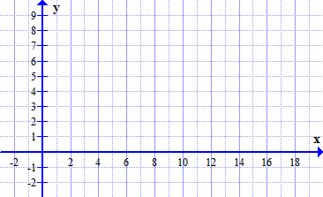
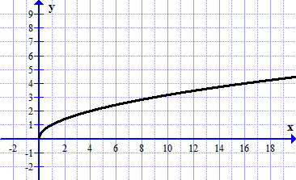
Graphing
Key Points
Are there any restrictions on the domain?
x | y
0
0
1
1
4
2
9
3
Range
x- intercept
y- intercept

Slide 5
Transformations of the Radical Function
Which parameters affect the domain?
Range?
Use a table of values to sketch the graph of
Domain?
x | y
x | y
0
0
-3
0
1
1
-2
1
Range?
4
2
1
2
9
3
6
3

Slide 6
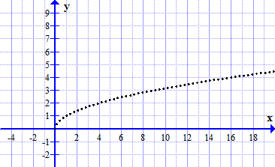
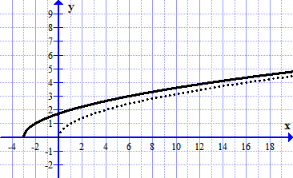
Translate the key points 3 units left.
Invariant Points?

Slide 7
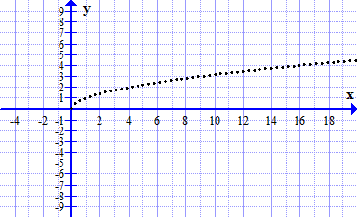
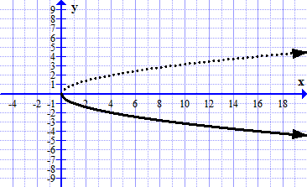
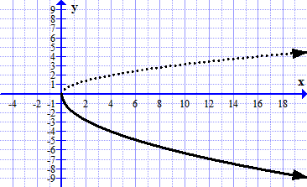
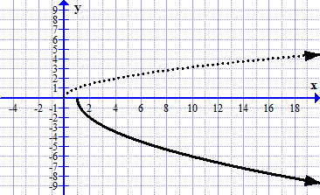
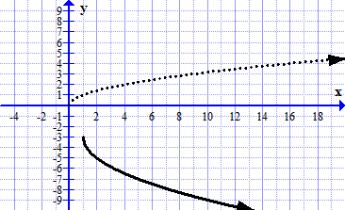
Sketch the Graph using Transformations
F
R
S
T
Domain
Range
Invariant Points?

Slide 8
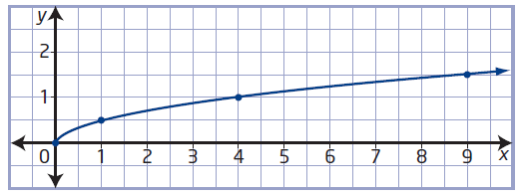
Consider the function
y = f(x)
Write an equation for the function in the form:
Show algebraically that the two equations are equivalent.

Slide 9
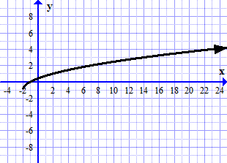
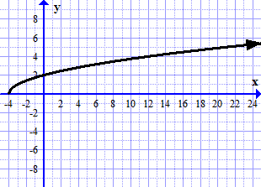
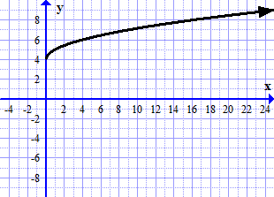
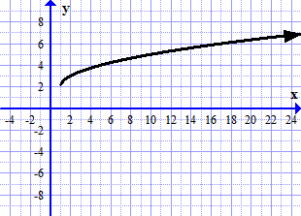
Match each graph with its function equation
Domain, Range, Invariant Points

Slide 10
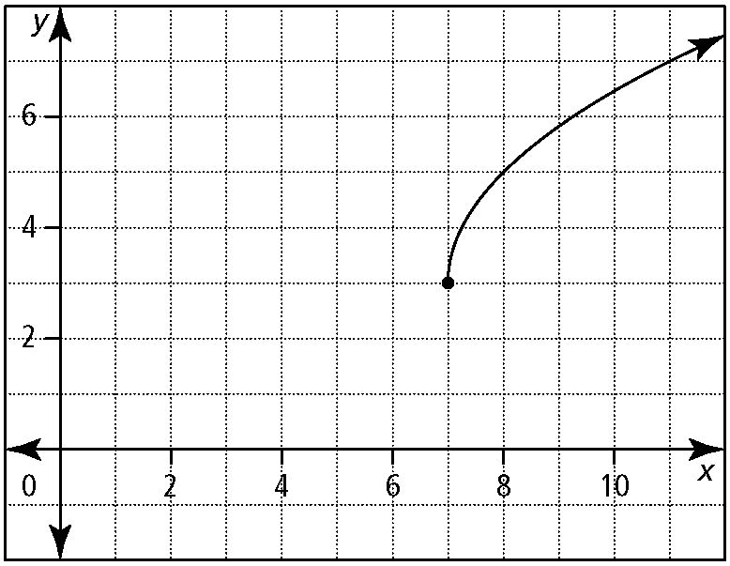
Write the function equation from the graph in the form
2
Horizontal translation 7 units right
Vertical translation 3 units up
Vertical Stretch
Horizontal Stretch
Each vertical distance is 2 times the corresponding distance for
Each horizontal distance is ¼ times the corresponding distance for
a = 2

Slide 11
Assignment:
Page: 72
1c,d, 2a, 3, 4a,b, 5a,b,f, 6, 8, 9

