Slide 1

5.2 Transformations of Sinusoidal Functions
Electric power and the light waves it generates are sinusoidal waveforms.

Slide 2
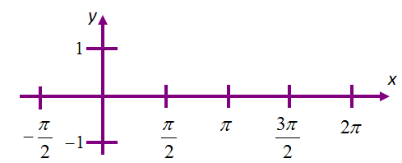
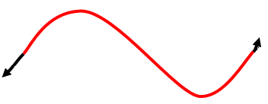
Graphing a Horizontal Translation
Graph y = sin x
Use 5 key points to plot the graph of y = sin x
x | sin x
0 | 0
 | 1
 | 0
 | -1
 | 0
y = sin x

Slide 3
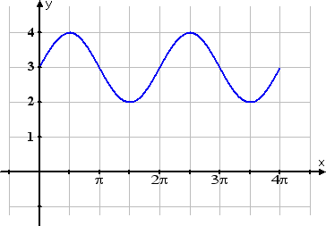
Graphing a Horizontal Translation
Vertical Translation - upward or downward shift in the graph of the function.
The constant “d” determines the magnitude and direction of the vertical displacement of a periodic function.

Slide 4
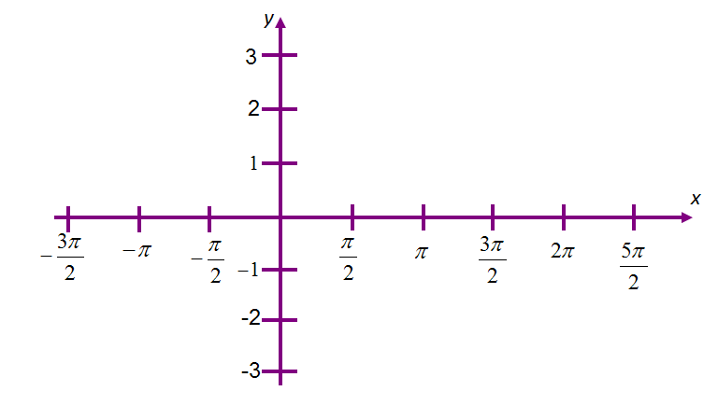
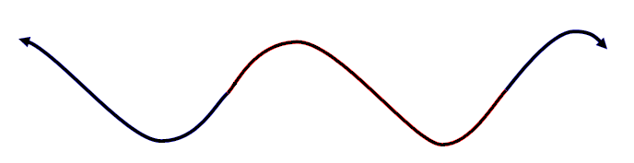
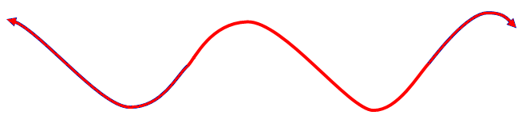
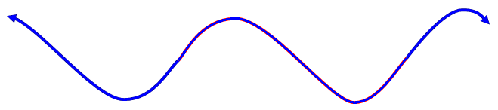
Graphing y = sinx + d
Sketch the graphs of y = sinx – 3 and y = sinx + 2
y = sin x + 2
y = sin x
y = sin x - 3

Slide 5
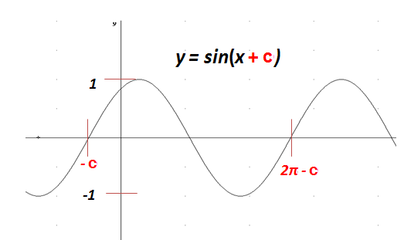
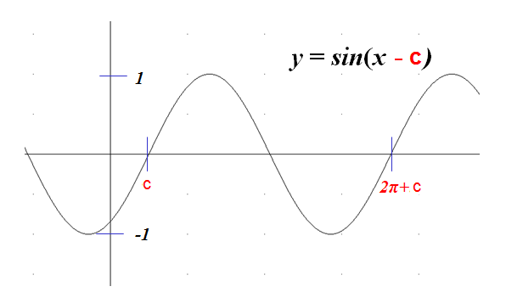
Graphing a Horizontal Translation
Horizontal Translation - upward or downward shift in the graph of the function.
The constant “c” determines the magnitude and direction of the phase shift of a periodic function.

Slide 6
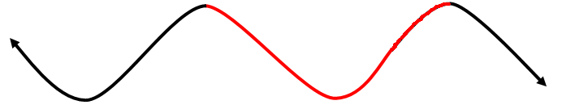
Graphing y = sin(x – c)
Sketch the graph of
y
x
y = cosx

Slide 7
Graphing y = sin(x – c)
Sketch the graph of
y
x
y = cosx

Slide 8
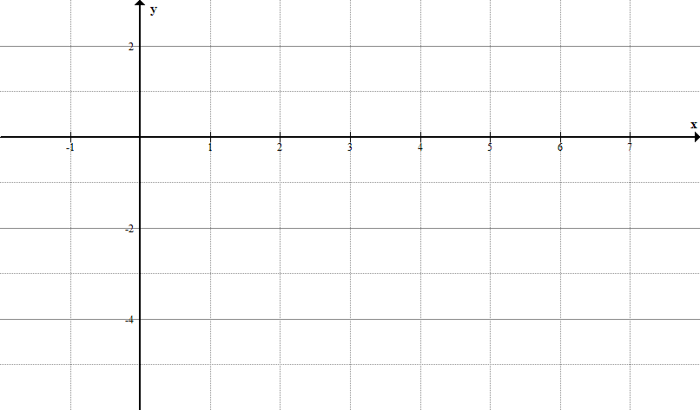
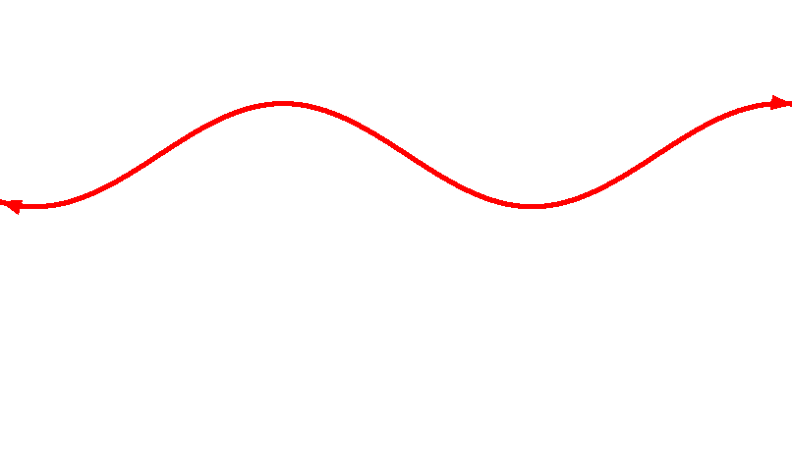
Graphing y = sin(x – c) + d
Sketch the graph of using transformations.
1. Sketch the graph of y = sin x. (radians)
y = sin x

Slide 9
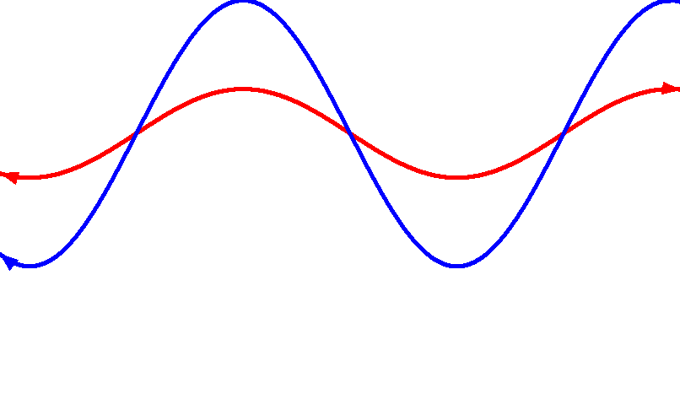
Graphing
2. Sketch the graph of y = 3sin x.
y = 3sin x
y = sin x

Slide 10
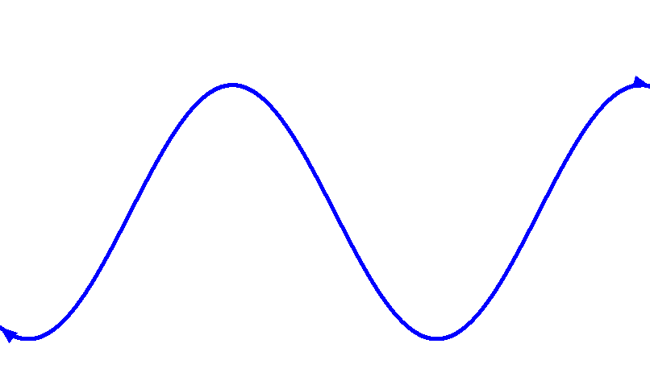
Graphing
2. Sketch the graph of y = 3sin x.
3. Sketch the graph of y = 3sin x – 2.
y = 3sin x
y = sin x
y = 3sin x - 2

Slide 11
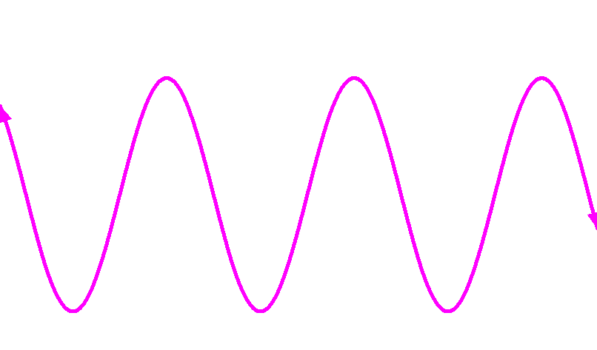
Graphing
4. Sketch the graph of y = 3sin 2x – 2.
y = 3sin x – 2
y = 3sin 2x – 2

Slide 12
Graphing
5. Sketch the graph of y = 3sin 2(x + 2) – 2.
y = 3sin 2(x + 2) – 2
y = 3sin 2x – 2

Slide 13
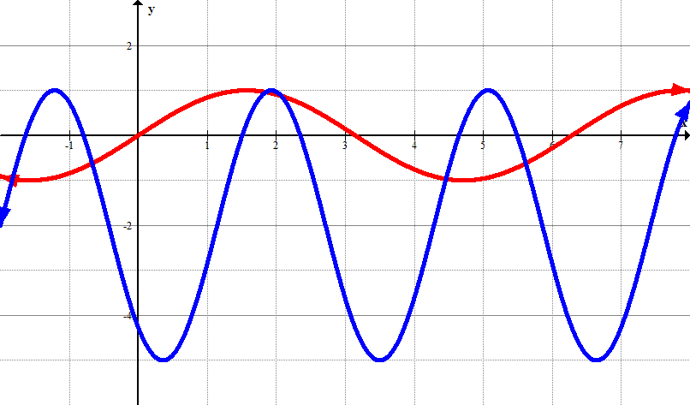
Graphing
y = sin x
y = 3sin 2(x + 2) – 2
Domain:
Range:
Amplitude:
Vertical Displacement:
Period:
Phase Shift:
the set of all real numbers
{-5 ≤ y ≤ 1}
3
2 units down
π
units to the left

Slide 14
Analyzing a Sine Function
π
2π
y- intercept:
x = 0
Domain:
Range:
Amplitude:
Vertical Displacement:
Period:
Phase Shift:
the set of all real numbers
-5 ≤ y ≤ 1
3
2 units down
π
units to the left

Slide 15
Determining an Equation From a Graph
A partial graph of a sine function is shown.
Determine the equation as a function of sine.
a = 2
d = 1
b = 2
Therefore, the equation is
.

Slide 16
Determining an Equation From a Graph
A partial graph of a cosine function is shown.
Determine the equation as a function of cosine.
a = 2
d = -1
b = 2
Therefore, the equation is
.

Slide 17
Determining an Equation From a Graph
A partial graph of a sine function is shown.
Determine the equation as a function of sine.
Amplitude:
Vertical Displacement:
Period:
3
The equation as a
function of sine is
2
π

Slide 18
Assignment
Page 250
1a,c,e, 2a,c,e, 3, 4, 5, 6a, 7a, 8, 10, 11a,c, 12a,b, 14a,b, 20, 22

Slide 19
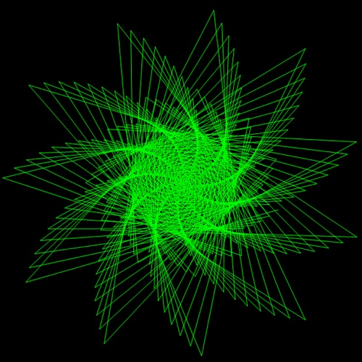
The End

Slide 20
Identify the key points of your basic graph
Find the new period (2π/b)
Find the new beginning (bx - c = 0)
Find the new end (bx - c = 2π)
Find the new interval (new period / 4) to divide the new reference period into 4 equal parts to create new x values for the key points
Adjust the y values of the key points by applying the change in height (a) and the vertical shift (d)
Graph key points and connect the dots

