Slide 1
Exponential Functions
Graphs
Characteristics
Transformations
Solving
Equations

Slide 2
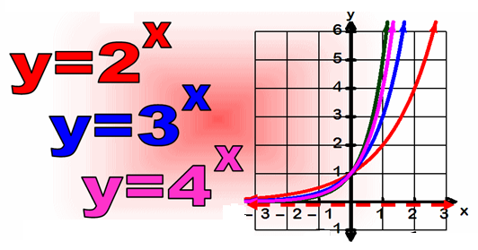
7.1 Exponential Functions
Multiplication is a notation for expressing repeated addition.
A Power is a notation for expressing repeated multiplication.
exponent
base

Slide 3
Exponential Functions
The exponential function f with base c is defined by
f (x) = c^{x} or y = c^{x}
Where c is a positive constant other than 1 and x is any real number.
c > 0, c ≠ 1
Examples of exponential functions.
f (x) = 2^{x} g(x) = 10^{x} h(x) = 3^{x+1}
Base is 2.
Base is 10.
Base is 3.
Non- Examples of exponential functions.
r (x) = x² s(x) = 2x+1

Slide 4
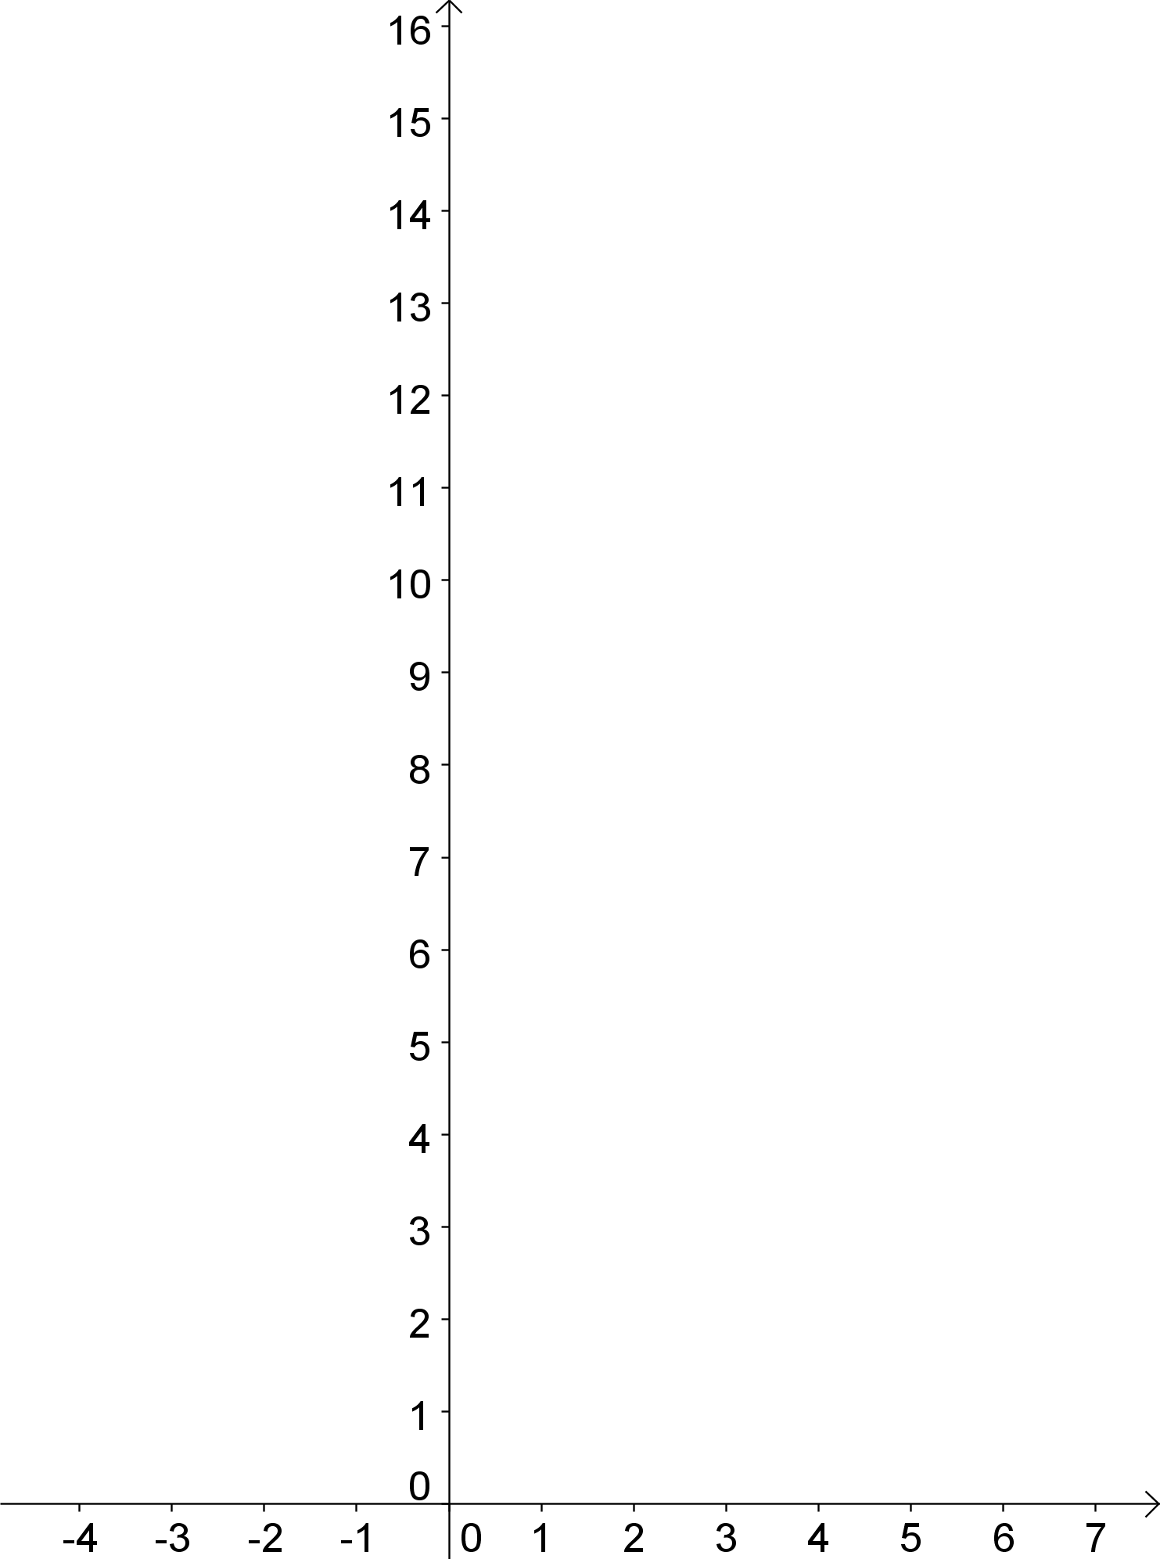
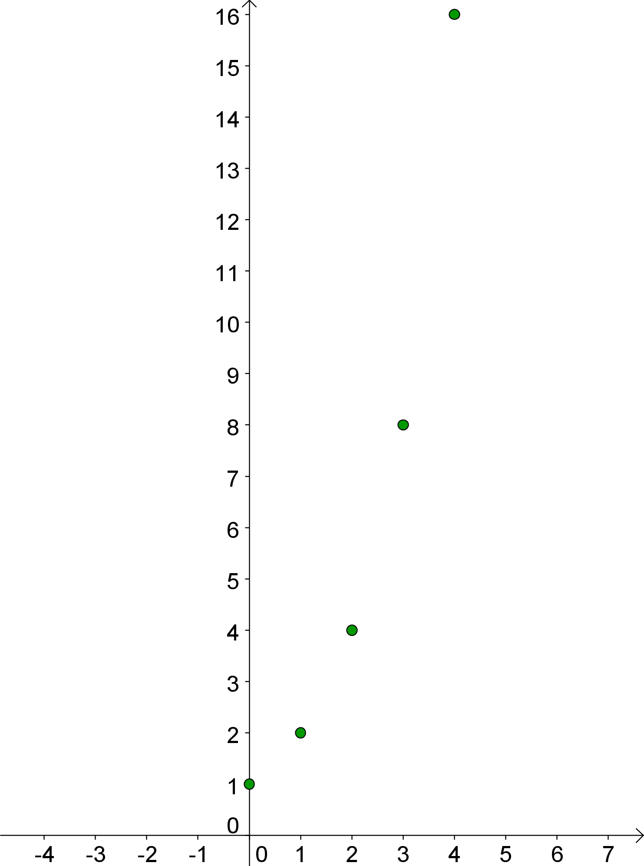
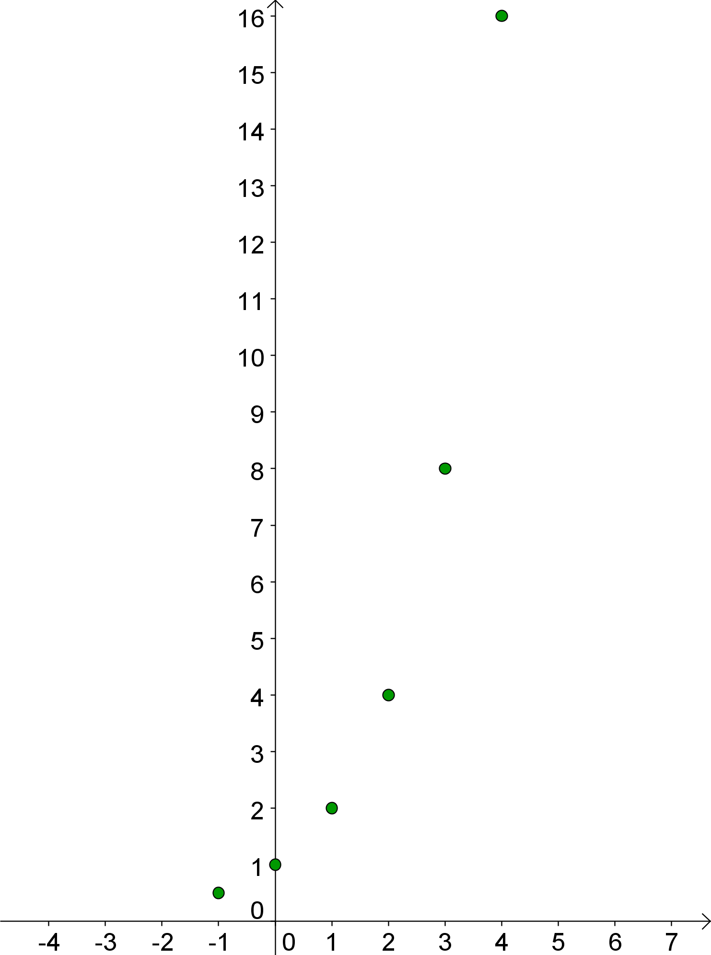
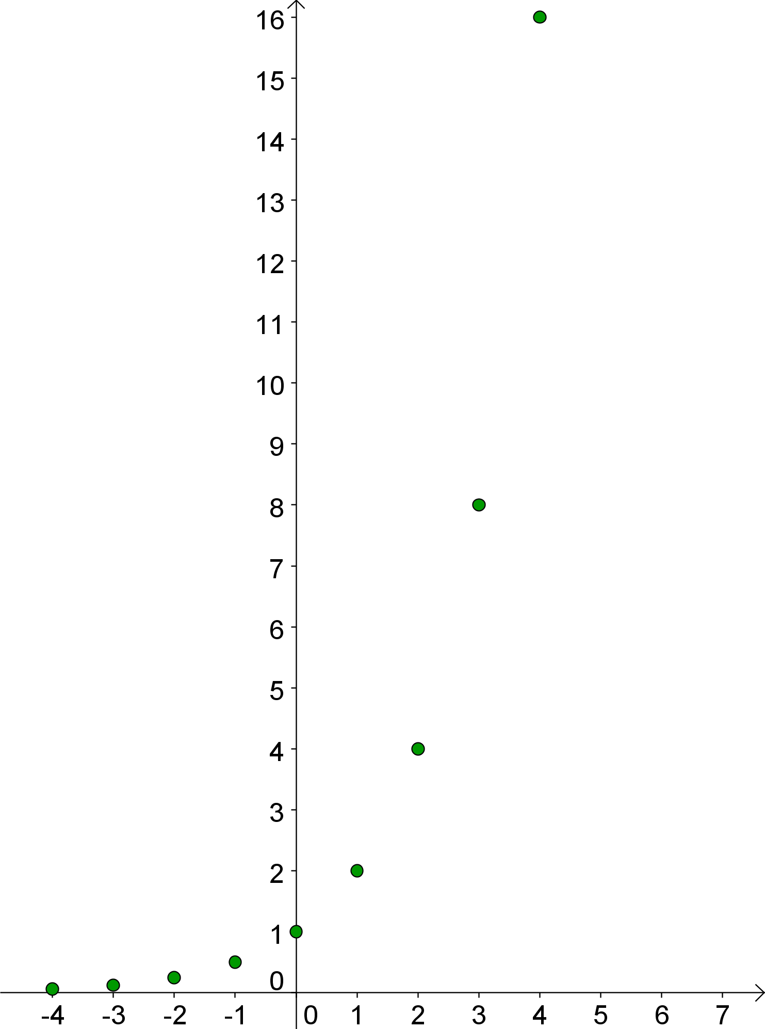
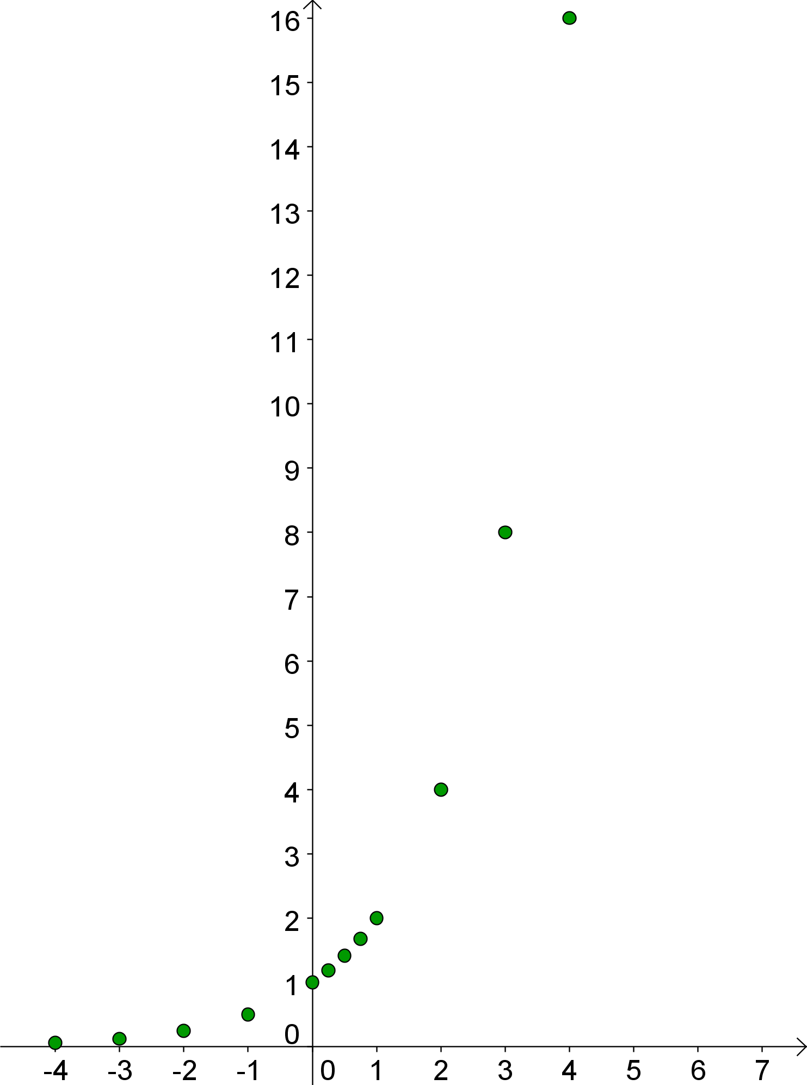
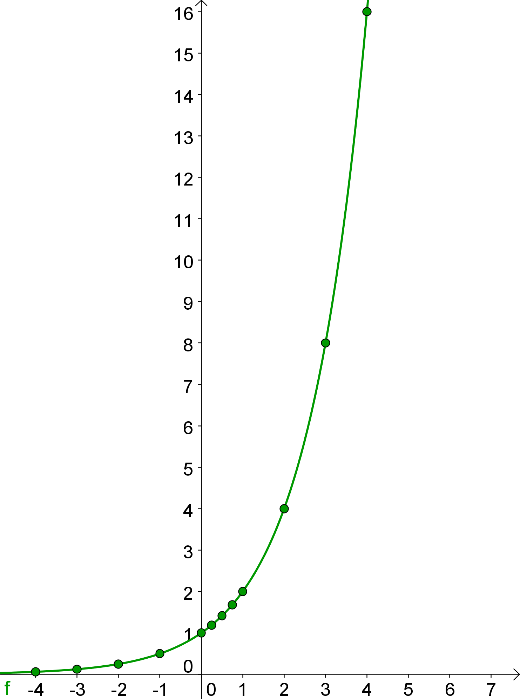
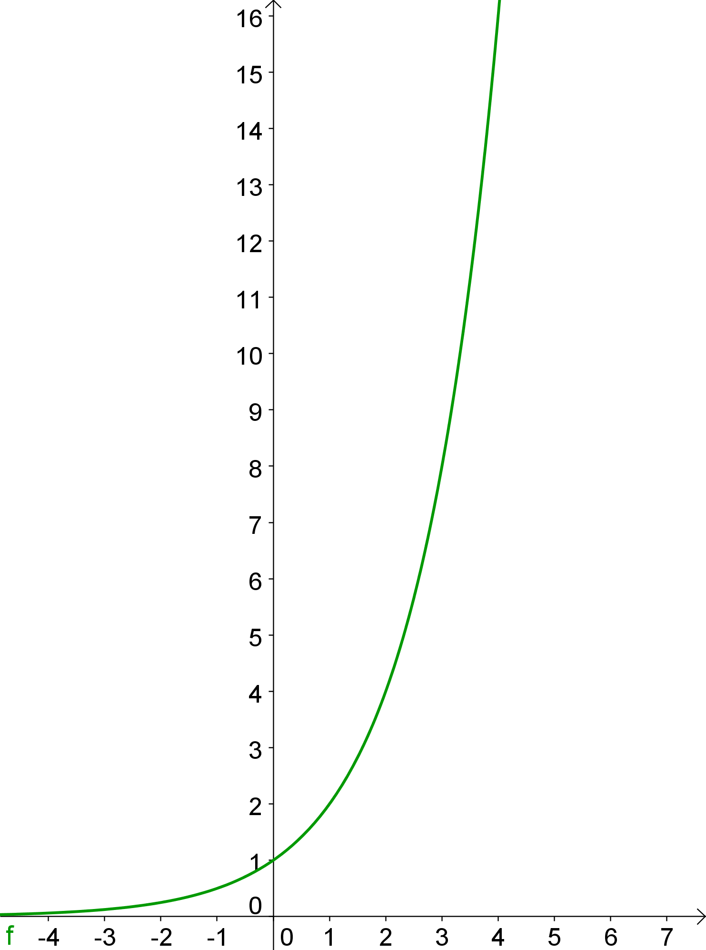
Analyse the Graph of an Exponential Function: y=2^{x}
Table
Graph
Notice the rapid increase in the graph as x increases.
x | y
-4 | 2⁻⁴=1/16=0.0625
-3 | 2⁻³=1/8=0.125
-2 | 2⁻²=1/4=0.25
-1 | 2⁻¹=1/2=0.5
0 | 2⁰=1
0.25 | 2^{0.25}=1.1892…
0.5 | 2^{0.5}=1.4142…
0.75 | 2^{0.75}=1.6817…
1 | 2¹=2
2 | 2²=4
3 | 2³=8
4 | 2⁴=16
The graph increases slowly for x < 0.
y-intercept is 1.
Horizontal asymptote at y = 0

Slide 5
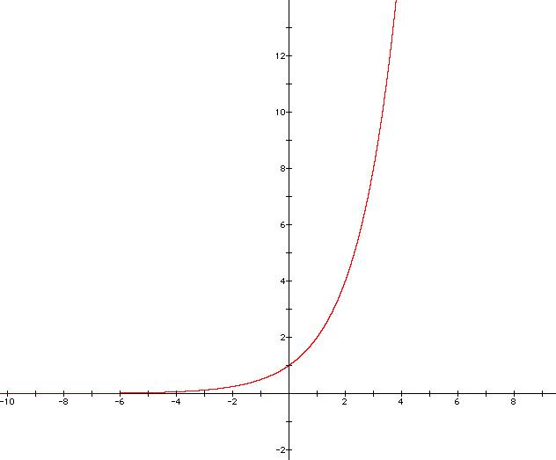
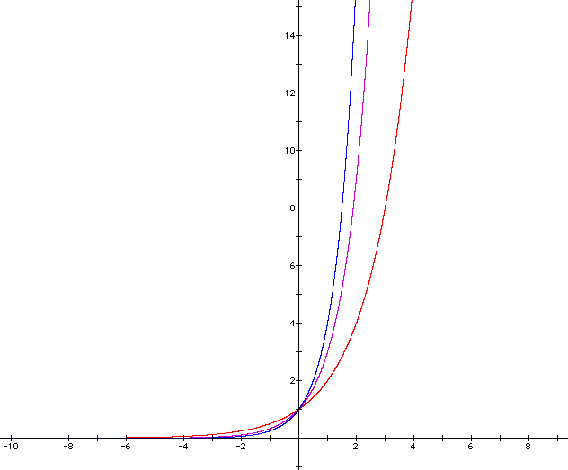
McGraw Hill Teachers Resource DVD
N04_7.1_338_IA_F
Graph y = 2^{x}
y = 3^{x}
y = 4^{x}
y = 2^{x}
y = 4^{x}
y = 2^{x}
Exponential Growth
What is the effect on the graph as the base changes?
y = 3^{x}
What characteristics remain the same as the base changes?
The y-intercept is 1.
There is no x-intercept.
The domain is {x| x ϵ R}.
The range is {y| y > 0}.
There is a horizontal asymptote
at y = 0.

Slide 6
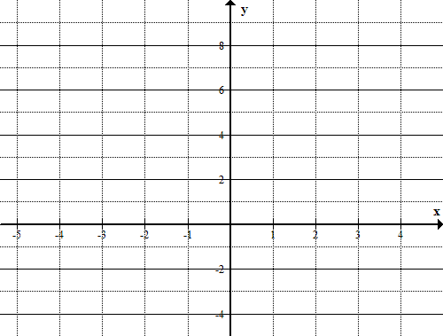
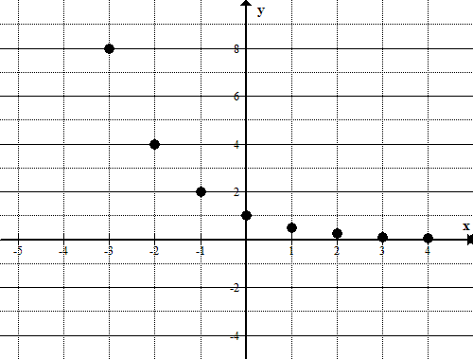
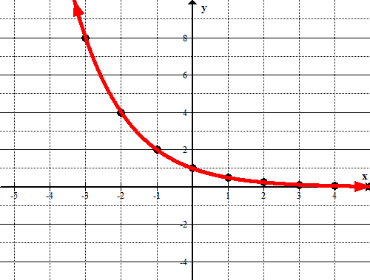
The Graph of an Exponential Decay (Decline) Function
The graph of an exponential decay function is an exponential function that decreases as x increases. It has the form
Example: g(x) = (½)^{x}
g(x)=2^{-x}
x | f(x)
-3 | 8
-2 | 4
-1 | 2
0 | 1
1 | 0.5
2 | 0.25
3 | 0.125
4 | 0.0625
5 | 0.03125
x | f(x)
-3
-2
-1
0
1
2
3
4
5
Notice the rapid decline in the graph for x < 0.
The graph decreases more slowly as x increases.
y-intercept is 1
Horizontal asymptote is y = 0.

Slide 7
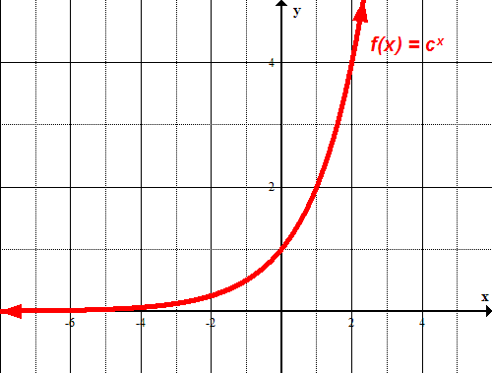
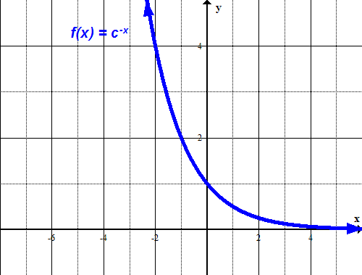
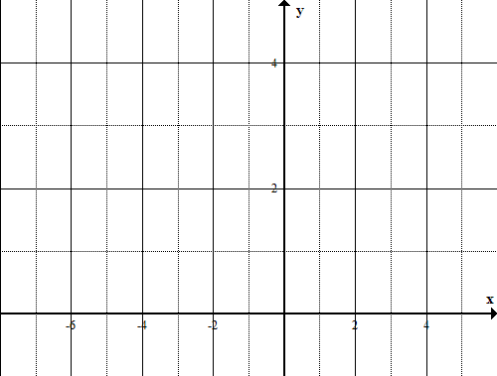
Graphing Exponential Functions
When c > 1, f(x) has a graph that goes up to the right and is an increasing function.
When 0 < c < 1, f(x) has a graph that goes down to the right and is a decreasing function.
What happens when c = 0?

Slide 8
Characteristics of Exponential Functions
The domain of f (x) = c^{x} consists of all real numbers.
The range of f (x) = c^{x} consists of all positive real numbers.
The parent graph of all exponential functions passes through the point (0, 1) because f (0) = c⁰ = 1.
If c > 1, f (x) = c^{x} has a graph that goes up to the right and is an increasing function.
If 0 < c < 1, f (x) = c^{x} has a graph that goes down to the right and is a decreasing function.
The graph of f (x) = c^{x} approaches but does not cross the x-axis. The line y = 0 is a horizontal asymptote.
f (x) = c^{x}
0 < c < 1
f (x) = c^{x}
c > 1

Slide 9
Use the following information for the next question.
Consider numbered ordered pairs listed below.
1. | 2.
3. | 4.
Write the number of the ordered pair that would lie on the graph of each exponential equation.

Slide 10
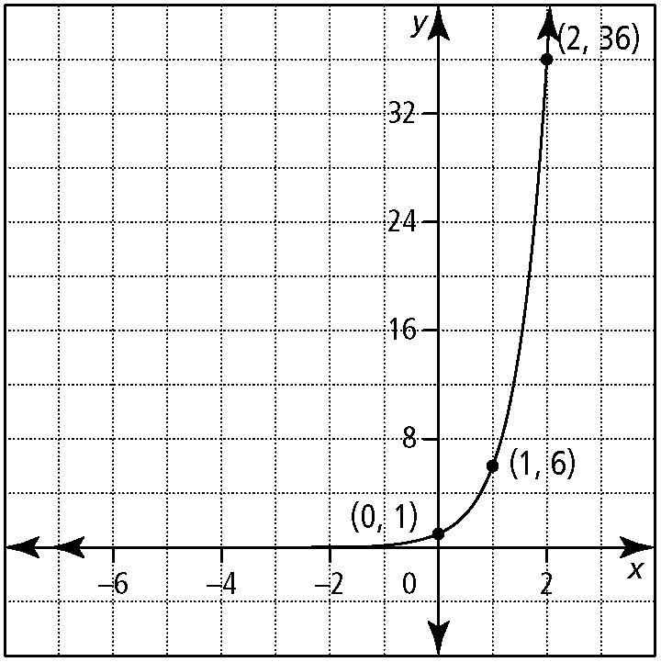
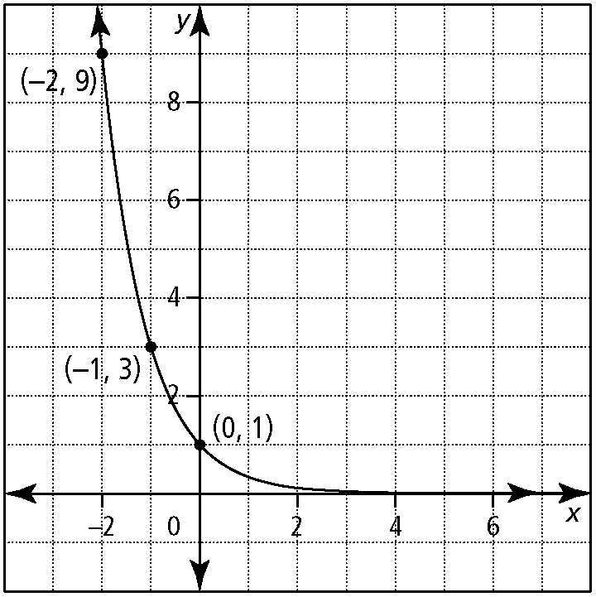
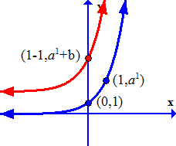
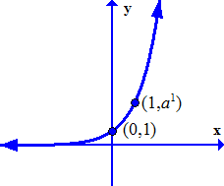
Write the equation that models the graph in the form y = a^{x}.
The y-intercept on the graph of
is

Slide 11
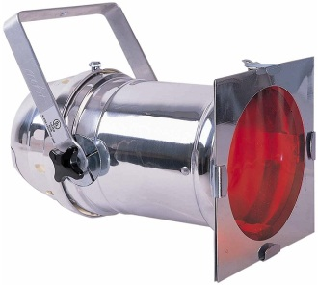
The intensity of light from a stage light decreases exponentially with the thickness of the coloured gels covering it. The intensity, I, in watts per square centimetre, can be calculated using the formula ,
where n is the number of coloured gels used.
What is the intensity of light with the following number of gels?
2 gels
4 gels
768 watts/cm²
491.5 watts/cm²
What is the domain of this situation?
n must be a whole number

Slide 12
Assignment
Page 342
1, 2, 3, 4, 5, 6a,b, 7, 8, C2

