Slide 1
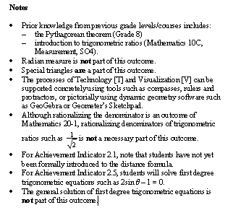
Math 20-1 Chapter 2 Trigonometry
Teacher Notes
2.2B Trig Ratios of Any Angle (Solving for the Angle)

Slide 2
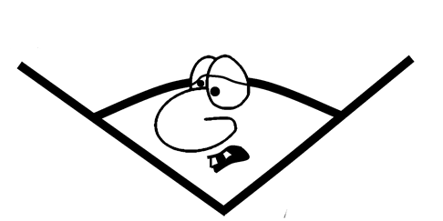
Math 20-1 Chapter 1 Sequences and Series
2.2B Trig Ratios of Any Angle
Quadrantal Angles and Solve for the Angle
The reference angles for angles in standard position 150° and 210° are equal. Does this imply that ?
II
ref 30°
III
ref 30°
2.2.1

Slide 3
Quadrantal Angles
90°
P(0, 3)
180°
0°
, 360°
Q(-4, 0)
270°
2.2.2

Slide 4
Determine the Measure of an Angle Given a Trig Ratio
0⁰ ≤ θ < 360⁰
Solve for angle θ given
I or II
2
2
1
θ
1
θ
R
Reference
Angle
θ = 30⁰
R = 30⁰
Reference Angle
θ = 30⁰
Angle in Standard
Position
θ = 150⁰
Angle in Standard
Position
2.2.3

Slide 5
Determine the Measure of an Angle Given a Trig Ratio
0⁰ ≤ θ < 360⁰
^{nearest degree}
Solve for angle θ given
I or II
5
5
3
θ
3
θ
R
Reference
Angle
θ = 37⁰
R = 37⁰
Reference Angle
θ = 37⁰
Angle in Standard
Position
θ = 143⁰
Angle in Standard
Position
2.2.4

Slide 6
Determine the Measure of the Angle Given the Exact Ratio
Solve for each angle θ given a specific trig ratio.
0⁰ ≤ θ < 360⁰
I
II
I
III
θ = 45⁰,
135⁰
θ = 30⁰
, 210⁰
RA = 45⁰
RA = 30⁰
I
IV
I
II
θ = 60⁰
, 300⁰
θ = 30⁰,
150⁰
RA = 60⁰
RA = 30⁰
II
III
II
IV
θ = 135⁰
, 225⁰
θ = 120⁰
, 300⁰
RA = 45⁰
RA = 60⁰
II
III
II
III
θ = 120⁰
, 240⁰
θ = 150⁰
, 210⁰
RA = 60⁰
RA = 30⁰
2.2.5

Slide 7
Determine the Measure of the Angle Given the Approximate Ratio
Determine the measure of angle A, to the nearest degree:
0⁰ ≤ A < 360⁰
Enter a positive ratio in your calculator
R A
Quadrants
sinA = 0.5632
34⁰
I
34⁰
II
146⁰
cosA = -0.7542
41⁰
II
139⁰
III
221⁰
tanA = -1.5643
57⁰
II
123⁰
IV
303⁰
cosA = 0.5986
53⁰
I
53⁰
IV
307⁰
III
240⁰
IV
300⁰
sinA = -0.8667
60⁰
tanA = 0.5965
31⁰
I
31⁰
III
211⁰
2.2.6

Slide 8
Assignment
Suggested Questions
Page 96:
7, 9a,d,e,f, 10, 12, 15, 29
22a
2.2.7

