Slide 1
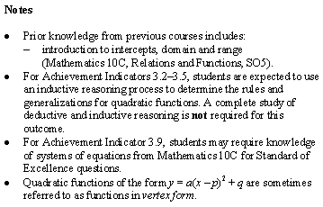
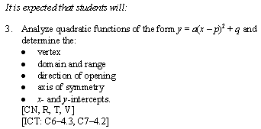
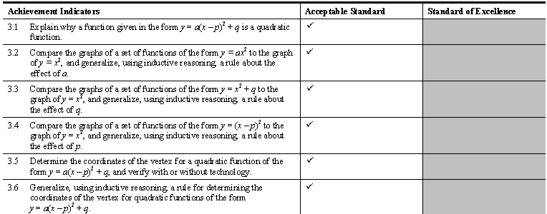
Math 20-1 Chapter 3 Quadratic Functions
Teacher Notes
3.1A Quadratic Functions

Slide 3


3.1A Quadratic Functions
Definition:
A quadratic function is a function determined by a second degree polynomial.
A quadratic function can be written in the form
f(x) = ax² + bx + c or f(x) = a(x - p)² + q
where a, b, and c or p and q are real numbers and a ≠ 0.
Examples:
Non-Examples:
3.1.1

Slide 4

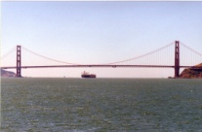
Facts/characteristics
The graph of a quadratic function is in the shape of a parabola, that has either a maximum (highest) point or a minimum (lowest) point, called the vertex.
Every parabola is symmetrical about a vertical line, called the axis of symmetry that passes through the vertex.
Direction of Opening
Domain
Range
x- and y-intercepts
3.1.2

Slide 5
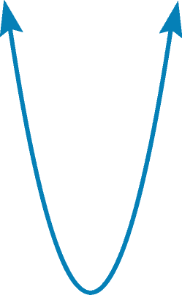
Characteristics of a Quadratic Function f(x) = a(x-p)² + q
The maximum or minimum point on the parabola is called the vertex. (p, q)
A parabola is symmetrical about the axis of symmetry (the vertical line through the vertex.) This line divides the function graph into two parts. x = p
The x - intercepts for the parabola are where f(x) = 0. They are related to the zeros of the graph of the function.
Domain
Range
3.1.4

Slide 6
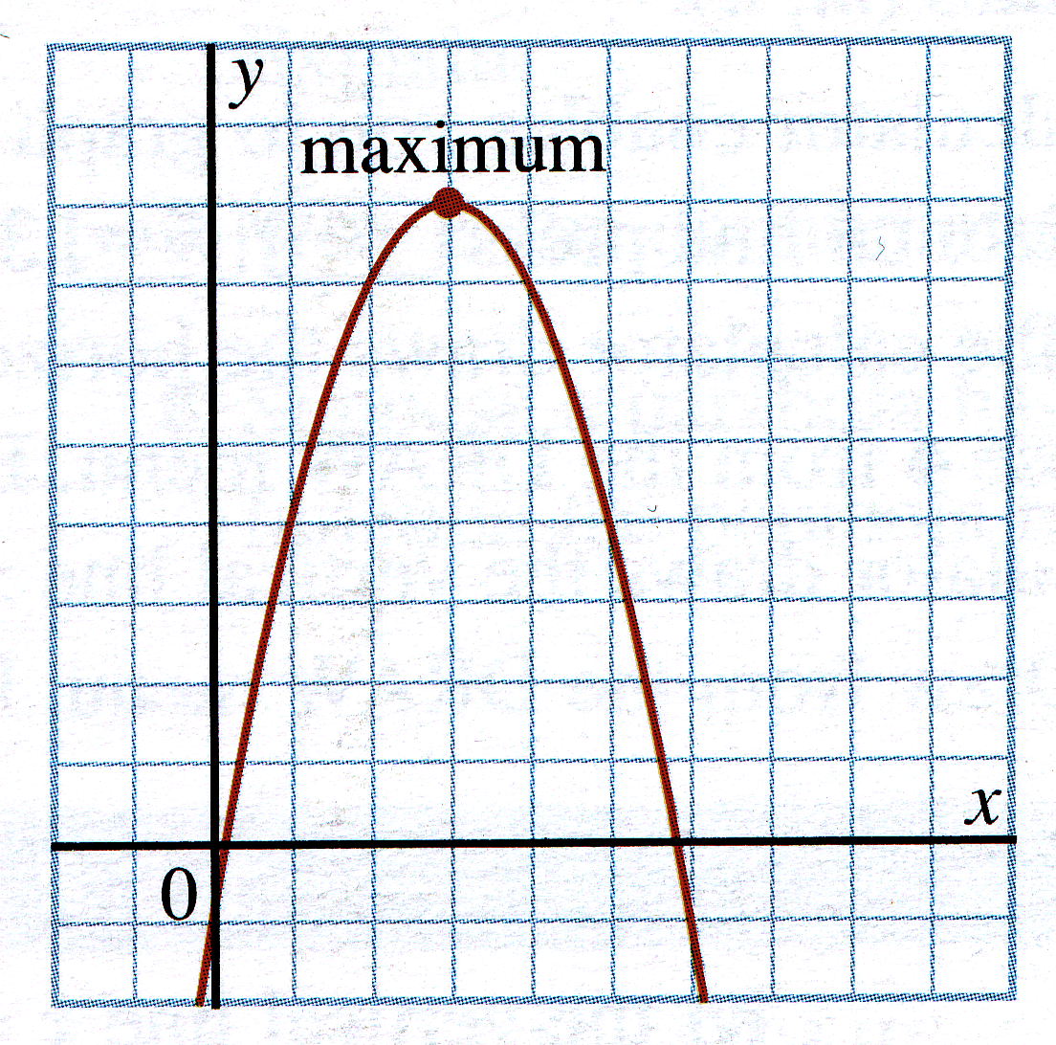
Listing Properties of a Quadratic Function from a Graph
vertex
(3, 8)
maximum
y = 8
domain
range
axis of symmetry
x-intercepts
0.2 and 5.8
y-intercept
-1
Why is the axis of symmetry in the form x =
rather than in the form y =
3.1.5

Slide 7
Exploring Transformations of the Quadratic Graph
In mathematics transformations refer to a manipulation of the graph of a function or relation such as a translation, a reflection or a stretch. The result of a transformation is called the image.
A transformation is indicated in an equation by including a parameter in the parent function.
I. Graphing the Parent Function
1. Graph the equation f(x) = x² .
2. Does the graph open up or down?
3. The extreme point of curvature of the graph is called the vertex. What are the coordinates of the vertex?
4. Identify the domain and range of the graph of f(x) = x²
5. What is the equation of the axis of symmetry.
3.1.6

Slide 8
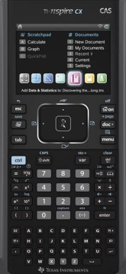
Move to page 1.2. Help Devin make a basket!!
Grab and move the parabola to represent the path the basketball would follow to make a basket.
What do you notice changed in the equation of the parent graph ?
Move to page 2.1
Click the slider to change the value of parameter a.
1. What do you observe about the vertex of the parabola as the a value changes?
2. How does the value of a affect whether the graph opens up or down?
Can a = 0 for a quadratic?
3. How does the value of a affect the shape of the graph?
Answer Questions on pages 2.2 to 2.5.
3.1.7

Slide 9

Summary: f(x) → a · f(x)
f(x) = a(x-p)² + q
The graph of 0.5x² as compared to the parent function, y = x² appears...
 wider  narrower
2. The graph of y = 2·x² as compared to y = x² is...
    wider  narrower
3. When 0 < |a| < 1, the graph of y = ax² is…
    wider  narrower than the graph of y = x² .
4. When |a| > 1, the graph of y = ax² is…
     wider  narrower than the graph of y = x² .
5. Describe the graph of f(x) = ax² when a is negative as compared to when a is positive.
a > 0
parabola opens up
a < 0
parabola opens down
3.1.8

Slide 10
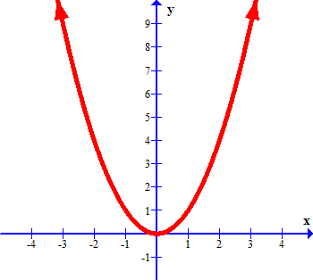

Horizontal Translations.
Write the coordinates of the vertex on the graph.
If the graph is moved three units to the right,
what are the coordinate of the image of the vertex?
Predict how the equation of the parent graph would change.
Verify your prediction.
What did you notice?
f(x) = a(x-p)² + q
Move to page 3.1 to explore the effect of p and q.
3.1.9

Slide 11
Summary: y = x² → y = (x – p)²
    The graph of y = (x – 2)² is just like the graph of y = x² but the graph has been shifted…
 2 units up  2 units left
 2 units down  2 units right
Prediction of how y = (x + 5)² compares to y = x² : The graph will shift…
 5 units up  5 units left
    5 units down  5 units right
In general, the transformation of f(x) → f(x – p) shifts the graph…
 p units horizontally  p units vertically
This is because the _______ are affected.
 x-values/inputs  y–values/outputs
Note: For y = (x – p)² the vertex and parabola shifts to the right p units.
Note: For y = (x + p)² the vertex and parabola shifts to the left p units.
On page 3.1 to explore the effect of q.
3.1.10

Slide 12
Summary: y = x² → y = x² + q
1. The graph of y = x² + 4 is just like y = x² but the graph has been shifted…
 4 units up  4 units left
 4 units down  4 units right
2. The graph of y = x² - 3 is just like y = x² but the graph has been shifted…
 up 3 units  left 3 units
 down 3 units  right 3 units
3. In general, the transformation of f(x) → f(x) + k shifts the graph...
 k units horizontally  k units vertically
This is because the _______ are affected.
 x-values/inputs  y–values/outputs
Note: For y = (x )² + q the vertex and parabola shifts up q units.
Note: For y = (x )² - q the vertex and parabola shifts down q units.
3.1.11

Slide 13
The Vertex Form of the Quadratic Function
Horizontal
Shift
Vertical Stretch
Factor
Vertical
Shift
f(x) = a(x - p)² + q
Indicates direction
of opening
Coordinates of
the vertex are (p, q)
If a > 0, the graph opens
up and there is a
minimum value of y.
If a < 0, the graph opens
down and there is a
maximum value of y.
Axis of Symmetry
is x - p = 0
3.1.12

Slide 14
Characterists of f(x) = a(x - p)² + q
Comparing f(x) = a(x - p)² + q with f(x) = x ²:
(3, 2)
(-2, 1)
f(x) = (x +2)² + 1
f(x) = x²
f(x) = -(x - 3)² + 2
Vertex is (-2, 1)
Axis of symmetry is x + 2 = 0
Minimum value of y = 1
Range is y > 1
Domain is all real numbers
x- intercepts
y-intercept
Vertex is (3, 2)
Axis of symmetry is x = 3
Maximum value of y = 2
Domain is all real numbers
Range is y < 2
x- intercepts
y-intercepts
3.1.13

Slide 15
Complete the following chart
y = 2x² + 3
y = 2(x - 1)² + 3
y = -2(x - 1)²
y = 2(x + 1)²-1
Vertex
(0, 3)
(1, 3)
(1, 0)
(-1, -1)
Axis of Symmetry
x = 0
x -1 = 0
x -1 = 0
x +1 = 0
Max/ Min Value
Min of y = 3
Min of y = 3
Max of y = 0
Min of y = -1
Domain
Range
y ≥ 3
y ≥ 3
y ≤ 0
y ≥ -1
y-intercept
(0, 3)
(0, 5)
(0, -2)
(0, 1)
none
( -0.3, 0)
( -1.7, 0)
x-intercept
none
(1, 0)
3.1.14

Slide 16
Assignment
Worksheet
3.1.15

