Slide 1
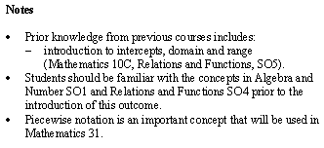
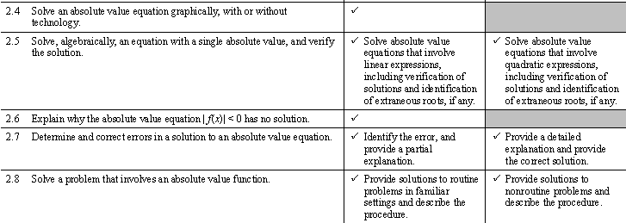
Math 20-1 Chapter 7 Absolute Value and Reciprocal Functions
Teacher Notes
7.3 Absolute Value Function

Slide 2
7.3 Absolute Value Equations
To solve absolute value equations, use the definition of absolute value.
The range must be < 0
Ex. Solve |x| = 3
The output must not be negative.
To solve an absolute value equation, there are two equations to consider:
Case 1. Solution is in the domain x > 0
Use | x | = x, so the first equation to solve is x = 3
Case 2. Solution is in the domain x < 0
Use | x | = –x, so the second equation to solve is –x = 3
x = –3
Therefore the solution is 3 or –3.
How can you use the definition of distance from zero to determine solutions?
7.3.1

Slide 3
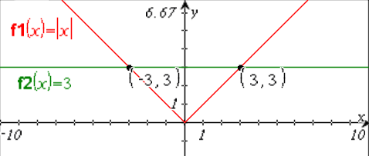
Solving Graphically
Ex. Solve |x| = 3
The height of the graph is 3 for input values of 3 or -3.
The roots of the equation are x = 3 or -3.

Slide 4
Absolute Value Equations
Solve |x – 5| = 2
The output must not be negative.
Case 1
The solution is in the domain x ≥ 5, use x – 5 = 2
x – 5 = 2
x = 7
The value 7 satisfies the condition x ≥ 5.
Case 2
The solution is in the domain x < 5, use –(x – 5).
–(x – 5) = 2
x - 5 = –2
x = 3
The value 3 satisfies the condition x < 5.
The roots of the equation are x = 3 or x = 7.
7.3.2

Slide 5
Verify Solutions for an Absolute Value Equations
The two cases create "derived" equations. These derived equations may not always be true equivalents to the original equation. Consequently, the roots of the derived equations MUST BE VERIFIED in the original equation so that you do not list extraneous roots as answers.
For x = 3
For x = 7
|x – 5| = 2
|3 – 5| = 2
|2| = 2
2 = 2
|x – 5| = 2
|7 – 5| = 2
|2| = 2
2 = 2
Both values are solutions to the equation |x – 5| = 2
Remember: To solve an absolute value equation, you must solve two separate equations!
7.3.3

Slide 6
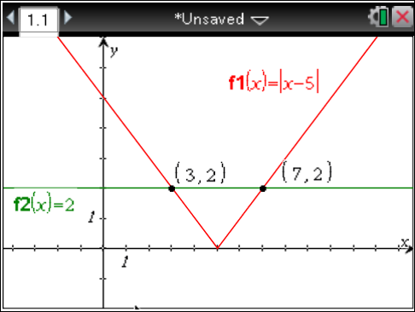
Verify the solutions to |x – 5| = 2 using technology.
The roots are x = 3 or x = 7
Can an absolute value equation equal a negative value?
|x – 5| = -2
7.3.4

Slide 7
Absolute Value Equations
Solve |3x + 2| = 4x + 5
What restriction is on the expression 4x + 5?
Explain your reasoning.
Case 1 | Case 2
3x + 2 = 4x + 5 3x – 4x = 5 – 2 –x = 3 x = –3 | –(3x + 2) = 4x + 5 –3x – 2 = 4x + 5 –3x – 4x = 5 + 2 –7x = 7 x = –1 | Note that x = –3 does not satisfy the domain of for the positive case.
Check x = –3 | Check x = -1
|3(–3) + 2| = 4(–3) + 5 |–9 + 2| = –12 + 5 |–7| = –7 7 ≠ –7 | |3(–1) + 2| = 4(–1) + 5 |–3 + 2| = –4 + 5 |–1| = 1 1 = 1 | The solution is x = –1
7.3.5

Slide 8
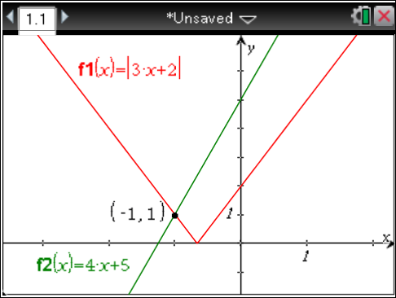
Absolute Value Equations
Solve |3x + 2| = 4x + 5 using technology.
The solution is x = -1
7.3.6

Slide 9
Algebraically Determine the solutions to the Absolute Value Equation
What restriction on the variable comes from 8 – 2x?
x < 4
Case 1 (positive)
Do the solutions “fit” in the domain of the positive case?
Verify
x = 4
x = -5
7.3.7

Slide 10
Case 2 (negative)
x < 4
Do the solutions “fit” in the domain of the negative case?
Verify
x = 4
x = –1
X = 4 is not in the domain of the negative case, why does it work?
Solutions are
x = 4
x = 5
or x = -1
7.3.8

Slide 11
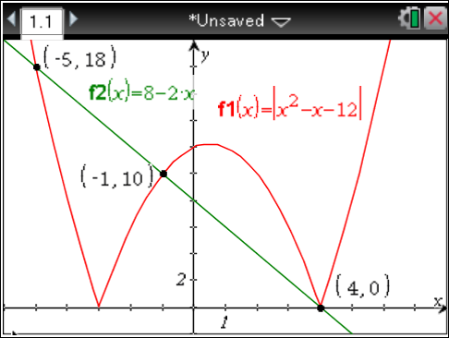
Verify the Solutions Graphically
The solution is x = -5 or x = -1 or x = 4
7.3.9

Slide 12
Applications of Absolute Value Equations
Before a bottle of water can be sold, it must be filled with 500 mL of water with an absolute error of 5 mL. Determine the minimum and maximum acceptable volumes for the bottle of water that are to be sold.
V – 500 = 5
V = 505
–(V – 500) = 5
V - 500 = –5
V = 495
The minimum volume would be 495 mL and
the maximum volume would be 505 mL
7.3.10

Slide 13
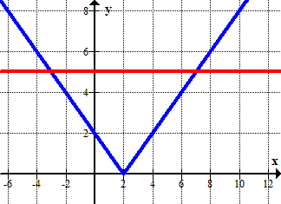
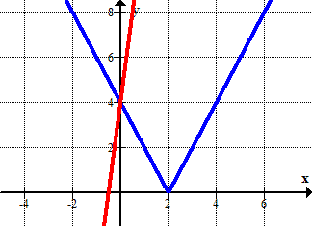
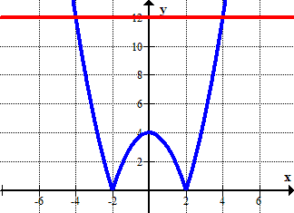
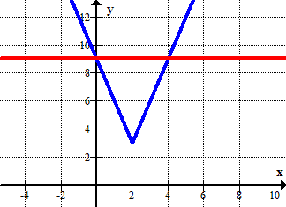
Solve an Absolute Value Equation Graphically
Determine the solution(s) for each absolute value equation.
|x – 2| = 5
|2x – 4| = 8x + 4
x = -3 or x = 7
x = 4
|x² – 4| = 12
|3x – 6| + 3 = 9
x = -4 or x = 4
x = 0 or x = 4

Slide 14
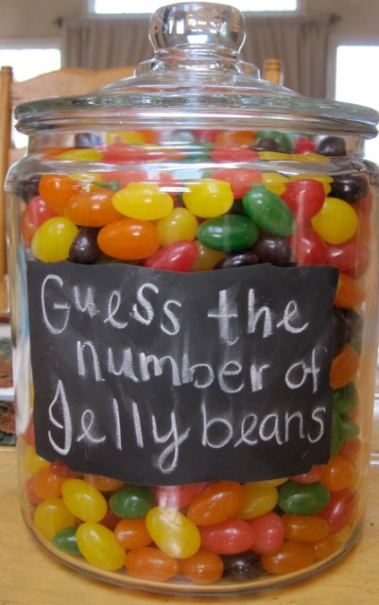
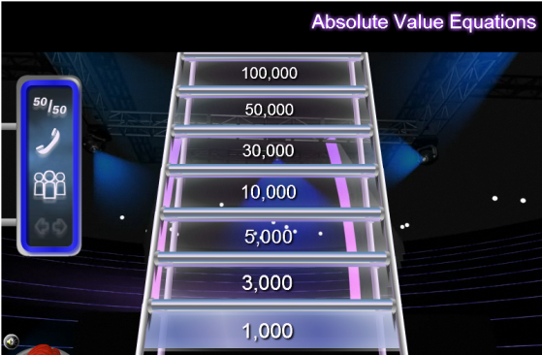
Ron guessed there were 50 jelly beans in the jar.
His guess was off by 15 jelly beans.
How many jelly beans are in the jar?
35 or 65
50 – 15 or 50 + 15
Write an absolute value equation that could be used to represent the number of jelly beans.
Assignment
Suggested Questions:
Page 389:
1b,d, 2a,c, 3b, 4a,b,c, 5a,b,e, 6b,
7, 10, 12, 15, 16, 19
http://www.math-play.com/Absolute-Value-Equations/Absolute-Value-Equations.html
7.3.11

